Slide 1

BPC WATER QUALITY MONITORING FOR PESTICIDES: PAST, PRESENT, & FUTURE
Mary Tomlinson
Board of Pesticides Control
Maine Agricultural Trade Show
January 13-15, 2015

Slide 2
OUTLINE OF PRESENTATION
The beginning
Past studies:
  Groundwater monitoring 1994-2013
  Surface water monitoring 1994-2013
Present: monitoring in 2014
Future studies

Slide 3
The Beginning
State law
Guthion residue study
Aldicarb contamination
Collaborative groundwater studies

Slide 4

State Law
7 M.R.S.A. §607-A (2-A) requires water residue surveys:
Wells or bodies of water
Areas of possible contamination or at other locations
At least once every 6 years
Purpose – develop profile of pesticides present

Slide 5

1978 Guthion Residue Study
To determine if guthion from blueberry spray operations moved through soils and entered various water bodies
8 locations selected on the Cherryfield Quadrangle map
Sites sampled: 2 rivers, 1 brook, 2 lakes, 1 spring, 1 fish hatchery, 1 drilled well
No detections at minimum level of detection (MLD) of 3 ppb (parts per billion)

Slide 6

Aldicarb (TemikTM) Contamination
  1980-1983:
  Testing by Union Carbide due to groundwater contamination in other states
  107 contaminated wells near potato fields in Aroostook Co.
11 wells over maximum contamination level (MCL = 10 ppb)
77 ppb highest level detected

Slide 7
Aldicarb (TemikTM) Contamination cont.
Label directions changed
Filters placed on wells
1984: BPC mandatory buffer zones enacted
1985: 49 wells contaminated, 6 over MCL
  20 ppb highest level detected
No longer registered in Maine
01 DEPARTMENT OF AGRICULTURE, FOOD AND RURAL RESOURCES
026 BOARD OF PESTICIDES CONTROL
Chapter 41: SPECIAL RESTRICTIONS ON PESTICIDE USE
SUMMARY: This chapter describes special limitations placed upon the use of (1) aldicarb (Temik 15G) in proximity to potable water bodies;

Slide 8

Collaborative Studies
1985-1987: Maine Geological Survey (MGS) and the Department of Agriculture, Food and Rural Resources (DAFRR):
3-year study in potato regions of Maine
Objective: Evaluate impact of agricultural pesticides on groundwater quality
Trace levels of pesticides in 14% of wells
Conclusions: Contamination by agricultural pesticides, seems to occur more frequently in bedrock wells that are overlain by till

Slide 9
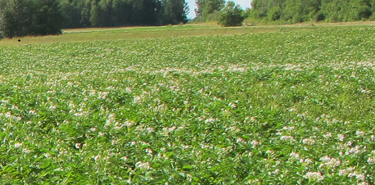
Collaborative Studies cont.
1989: MGS, DAFFR, and USEPA
Private wells near potato fields in Aroostook Co.
Traces of pesticides in
42% of 51 wells

Slide 10
Collaborative Studies cont.
199o: BPC and University of Maine
Objective: Evaluate effectiveness of using immunoassay tests for monitoring groundwater for pesticides
Of 58 wells:
  Atrazine detected in 31%, MCL exceeded in 2
  Alachlor detected in 12%, all exceeded MCGL
  Carbofuran detected in 5%, all below MCL

Slide 11
Collaborative studies cont.
1992 – BPC and University of Maine
Maine Triazine Assay Survey
Results confirmed by laboratory analysis
Detections in 38 of 152 wells:
  Atrazine detected in 20%
  Simazine detected in 3%
  Cyanizine detected in 1 sample (< 1%)
Positive wells resampled later in year
  Detections remained below health advisories

Slide 12
Past Studies 1994-2013

Slide 13
Groundwater Monitoring (GW)
1994-2013
Statewide Groundwater Management Plan
Statewide GW monitoring results
Hexazinone State Management Plan
Hexazinone GW monitoring results
Corn herbicide study

Slide 14
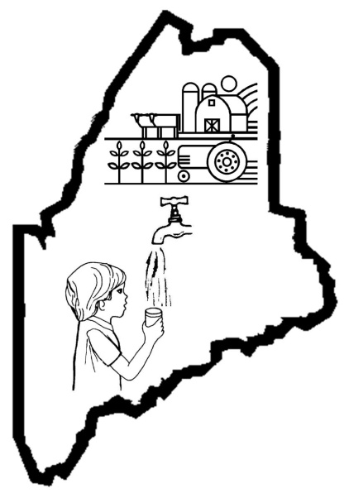
Maine Generic State Management Plan for Pesticides and Groundwater
1994 - Adopted by BPC
Guidance for assessing impact of labeled pesticide use on GW
Guidance for assessing effectiveness of normal pesticide practices
Guidance for developing pesticide-specific management plans
Focused on commodity/use sites
Sampling every 5-7 years

Slide 15
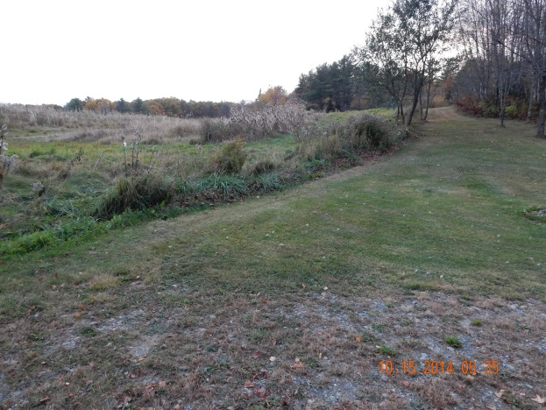
GW Study Well Criteria
Random and targeted sampling
Private residence
Within ¼ mile of target crop
Down gradient of or equal elevation with crop site
No water bodies between crop site and well
Grab samples
No filters or water treatment systems

Slide 16
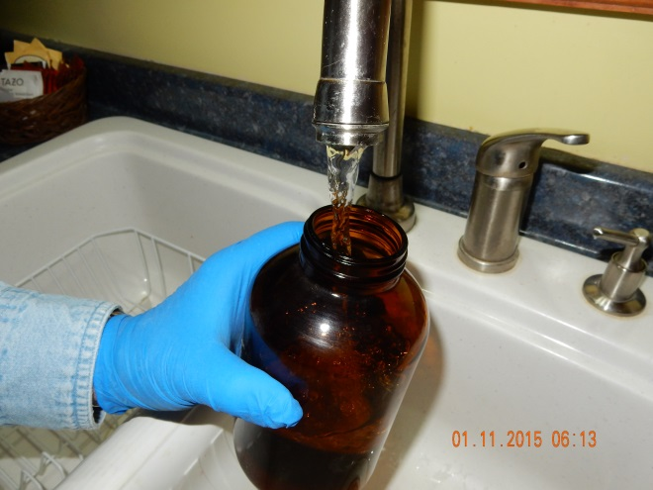
Quality Assurance/Quality Control
Training
Standard operating procedures (SOPs)
Equipment blanks
Field blanks (water and drift cards)
Duplicate samples
Laboratory QA/QC
Data entry verification

Slide 17
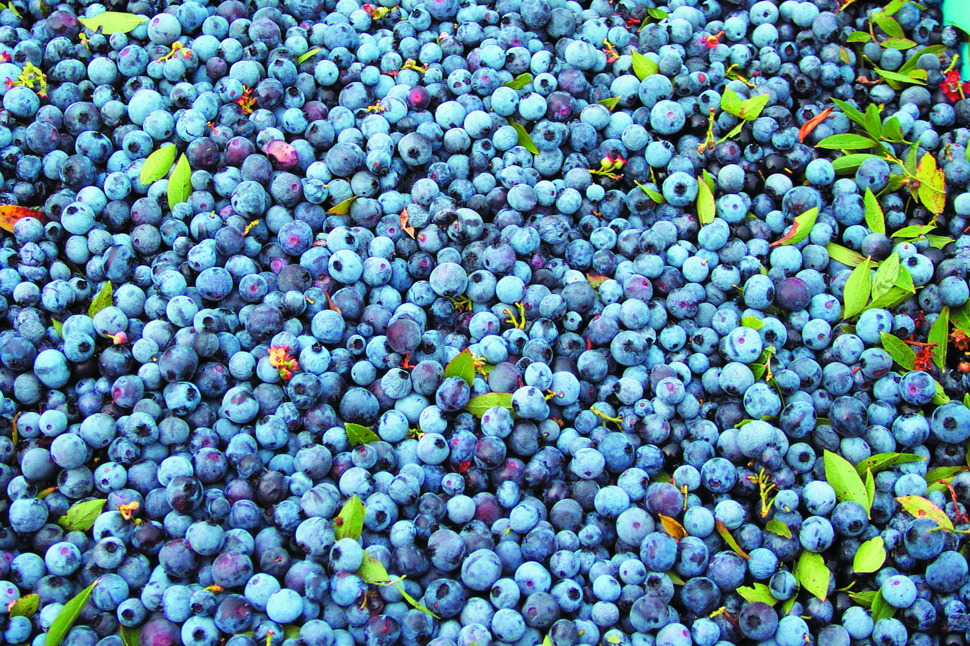

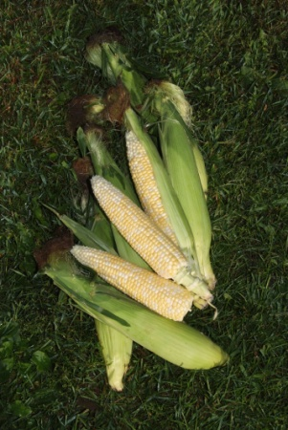


Statewide GW Monitoring:
Focused on Commodities
1994, 1999, 2005, 2013
Crop sites:
  Potatoes
  Corn
  Blueberries
  Small grains
  Orchards
  Christmas trees
  Strawberries
  Rights of way (except 2013)
  Market gardens

Slide 18
Statewide GW Monitoring Results (1994-2013)
 | 1994 | 1999 | 2005
Number of wells sampled | 129 | 194 | 127
Number of samples | 129 | 194 | 137
Percent of wells with positive detections | 24 | 9 | 11
Number of samples with positive detections | 31 | 17 | 14
Percent of samples with positive detections | 24 | 9 | 10
Number of pesticides detected | 10 | 4 | 8
Number of pesticides analyzed | 38 | 32 | 31
Number of detections above HAL, MEG, MCL | 1** | 0 | 0
**Diazinon applied around well casing for ant control

Slide 19
Hexazinone State Management Plan
for the Protection of Groundwater
1994: Most frequently detected pesticide in first statewide GW monitoring study
  35 of 48 sites positive in follow up sampling
1996: Adopted by BPC to retain use of hexazinone (blueberry pesticide)
Private, domestic wells
Sampling every 5-7 years
Previously positive and new wells

Slide 20
Hexazinone Monitoring Results (1994-2011)
 | 1994 | 1998 | 2002 | 2006 | 2011
Number of wells sampled | 20 | 42 | 49 | 46 | 52
Number of wells with positive detections | 15 | 18 | 29 | 32 | 21
Percent of wells with positive detections | 75 | 72.8 | 59.2 | 69.6 | 41
Mean Concentration (ppb)* | 1.08 | 0.41 | 1.45 | 0.98 | 0.62
Highest concentration | 5.97 | 2.15 | 11.41 | 8.43 | 5.36
Number of detections above EPA health advisory 400 ppb | 0 | 0 | 0 | 0 | 0
*Mean concentration was calculated assuming that non–detections were equal to half the limit of quantification

Slide 21
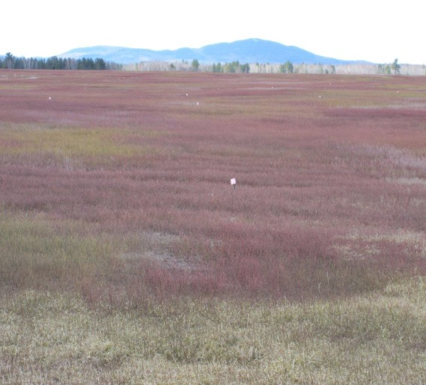
Hexazinone Monitoring Results cont.
Additional Pesticides Analyzed 1999-2011
Detections and Concentrations
Azinphos-Methyl
Captan
Chlorothalonil
Diuron
Fenbuconazole
Phosmet
Propiconazole
Terbacil
Tribenuron methyl
1999: Propiconazole
  0.18 ppb
  1 sample
2011: Terbacil
  0.103-0.467 ppb
  4 samples

Slide 22
1996 Corn Herbicide Study
Objective: To determine effectiveness of label changes and BMP education efforts
Sampled 38 positive wells from 1992 Triazine Survey
Pesticides analyzed: atrazine, simazine, cyanazine, alachlor, metolachlor, acetochlor
12 of 38 with detectable levels of pesticides
    Atrazine, simazine, alachlor, metolachlor
No exceedances of human health guidelines

Slide 23
Surface Water Monitoring
1994-2013
Blueberry studies
  Salmon River Study
  Pleasant River Time Series
  Blueberry Drift Studies
  Pleasant River Spring Study
Storm event projects
Browntail moth monitoring
Urban watershed monitoring

Slide 24
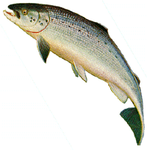
Salmon River Study 1997
Directive of the Atlantic Salmon Conservation Plan
for Seven Maine Rivers
Objective: Baseline assessment of impact of pesticide use on surface water
7 Maine Atlantic salmon rivers and 2 tributaries sampled 2 months after application
33 pesticides analyzed
Hexazinone detected in 19 of 64 samples: 0.10- 1.7 ppb
LC50 concentration for fish + 246,000-320,000 ppb
  (LC50 – lethal concentration to 50% of test population)
Hexazinone metabolite B detected in 4 of 19 samples
All detections from Machias, Narraguagus, Pleasant Rivers

Slide 25
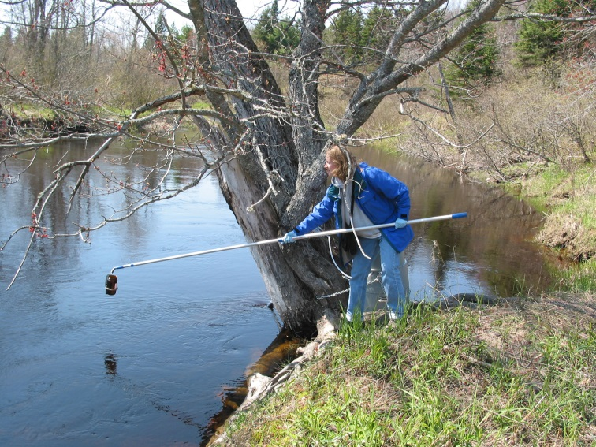
Pleasant River Time Series Study
1998-2002
5-year study initiated due to frequent detections of hexazinone near blueberry production areas
Objective: Assess presence and temporal variation of hexazinone concentrations over 1 year at 3 sites
Grab samples
Detected at least once in every
month of the year
Concentration ND-1.98 ppb

Slide 26
Pleasant River Time Series
Table by Heather Jackson

Slide 27
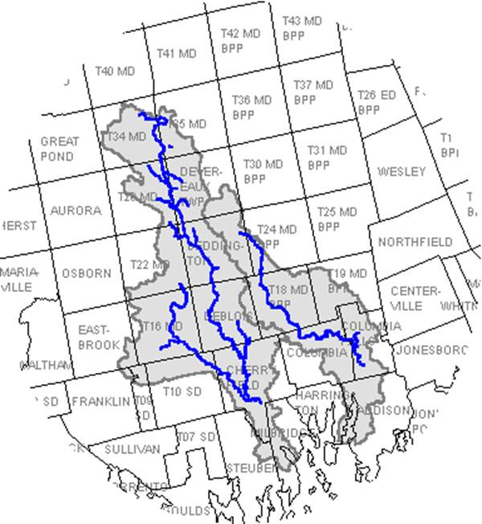
Blueberry Drift Studies 1999-2004
Pleasant and Narraguagus Rivers watersheds
Objective: Determine presence of off-target drift in surface waters and on drift cards adjacent to sprayed fields
Low levels of drift detected up to 1000 ft. from target fields in 4 of 6 years

Slide 28
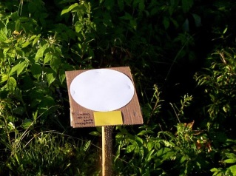
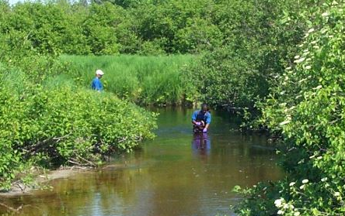
Blueberry Drift Studies cont.
2000-2004 studies
Analyzed water samples and drift cards
Phosmet
  Most commonly detected
  Found in all years
  Different site each year
  Water: ND-0.815 ppb
  Filters: ND-21.978 ng per filter
Febuconazole detected
in one site in 2004

Slide 29
Pleasant River Spring Study 2000
Objective: Compare levels of hexazinone discharging from groundwater with historic levels into main stem of river
Analyzed for 11 blueberry pesticides
6 of 8 samples positive
Hexazinone only pesticide detected
  Hexazinone 0.17-3.08 ppb
  Hexazinone metabolite B 0.045-0.0.098 ppb
(3 samples)

Slide 30
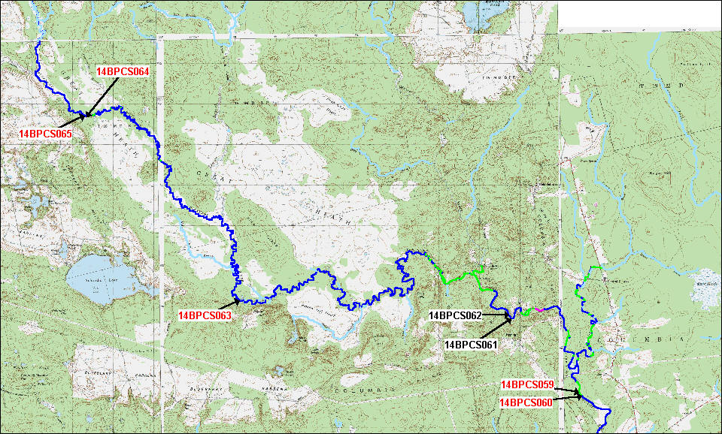
PLEASANT RIVER SPRING STUDY 2000

Slide 31
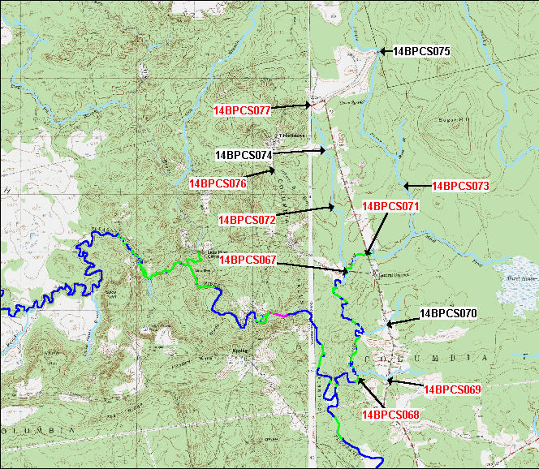
Pleasant River Tributary Study 2000
Sampled first-order streams
Objective: Compare levels of hexazinone in tributaries to historic levels in main stem of river
8 of 11 samples positive
Concentration range 0.1-0.803

Slide 32
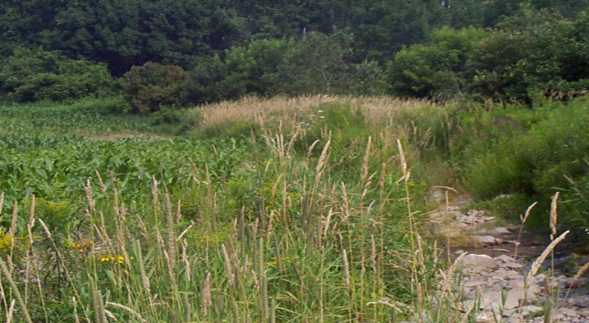
Kennebec Co. Storm-Event Project 1998
Corn Herbicide Project
1 site, first-order stream
Kennebec Co.
Atrazine detected in 6 of 7 samples
0.59-8018 ppb, above MCL 4 days after application
Concentration directly proportional to stream rise
Corn
Stream

Slide 33
Aroostook County Storm-Event Project 1998
Potato Herbicide Project
One site, first-order stream
Metribuzen
  Four of seven samples
  23.7-520 ppb
  Exceeded Lifetime Health Advisory Level (HAL) of 100 ppb
Chlorothalonil
  Three of six samples
  0.398-117
  Exceeded Maine Maximum Exposure Guidelines (MEG) of 15 ppb

Slide 34
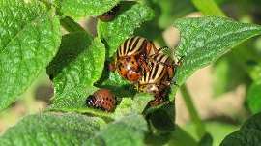
Storm-Event Studies 2003
Corn Herbicide Study
Five sites: Waldo, Kennebec, York Counties
20 samples analyzed for 11 pesticides and metabolites
Atrazine: 7 samples, 0.03-0.62 ppb
Metolachlor: 2 samples, 0.07 ppb-0.37 ppb
Potato Pesticide Study
1 site
2 samples
Metribuzin: both samples at 2.14-1.49 ppb
Chlorothalonil and imidicloprid not detected

Slide 35

Railroad ROW Herbicide Drift Study 2003
Objective: To determine adequacy of 10 ft. buffer between railroad application areas and surface water bodies
Sites: river, lake, pond, well, one site not near water
Results: No detection of imazapyr
Conclusion:
  Unlikely to find imazapyr in lake water 1.5 months after application or 48 hours after significant rainfall
  More data needed

Slide 36
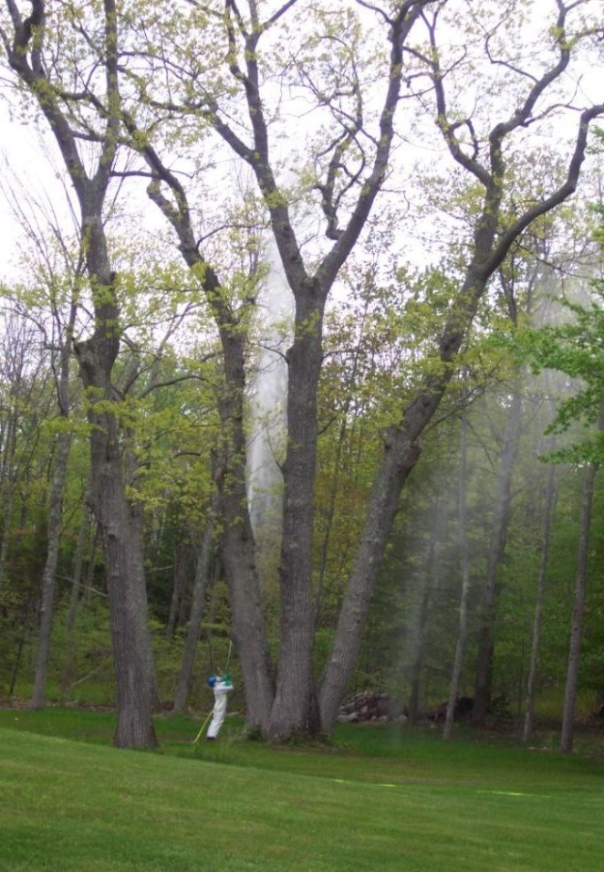
Browntail Moth Monitoring 2006
PL 2006, Chapter 553: Established temporary restrictions on pesticide applications for browntail moth control
Objective: Monitor pesticide drift to determine whether untreated buffer areas or other BMPs are necessary to prevent unreasonable drift into marine waters.

Slide 37
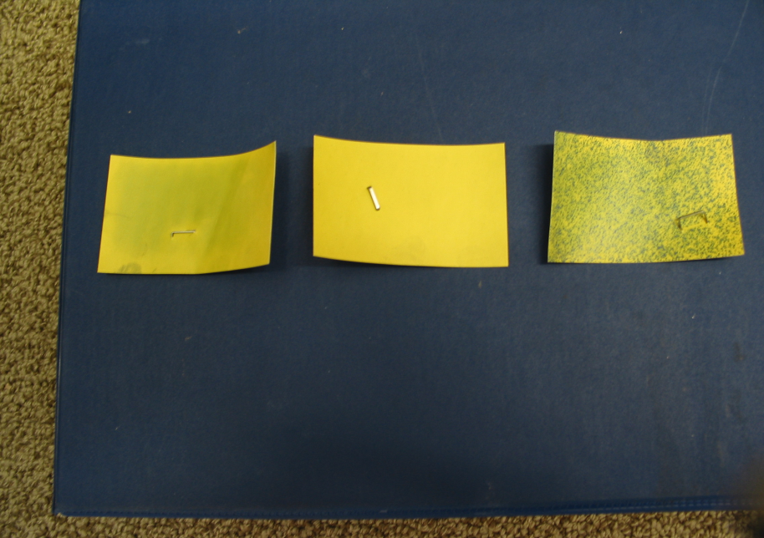
Browntail Moth Monitoring cont.
Four sites: Yarmouth, Harpswell, Freeport, Falmouth
Two sites treated with cyfluthrin, two sites with permethrin
Results: low levels of pesticides detected as far as 250’
BPC Recommendations: extend BTM restrictions and prohibit spraying when wind speed is less than 2 mph
Water sensitive cards from Freeport site. Left to right: 250’, 150’, 50’ downwind from target.

Slide 38

Residential Pesticide Studies 2003
Objective: Look for presence of homeowner use pesticides in surface water
Penobscot River, Brewer
  6 samples analyzed for 8 pesticides
  Dicamba: 1 sample, 3.5 ppb
  2,4-D: 1 sample, 1.2 ppb
Small streams in Augusta & Scarborough
  non-detect
Friends of Casco Bay (FOCB)
  10 samples analyzed
  Dicamba: 3 samples, 2.2-4.1 ppb
  Propiconazole:
    2 samples, 0.057 -0. 075 ppb
  Clopyralid: 1 sample, 0.91 ppb
All results below current aquatic life benchmarks

Slide 39
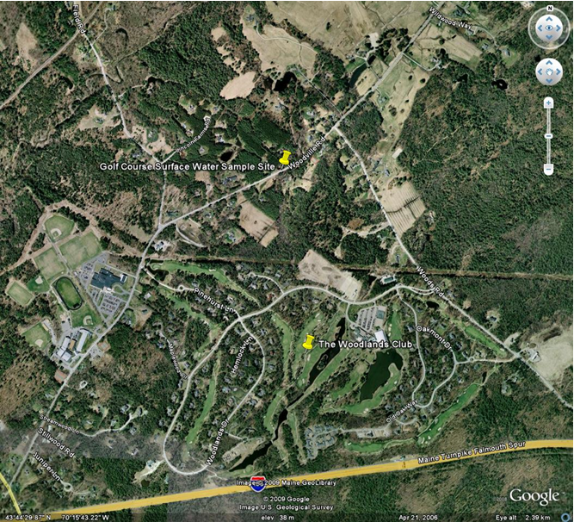
Urban Surface Water Sampling
Collaborations with FOCB and City of South Portland
2008
Downstream from 3 golf
courses and 1 residential area
Analyzed for 9 pesticides
Chlorothalonil:
  4 of 9 samples,
  0.08-0.22 ppb
  Did not exceed aquatic life
  benchmark 0.6 ppb

Slide 40
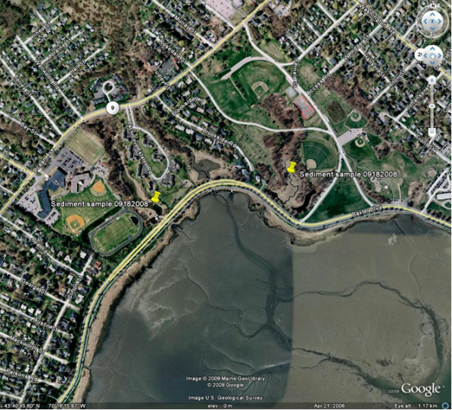
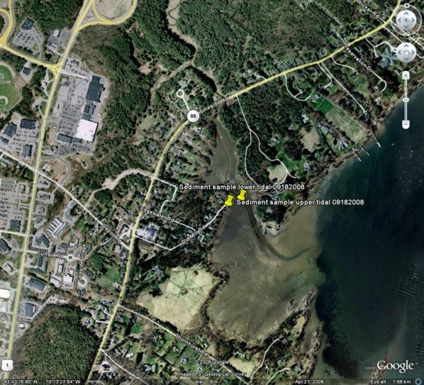
Urban Sediment Sampling
2007: Back Cove
  Non-detect; protocol flawed
2008: Mussel Cove, Payson Park
Creek, Back Cove Pumping Station
  Analyzed for five synthetic pyrethroids
  Bifenthrin
    Detected in all 4 samples
    0.48-16.8 ppb
    No aquatic life benchmarks
    for sediment

Slide 41
Urban Sediment Sampling cont.
2009-2010: Portland/South Portland
6 samples each year
Pesticide | # of Detections 2009 | # Detections 2010
Bifenthrin | 5 | 4
λ-Cyhalothrin | 4 | 0
Permethrin | 1 | 1
Cypermethrin | 4 | 0
Sumithrin | Not tested | 6
Esfenvalerate | 3 | 1
Piperonyl butoxide (PBO) | Not tested | 2

Slide 42
Monitoring in 2014
Groundwater monitoring
Gulf of Maine Coastal Pesticide Study

Slide 43
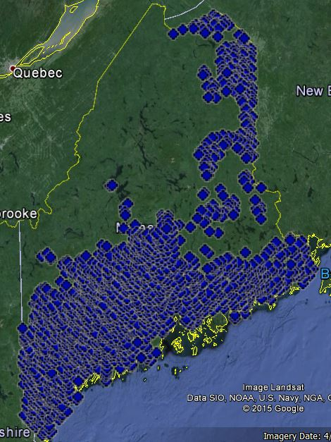
Statewide Groundwater Monitoring
Revised method for generation of potential sample points
Used Generalized Random Tessellation Stratified (GRTS) program
  Random points spatially-balanced across state
  Not allocated per crop
Used previous methodology to select actual sample sites
Process still needs refinement

Slide 44
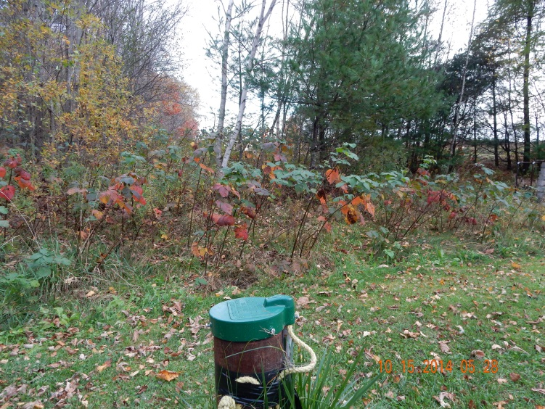
Statewide Groundwater Monitoring
Analyzed for 96 pesticides
Detections in 32 of 47 wells
81 detections of 23 pesticides
and metabolites
All detections, except one,
below human health
guidelines and benchmarks
8 analytes detected in one well

Slide 45
Statewide GW Monitoring Results (2014)
 | 1994 | 1999 | 2005 | 2014
Number of wells sampled | 129 | 194 | 127 | 47
Number of samples | 129 | 194 | 137 | 50
Percent of wells with positive detections | 24 | 9 | 11 | 68
Number of samples with positive detections | 31 | 17 | 14 | 32
Percent of samples with positive detections | 24 | 9 | 10 | 64
Number of pesticides detected | 10 | 4 | 8 | 23
Number of pesticides analyzed | 38 | 32 | 31 | 96
Number of detections above HAL, MEG, MCL | 1* | 0 | 0 | 1**
*Misuse: Diazinon applied around well casing for ant control ** Atrazine and 4 metabolites

Slide 46
Gulf of Maine Coastal
Pesticide Study (GOM)
Initiated in response to:
CT study, Health Assessment Monitoring of American Lobster in Long Island Sound, conducted 2012
Proposed bill in Maine to ban use of methoprene and resmethrin
National studies

Slide 47

Gulf of Maine (GOM) Coastal
Pesticide Study cont.
BPC Environmental Risk Assessment Committee established and convened, April, 2014
Objective: To examine whether current pesticide residues have the potential to affect the lobster resource in Maine, directly or via impact on other marine organisms.
Photo courtesy of Gary Fish

Slide 48
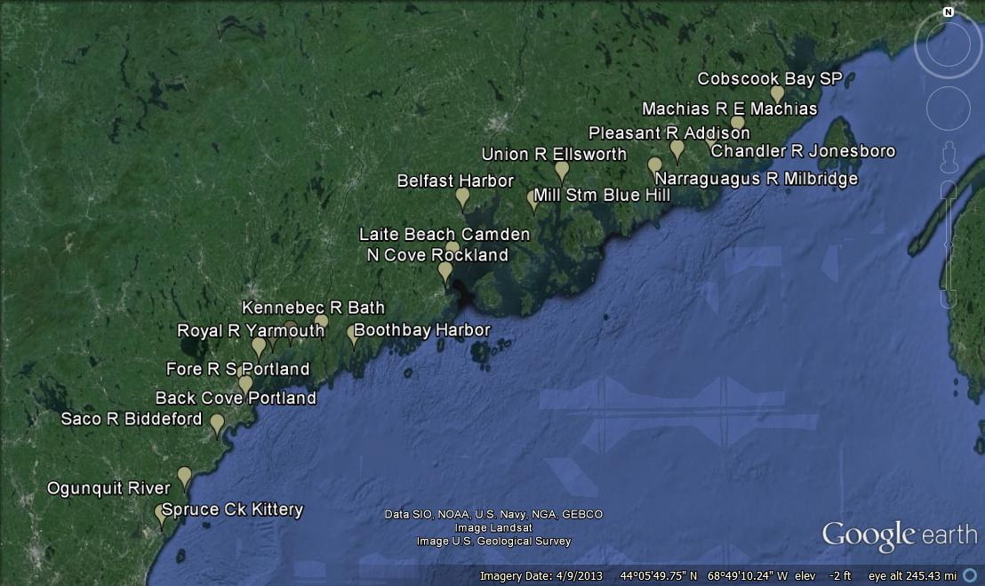
GOM Sample Sites
20 sites selected, paired for storm water and sediment sampling

Slide 49
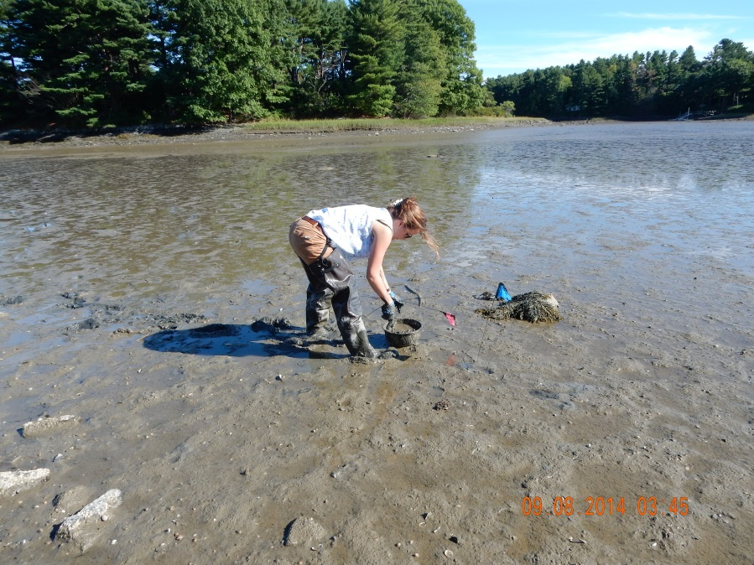
GOM Coastal Pesticide Study cont.
No storm water samples collected
Sediment analyzed for: methoprene, fipronil, fipronil metabolites, pyrethrins, pyrethroids, PBO

Slide 50
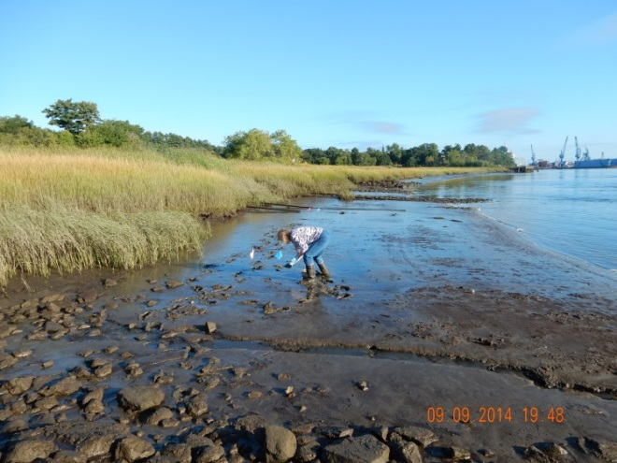
GOM Coastal Pesticide Study cont.
Detection limits from one lab for pyrethroids too high, no detects; fipronil MDL very low, but no detects
Results from second lab:
  Bifenthrin: 12 of 21 samples (12 of 20 sites), 0.091-1.0 ppb
  Cypermethrin: one sample, at 5.0 ppb
  12 sites with detections
  between Blue Hill and Kittery
Results need to be organic carbon normalized in order to be compared

Slide 51
Implications of Studies
A variety of agricultural and residential use pesticides are found in GW, SW, and sediment.
New technology has led to lower detection limits, resulting in more detections, than in past studies.
With rare exceptions, concentrations in water are below human health advisories and aquatic life benchmarks.
Most of the studies are too limited in scope and sample size; therefore, results are not statistically significant.

Slide 52
2015 and Beyond

Slide 53
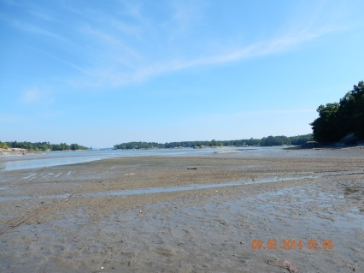
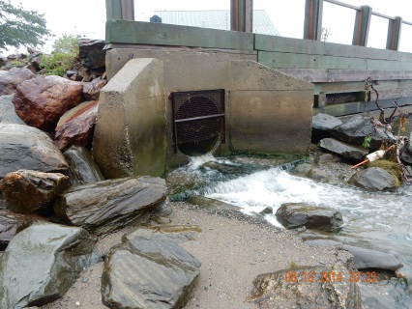
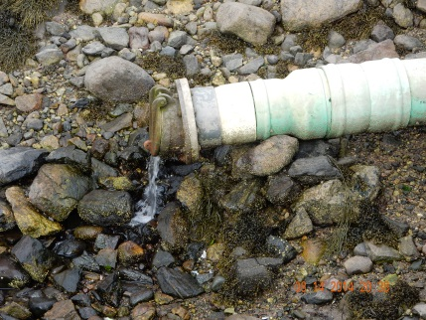
2015 Plan
Statewide GW study
Second phase of Gulf of
Maine Coastal Pesticide
Study
  Sediment sampling
  SW sampling

Slide 54


Future Studies
Plans continually evolve based on new: research, active ingredients, use patterns, and concerns.
Consider repeating and expanding earlier studies.
Continue GW, SW, sediment monitoring, looking for trends.
Photo courtesy of Gary Fish

Slide 55
BPC WATER QUALITY UPDATE: MONITORING FOR BLUEBERRY PESTICIDES
Questions?
Mary Tomlinson
Board of Pesticides Control
28 State House Station
Augusta, Maine 04333
(207) 287-2731
mary.e.tomlinson@maine.gov

