Slide 1
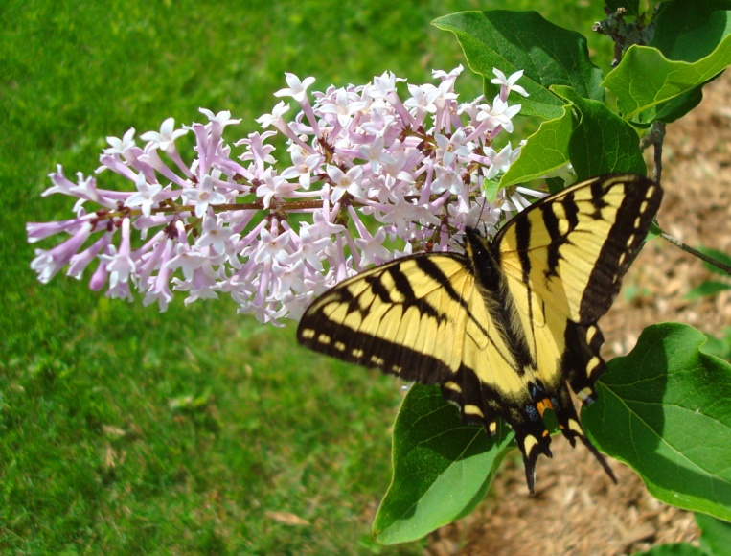
Pollinator Protection for Pesticide Applicators
Gary Fish
Maine Board of Pesticide Control
28 SHS
Augusta, ME 04333-0028
207-287-7545
gary.fish@maine.gov

Slide 2

Life with bees….
Whole Foods Market
Marla Spivak, University of Minnesota

Slide 3

… and without bees
Marla Spivak, University of Minnesota
Whole Foods Market

Slide 4

Marla Spivak, University of Minnesota
David Hansen

Slide 5
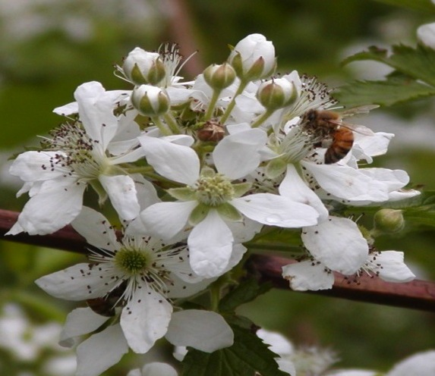
Who Are the Pollinators?
Tom Butzler,
Penn State Extension
Honey bees are relied on to perform most of the commercial pollination.

Slide 6
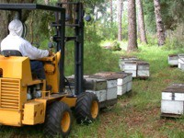
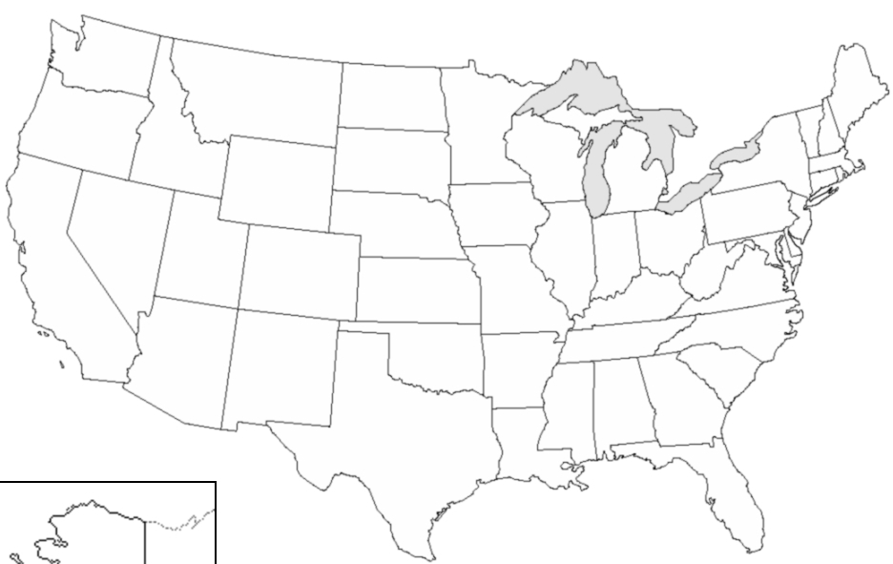










Major Migratory Routes of Honey Bee Colonies for Pollination
Marla Spivak, University of Minnesota

Slide 7
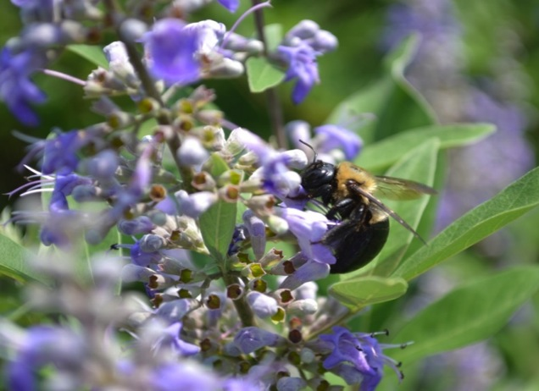
Importance of Pollinators
Fruit and seed production needed for the survival of the majority of flowering plants in our environment.
Essential to the
production of more
than 85 crops.
1 out of every 3 bites
of food can be attributed to pollinators.
Tom Butzler, Penn State Extension

Slide 8
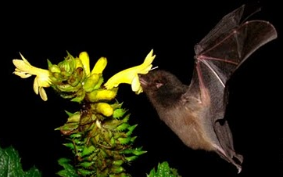
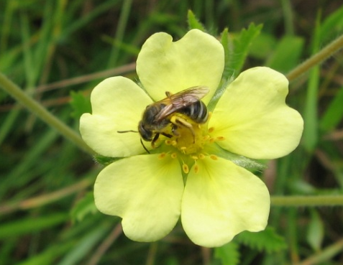
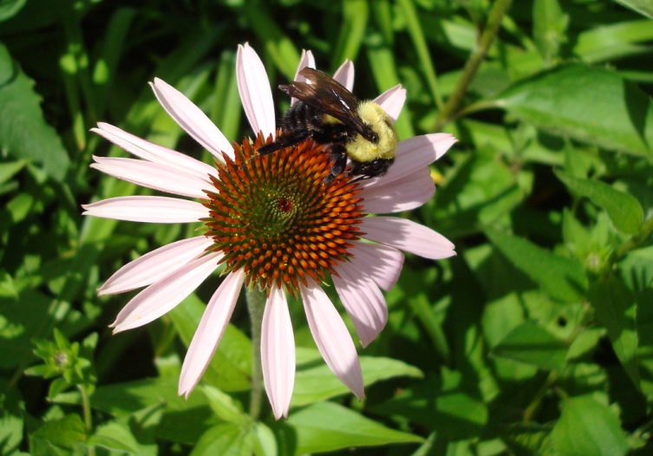
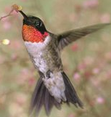
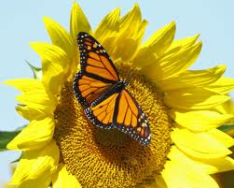
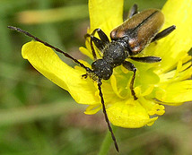
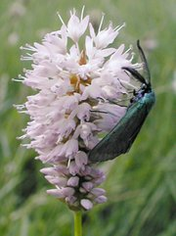
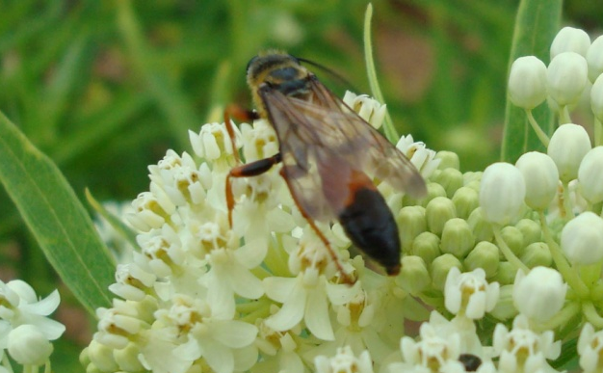
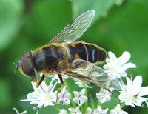
What organisms serve as pollinators?
Notes:
A pollinator is the agent that moves pollen from the male anthers of a flower to the female stigma of a flower to accomplish fertilization
There are different types of pollinators: bees, butterflies and moths (they are important pollinators of wildflowers), wasps, flies, even beetles, thrips, or ants can pollinate self fertile flowers.
Bats are important pollinators of tropical flowers. Hummingbirds accomplish pollination of deep throated flowers

Slide 9
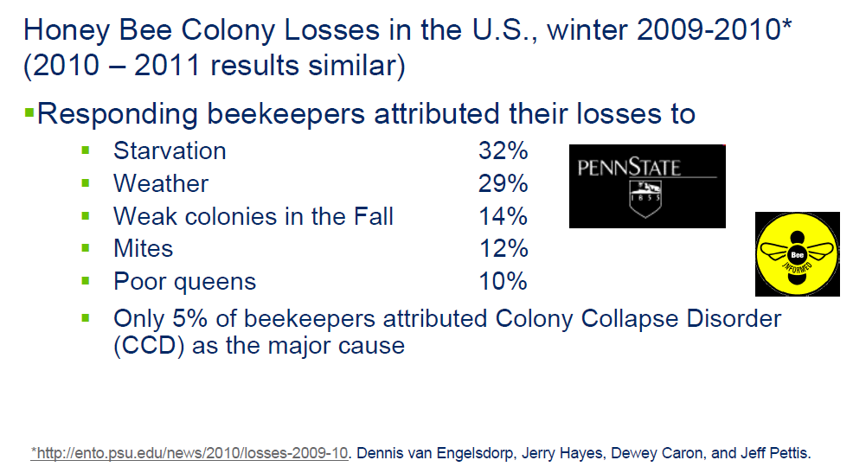
Bee Decline from the beekeeper point of view -2009-2010 winter losses

Slide 10
Bee Decline from the beekeeper point of view - 2011-2012 winter losses
Factor | % Selecting That Factor
Poor Wintering Conditions | 36.71
CCD | 35.99
Pesticides | 33.72
Varroa | 25.64
Nosema | 25.13
Weak in the Fall | 24.10
Queen Failure | 21.81
Don't Know | 21.58
Starvation | 20.89
Small Hive Beetle | 19.78

Slide 11
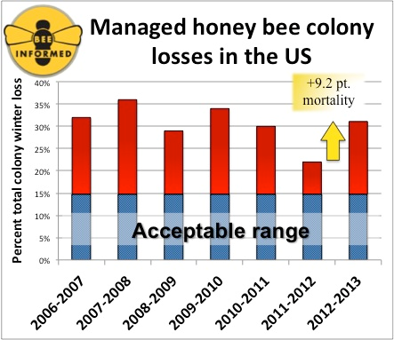
Winter Loss Survey Results
Over 7 Years

Slide 12
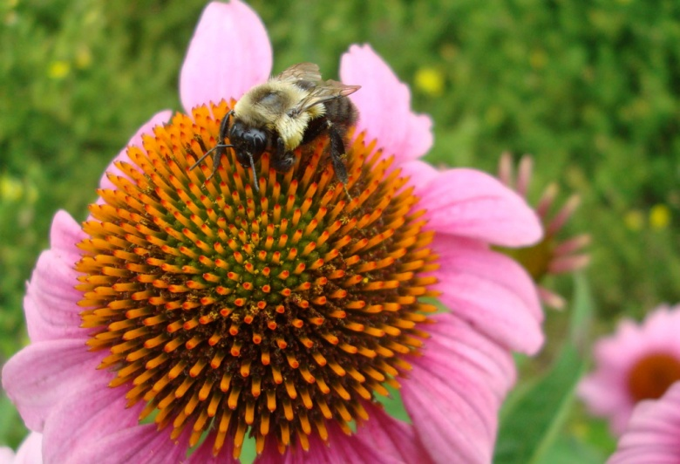
National Stakeholders Conference Key Findings
Parasites and disease are major factors
Increased genetic diversity is needed
Poor nutrition has a major impact on bee and colony longevity
  Mono-cropping may contribute to dietary deficiencies
Need to improve collaboration and information sharing
Additional research is needed to determine the pesticide risks

Slide 13
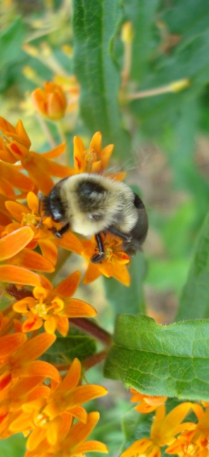
National Stakeholders Conference Key Findings
Undernourished or malnourished bees appear to be more susceptible to pathogens, parasites, and other stressors, including pesticides and other environmental contaminants.
    Research is needed on forage, pollen quality, artificial and natural food sources, and food processing and storage in the hive.
Federal and state partners should consider actions affecting land management to maximize available nutritional forage to promote and enhance good bee health and to protect bees by keeping them away from pesticide-treated crop acreage.

Slide 14
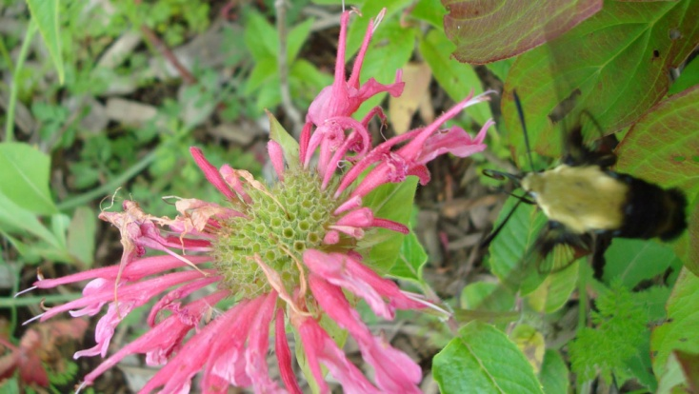
National Stakeholders Conference Key Findings
Pathogens and parasites have major negative impacts on colonies. The management of the parasitic Varroa mite and viruses needs special attention.
More outreach to farmers on managing potential exposure of honey bees to pesticides is needed.
    Efforts would benefit from involvement of beekeepers, crop consultants, pesticide manufacturers, pesticide applicators, state lead agencies and extension agents.

Slide 15
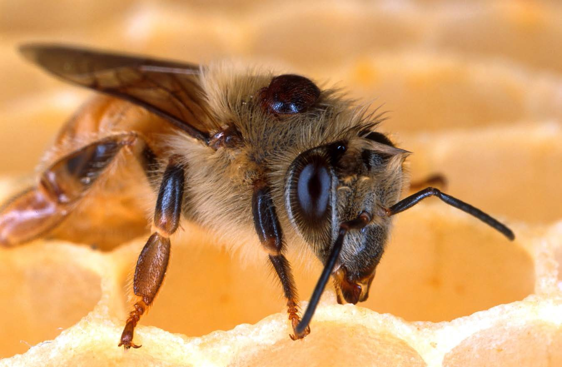

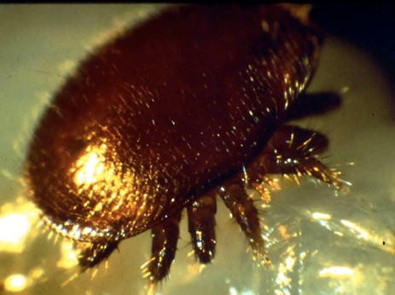

Varroa destructor mite
sucks bee blood and circulates viruses
Marla Spivak, University of Minnesota

Slide 16
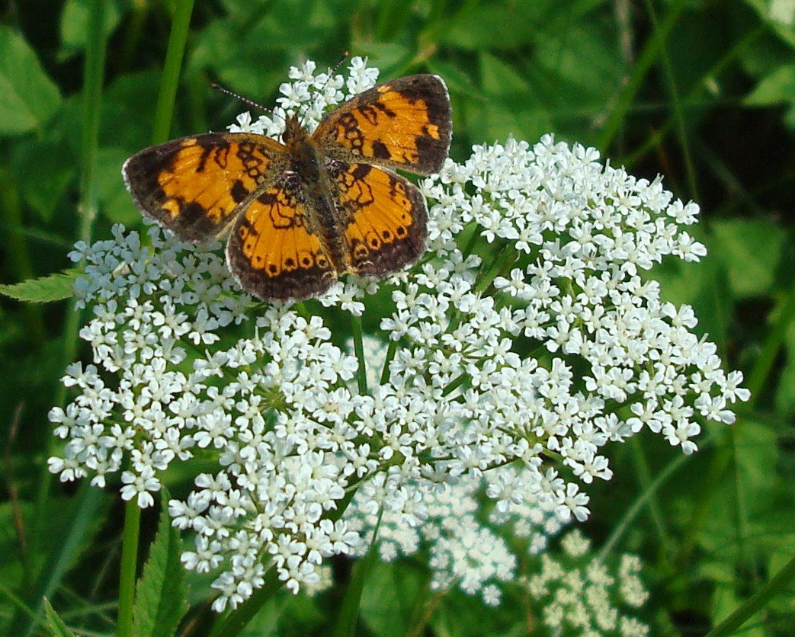
National Stakeholders Conference Key Findings
Best management practices associated with bees and pesticide use exist, but are not widely or systematically followed by members of the crop producing industry.
    We need informed and coordinated communication between growers and beekeepers and effective collaboration between stakeholders.
Beekeepers accentuated the need for accurate and timely bee kill incident reporting, monitoring, and enforcement.
Breeding should emphasize traits such as hygienic behavior that confer improved resistance to Varroa mites and diseases (such as American Foulbrood).

Slide 17
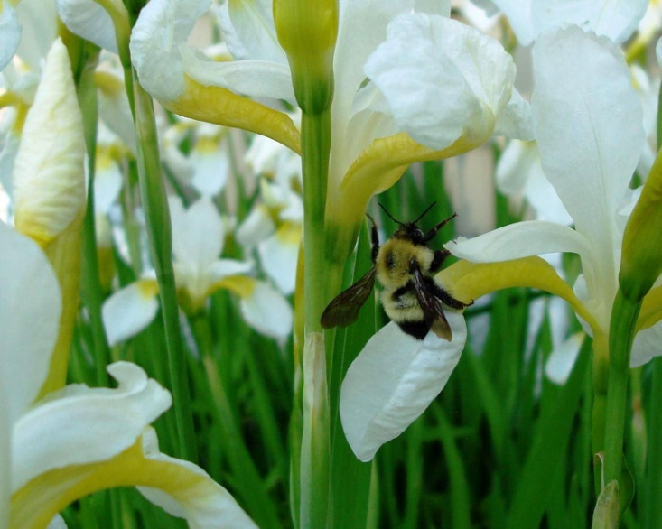
Managed Pollinator Coordinated Agriculture Program Update Highlights
Varroa mite is vector of Israeli Acute Paralysis Virus (IAPV) which is a potentially serious problem
Sentinel apiary study –
  Bee mortality increases as Ag land % increases
  6.2 pesticides on average found in bee pollen
  130 different pesticide residues found but no trend associated with bee mortality
  High levels of varroa = high levels of IAPV = low populations of adult bees and brood

Slide 18
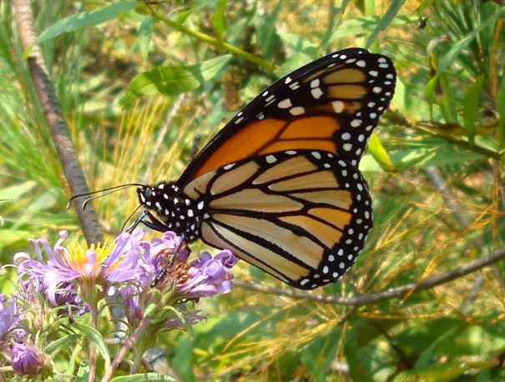
Managed Pollinator Coordinated Agriculture Program Update Highlights
High degree of cross-infection of viruses between honey bees and native bumble bees
Possible bee susceptibility to interactions (synergism) between agricultural insecticides and fungicides
Some of those fungicides include, chlorothalonil, boscalid, captan, propiconazole and myclobutanil
Acetamiprid is not very toxic to bees on its own, but when combined with propiconazole it becomes 900times more toxic

Slide 19

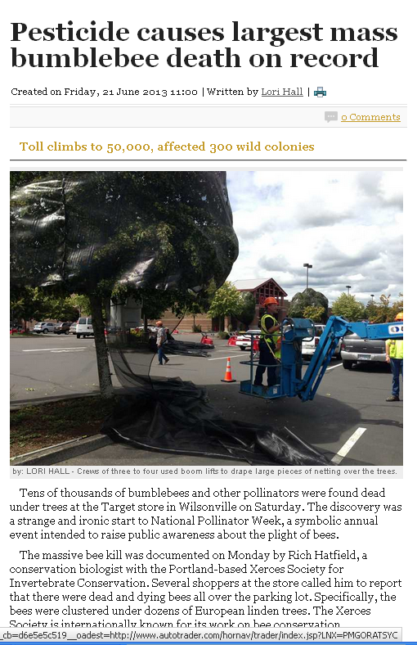
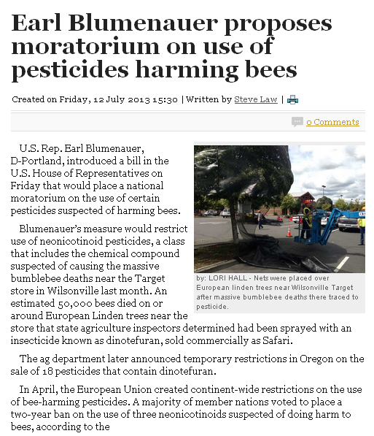
Pollinator Protection
Bee kills are in the news! Legislators are asking for bans or moratoriums all over the country
Growers must be extremely careful
This case involved “Safari” which is dinotefuran

Slide 20
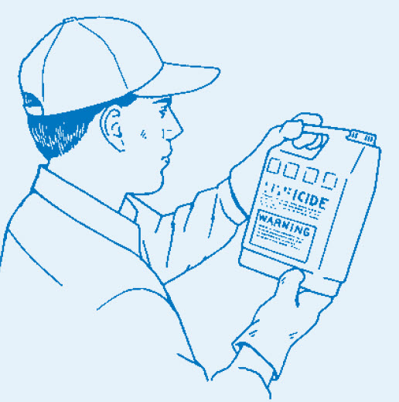
Pesticide applicators must reduce risks to honey bees and other pollinators.
Read the label
Use IPM
Follow Best
Management
Practices
Penn State Pesticide Education Program

Slide 21
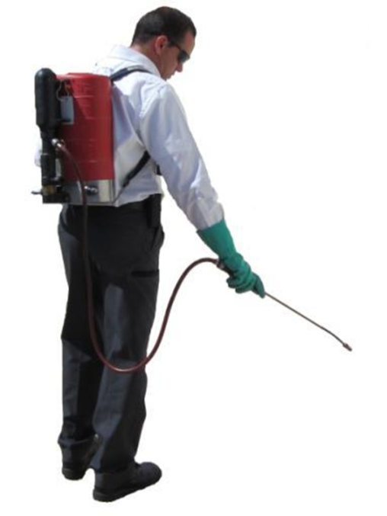

What Can You Do…?
As an applicator…
  Choose an insecticide with low hazard to bees
  Communicate with beekeeper
  Timing of application
  Avoid drift
  Be aware of blooming plants in the area when applying pesticides
  Mow blooming weeds around application sites before application, when possible
Notes:
Notify the beekeeper about application time and product to be used; so he can anticipated outcomes.
Timing of insecticide application: Never spray a crop in bloom unless it's absolutely necessary. If spraying a crop in bloom is necessary, spray when there will be minimal bee activity, preferably during the evening hours. Evening spraying also allows the insecticide to dry on the crop before bee activity begins the next morning.
Modify control programs according to weather. Cold temperatures prolong the residual of insecticide while warm temperatures break down insecticides more rapidly. Warm temperatures in late afternoon, early evening or early morning can "hold" bees in blooming fields for longer periods. Pay attention to wind direction and velocity in relation to nearby beeyard locations.
Why is the beekeeper hesitant to move or why does he sometimes leave the colonies in the area?
The colonies may contain new combs filled with honey that will break under vibration by the truck that hauls them over rough roads. If this occur, the bees in the cluster will be drowned by the honey and the combs lost. Finding an appropriate location may be difficult (road to them, shade, food, pesticides used in the area, etc)

Slide 22
Did You Know?
Most pesticides are not acutely toxic to honey bees and other pollinators.
As a general rule: insecticides pose greater concerns to pollinators than fungicides and herbicides.
  However, not all insecticides are toxic to pollinators.
New research shows that some combinations of insecticides and fungicides can be very toxic to bees.
Any pesticide that is toxic to insect pollinators will have warnings on its label.

Slide 23
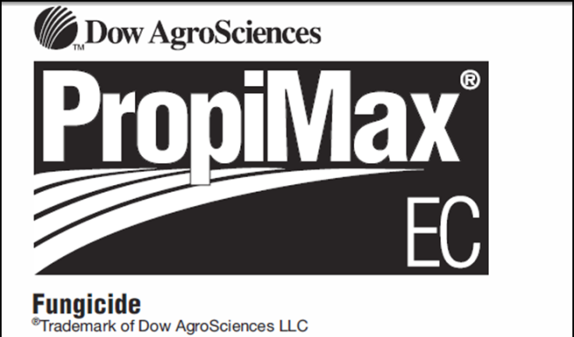
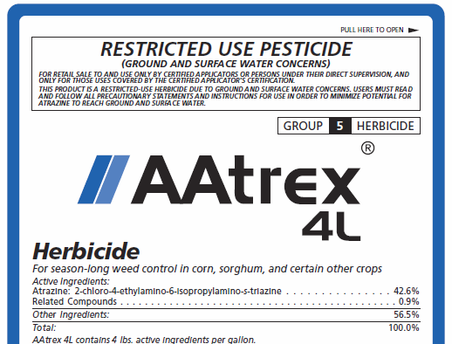
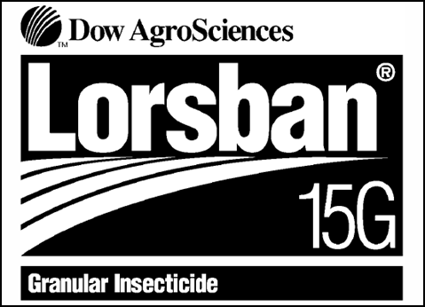
Different Formulations may affect pollinators…
Granules
Emulsifiable concentrates vs Wettable powder
Dusts & Microencapsulated
Oil sprays
Mixing miticides with insecticides
Some fungicides with insecticides
Notes:
Granular formulations are leaset hazardous because they are applied to the ground and are too big for bees to pick up. EC are safer than Wettable Powders because WP stay toxic longer. Dusts & Micro Encapsulated are most hazardous because they are similar in size to pollen and tend to stick to bee hairs, going back to the hiveBees are temporarily inactivated by direct contact with oil sprays. Mixing miticides with insecticides can be more toxic to bees. Mixing some fungicides the (demethylation-inhibiting (DMI) like propiconizole (Propimax, Quilt) with synthetic pyrethroids like lamda-cyhalothrin (Warrior). Similar effects have been seen with Neonics and DMI fungicides but not translated out to the field (Schmuck ,etal 2003)

Slide 24
Pollinator Protection Checklist
Read and follow the label.
Determine if the pesticide is toxic to pollinators.
Understand local pollinator visitation habits.
Use Integrated Pest Management.
Follow pesticide stewardship practices.
Cooperate and communicate with others.
Know symptoms of pesticide exposure to bees.
Check local ordinances pertaining to pollinators.

Slide 25
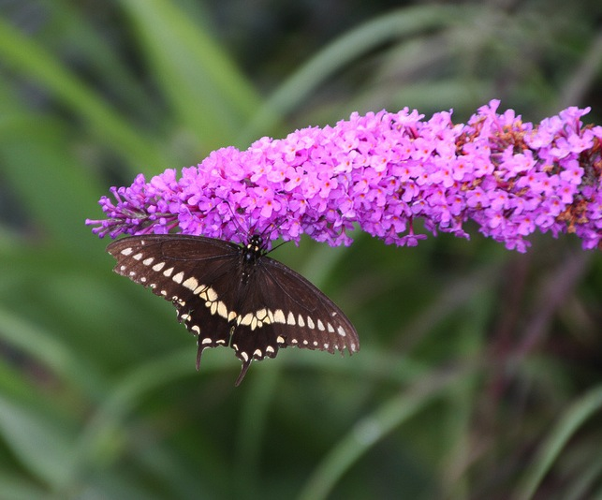
Pollinator Protection Checklist
1. Read and follow ALL pesticide label directions and precautions.
  Must reduce risk of
  pesticide exposure to
  honey bees and other
  pollinators.
Penn State Pesticide Education Program

Slide 26
Many insecticides have specific label warnings

Slide 27
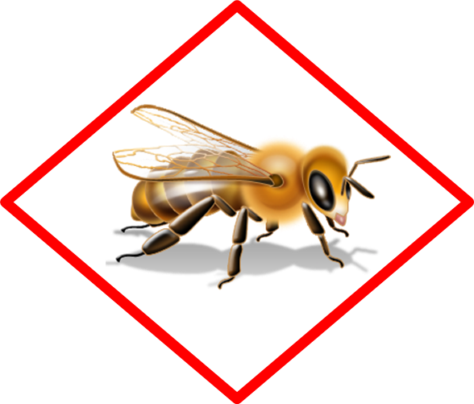
Look for the bee icon on new labels
Products with acute or residual toxicity to pollinators will have the bee icon on their labels
The new warnings will be next to that icon

Slide 28
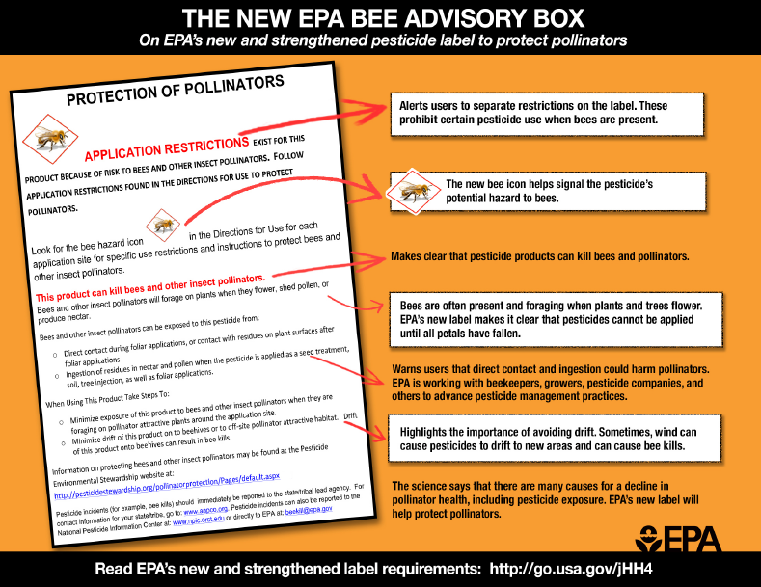
Pollinator Protection

Slide 29
Pollinator Protection Checklist
2. Determine if the pesticide may be toxic to pollinators.
  The Environmental Hazard section of a label will indicate if a pesticide is moderately or highly toxic to bees that contact the pesticide.
  There is also a “practically non-toxic to pollinators” category of pesticides.

Slide 30
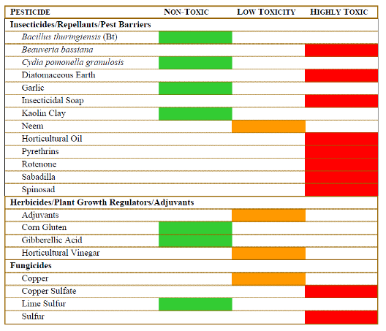
Even pesticides approved for organic grower use can be highly toxic to pollinators
Toxicity of Common Organic-Approved Pesticides to Pollinators
Soaps and Oils, only when directly sprayed upon the pollinator
Eric Mader – The Xerces Society for Invertebrate Conservation

Slide 31
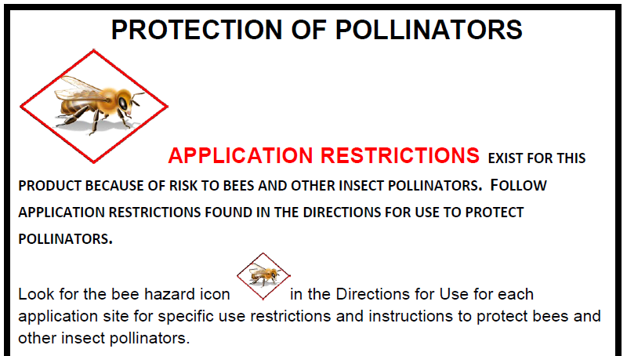

Slide 32
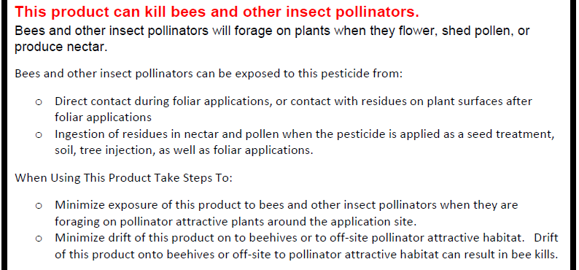
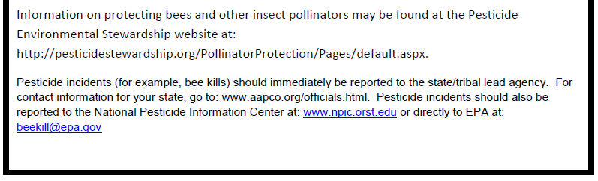

Slide 33
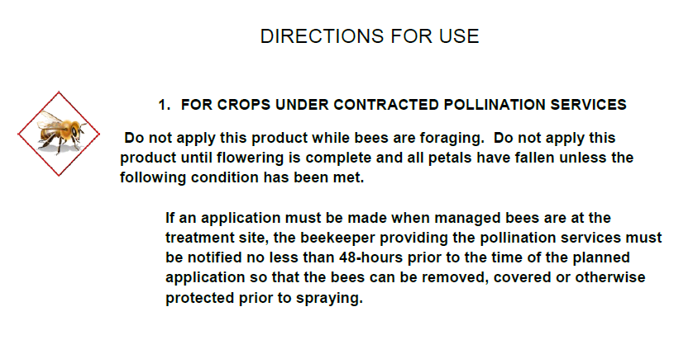
New use directions – Ag products

Slide 34
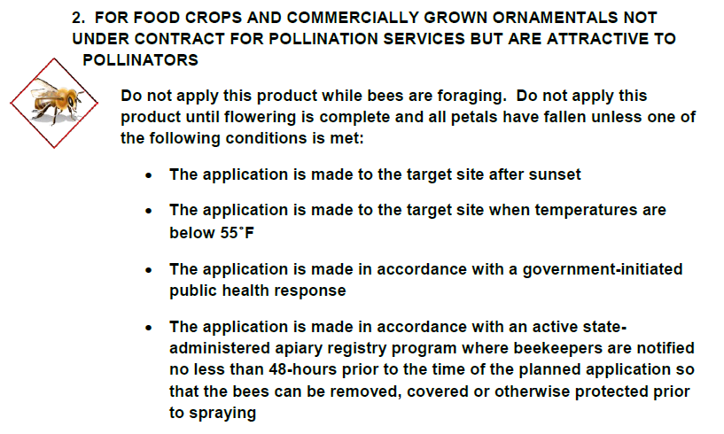
New use directions – Ag products

Slide 35
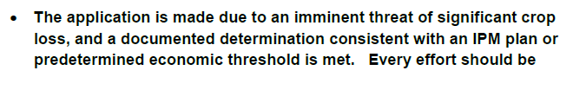
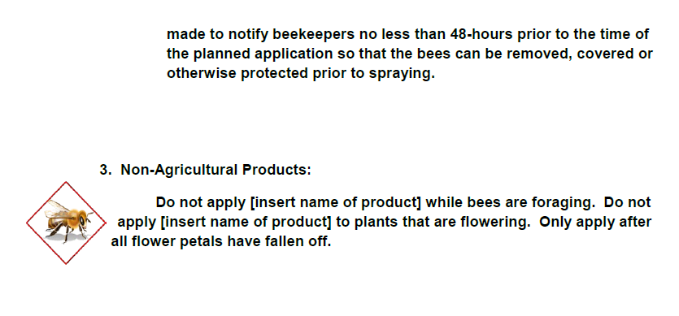
New use directions – Ag products & Non-Ag products

Slide 36
Residual Toxicity
Definition:
Residues on plants which can harm pollinators that visit the area after the treatment is dry or absorbed by the soil
Some pesticides have extended residual toxicity to bees and other pollinators.

Slide 37
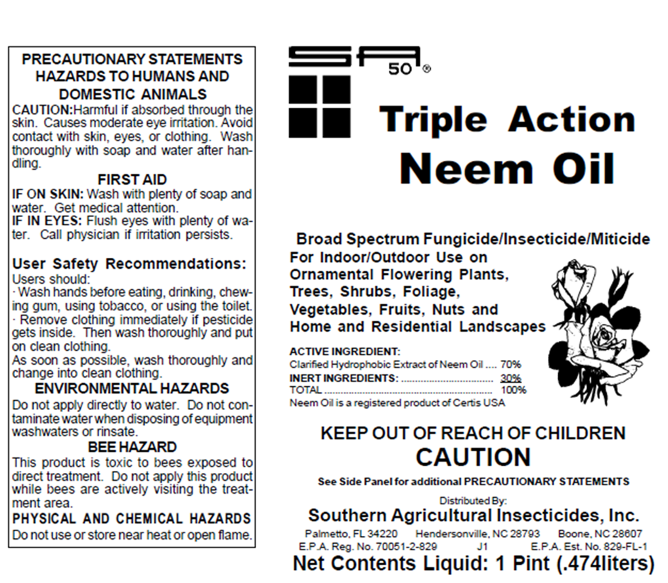

Residual Toxicity
If the pesticide does not have extended residual toxicity:
The pesticide can still harm pollinators exposed to direct treatment; during or shortly after the application while the plants are still wet.
Can often be applied after evening pollinator foraging is complete without harming pollinators that arrive the next day.

Slide 38
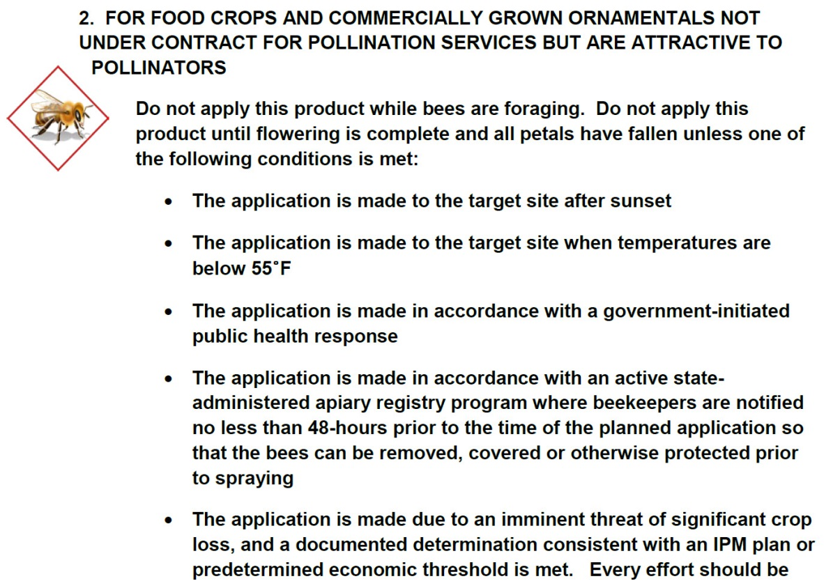
Additional Restrictions for pesticide with Extended Residual Activity www.epa.gov/pesticides/ecosystem/pollinator/bee-label-info-lrt.pdf

Slide 39

Residual Toxicity
Environmental conditions can affect residual toxicity.
  Examples: Low temperatures or heavy dews for the night or early AM after application may increase residual toxicity.

Slide 40
Pollinator Protection Checklist
3. Understand local pollinator visitation habits.
  Pollinators are at most risk when ANY vegetation is blooming.
  Observe application timing on the label relative to the blooming stage of crop and other plants.
  The right timing may be reduced by extended bloom or unfavorable weather conditions.
  Evening or nighttime applications are generally the least harmful to honey bees.

Slide 41
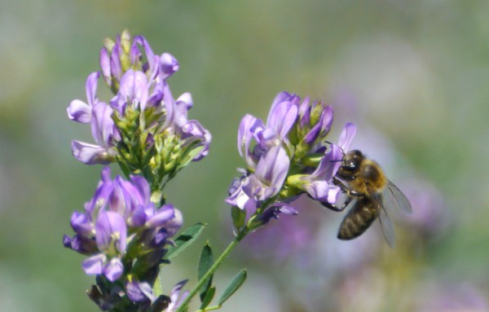
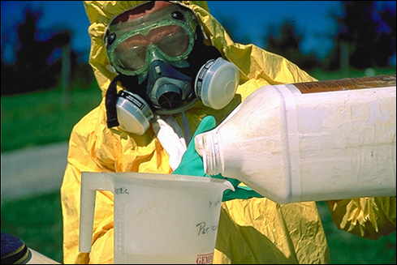
During Application
Watch for bee activity.
  Stop spraying if bees are present at the application site.
Be careful with refill or mixing/loading operations.
  Clean up any spills.
  Don’t contaminate any standing water.
Notes:
Conditions can change, so if you start early with your spray operation and then foraging bees enter the application site during application you may need to delay your application. Also, there may be places in your field that will attract bees in small locations. Pay attention to these areas and if there is significant activity, stop or delay spraying.
It is better to mix and load at a site away from the application site if there is bees in the area. Bees need water and might try to drink in puddles of spilled tankmix or will attempt to drink contaminated water. Clean up any spills and don’t leave any puddles or standing water at the mix/load site.

Slide 42
Pollinator Protection Checklist
4. Use Integrated Pest Management (IPM)
  Consider all suitable practices for managing pests.
  Use cultural practices that discourage pests from using a crop or landscape as a habitat.
  Carefully diagnose your pest problems.
  Monitor and assess pest populations to determine when levels warrant pesticide treatment.

Slide 43
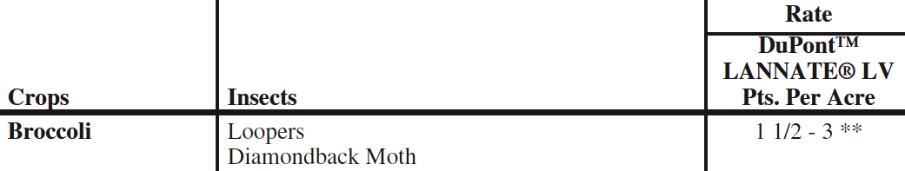
Pollinator Protection Checklist
4. Use Integrated Pest Management (IPM)
  Determine your best combination of management options.
  Use the recommended pesticide at the lowest appropriate labeled rate, based on the life stage of the pest/infestation level with the proper timing and placement.
    Using rates below the labeled rate may cause loss of control or development of pest resistance.

Slide 44
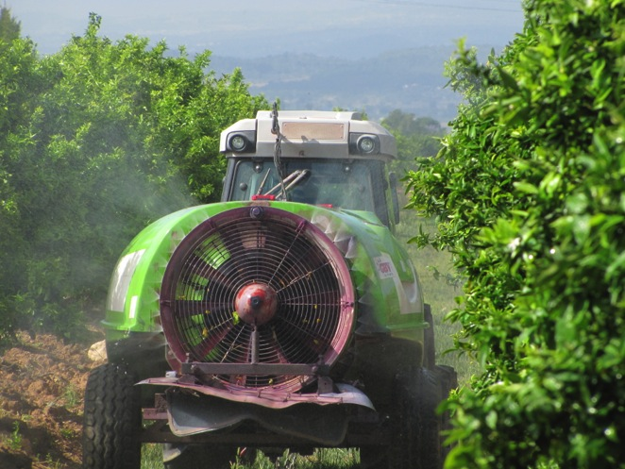
Pollinator Protection Checklist
5. Always follow pesticide stewardship practices.
  Minimize spray drift.
  Minimize volatility.
  Minimize off-site drift
  of seed treatment
  materials.

Slide 45
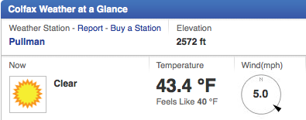
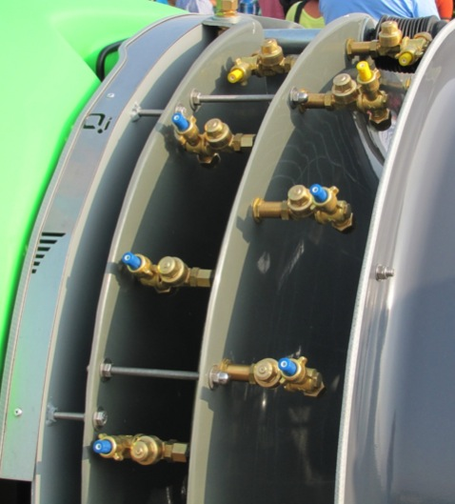
Minimize Spray Drift
Establish appropriate buffers.
Check weather forecast.
Shut off the sprayer when making turns and near ponds and other sources of water.
Choose low pressure or low-drift nozzles.
C. Black, Spain 2013

Slide 46

Minimize Vapor Drift
More prone to pesticides formulated as emulsifiable concentrates.
Spray during cool temperatures.
Soil-incorporate volatile products.
Use relatively coarse spray droplets.

Slide 47

Minimize Off-Site Drift of
Seed Treatment Materials
Specific label information takes precedence.
Always buy and use high quality seed, free from excessive dust.
When the pesticide needs to be coated onto the seed, always use an appropriate coating system to keep abrasion of coated pesticide to a minimum.

Slide 48
Minimize Off-Site Drift of
Seed Treatment Materials
Follow planter manufacturer recommendations for use of talc, graphite, or other flow agent.
  Avoid excess to minimize dust.
Avoid releasing dust from seed treatments into the air that could expose pollinators.
  Be careful when opening seed containers and when filling, emptying, or cleaning the planting equipment.

Slide 49


After Application
Properly dispose of leftover tank mix, rinsates and wash waters.
  Bees are attracted to water sources.
  Cover, drain, or dispose of any puddles or pools.
Store unused pesticides in a secure facility.

Slide 50

Pollinator Protection Checklist
6. Cooperate and communicate with others who are concerned about preserving beneficial insects, including pollinators.
  Beekeepers
  Custom applicators
  Neighboring growers
Penn State Pesticide Education Program

Slide 51
Pollinator Protection requires COMMUNICATION!
Growers
Applicators
PROTECT
THE
POLLINATORS
Beekeepers

Slide 52
What Can You Do…?
As a Beekeeper…
  Notify applicator of the location of hives
  Have your contact information on the hives
  All bee medications, even organic ones, (miticides) can also contribute to these problems. Minimize your use
  When highly toxic & long residual pesticides are applied nearby: consider moving hives
  When highly toxic & short residual pesticide are applied nearby : confine your bees
Notes:
Notify the beekeeper about application time and product to be used; so he can anticipated outcomes.
Timing of insecticide application: Never spray a crop in bloom unless it's absolutely necessary. If spraying a crop in bloom is necessary, spray when there will be minimal bee activity, preferably during the evening hours. Evening spraying also allows the insecticide to dry on the crop before bee activity begins the next morning.
Modify control programs according to weather. Cold temperatures prolong the residual of insecticide while warm temperatures break down insecticides more rapidly. Warm temperatures in late afternoon, early evening or early morning can "hold" bees in blooming fields for longer periods. Pay attention to wind direction and velocity in relation to nearby beeyard locations.
Why is the beekeeper hesitant to move or why does he sometimes leave the colonies in the area?
The colonies may contain new combs filled with honey that will break under vibration by the truck that hauls them over rough roads. If this occur, the bees in the cluster will be drowned by the honey and the combs lost. Finding an appropriate location may be difficult (road to them, shade, food, pesticides used in the area, etc)

Slide 53

Pollinator Protection Checklist
7a. Know the common symptoms of honey bee exposure to pesticides
7b. Know what other stressors impact bee health.
iStockphoto.com

Slide 54

Common Symptoms of Honey Bee Exposure to Pesticides
Excessive numbers of dead bees in front of hives.
Lack of the usual numbers of foraging bees, if not weather-related.
Bees in front of hives that appear disoriented and unable to fly.
www.hive-mind.com

Slide 55


Common Other Stressors to Bee Health
Colony starvation and nutritional deficiency.
Excessive cooling or heating
of the colony and brood.
Parasites.
www.gardenfork.tv
cyberbee.net/gallery

Slide 56

Pollinator Protection Checklist
8. Check for specific local ordinances pertaining to pollinators,
especially beehive
locations or
designated
preserves.
Penn State Pesticide Education Program

Slide 57

What we all can do to improve pollinator survival?
Grow plant for pollinators
Convert lawns and fallow field areas to bee gardens or bee pastures
Simply planting clovers, sunflowers or asters can make a big difference
Attracting Beneficial Insects with Native Flowering Plants
by Doug Landis, Rufus Isaacs

Slide 58
Use of this presentation or parts of this presentation is encouraged as long as this credit slide is included.
Photo/Graphic Credits:
Tom Butzler, Penn State Extension (slides 2, 3, and 4).
Environmental Protection Agency (slides 8, 12, and 30).
iStockphoto.com (slides 25 and 27).
Penn State Pesticide Education Program (slides 5, 7, 24, and 28).
Resources:
Bee Labeling Info Graphic (PDF). U.S. EPA.
http://www.epa.gov/opp00001/ecosystem/pollinator/bee-label-info-graphic.pdf
Pollinator Protection web page, U.S. EPA. http://www.epa.gov/pesticides/ecosystem/pollinator/
Pollinators and Pesticide Stewardship. Coalition for Urban/Rural Environmental Stewardship, Syngenta, and Bayer CropScience.
http://pesticidestewardship.org/pages/resources.aspx

Slide 59

This presentation was created in partnership with the
Pesticide Education Program, Penn State Cooperative Extension;
and the Pennsylvania Department of Agriculture.
It was slightly modified by
Washington State University
Urban IPM and Pesticide Safety Education Program
Where trade names appear, no discrimination is intended, and no endorsement by WSU or Penn State Cooperative Extension is implied. WSU and Penn State is committed to affirmative action, equal opportunity, and the diversity of its workforce.
© The Pennsylvania State University 2013 September 2013

Slide 60
Other contributors to this presentation
Frank Drummond – University of Maine
Tony Jadczak - MDACF
Sherm Takatori – Idaho Department of Agriculture
Thia Walker - Colorado State University
Carol Black – Washington State University
Jack Peterson – Arizona Department of Agriculture
Kerry Richards – Penn State University

Slide 61
Resources
http://www.usda.gov/documents/ReportHoneyBeeHealth.pdf
‎http://www.beeccdcap.uga.edu
http://pesticidestewardship.org/PollinatorProtection/Pages/default.aspx
http://www.epa.gov/opp00001/ecosystem/pollinator/

Slide 62
Questions?
That’s all folks!

