Slide 1


2014 BPC Update
287-2731
www.thinkfirstspraylast.org

Slide 2

BPC Update Overview
Reminder – Commercial Growers Will All Need A License Soon
Endosulfan (Thionex) Phase-Out Reminder
The Hazard Communication Standard Has Changed
Good Reading – The Pesticide Label
Persistent herbicides and compost
Protecting Pollinators
Measuring low rate pesticides
Legislative update
Container Deposit Deadline
Top 10 violations
Searching for a registered pesticide
Still phasing out snail mail

Slide 3
Private Applicator of General Use Pesticides
Public Law 2011, Chapter 169 requires anyone producing and selling over $1,000 worth of agricultural plants or plant products/year for human consumption to obtain a pesticide applicator license by April 1, 2015
Growers must obtain an Agricultural Basic, or
Private Pesticide Applicator license

Slide 4
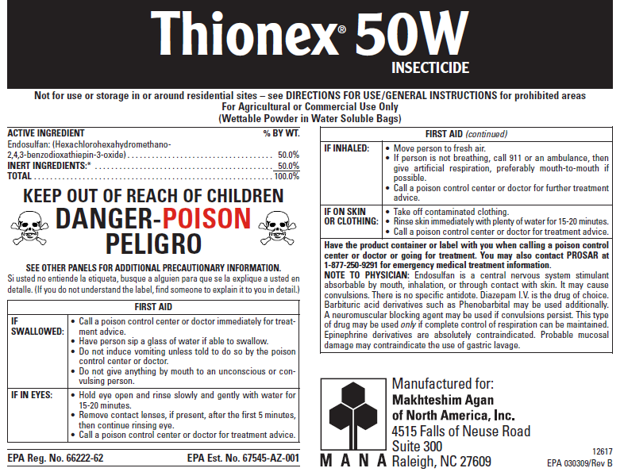
Endosulfan (Thiodan) phaseout
Group E: Use ends July 31, 2015
Apple
Blueberry
Peppers
Potatoes
Pumpkins
Sweet corn
Tomato
Winter squash
No endorsement intended or implied

Slide 5
Changes to the Hazard Communication Standard
The federal Hazard Communication Standard (called “worker right to know”) has been “harmonized” with international standards
MSDSs are now SDSs
Signal words have changed
Employers must retrain employees on the changes

Slide 6
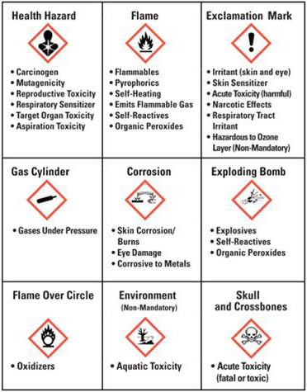
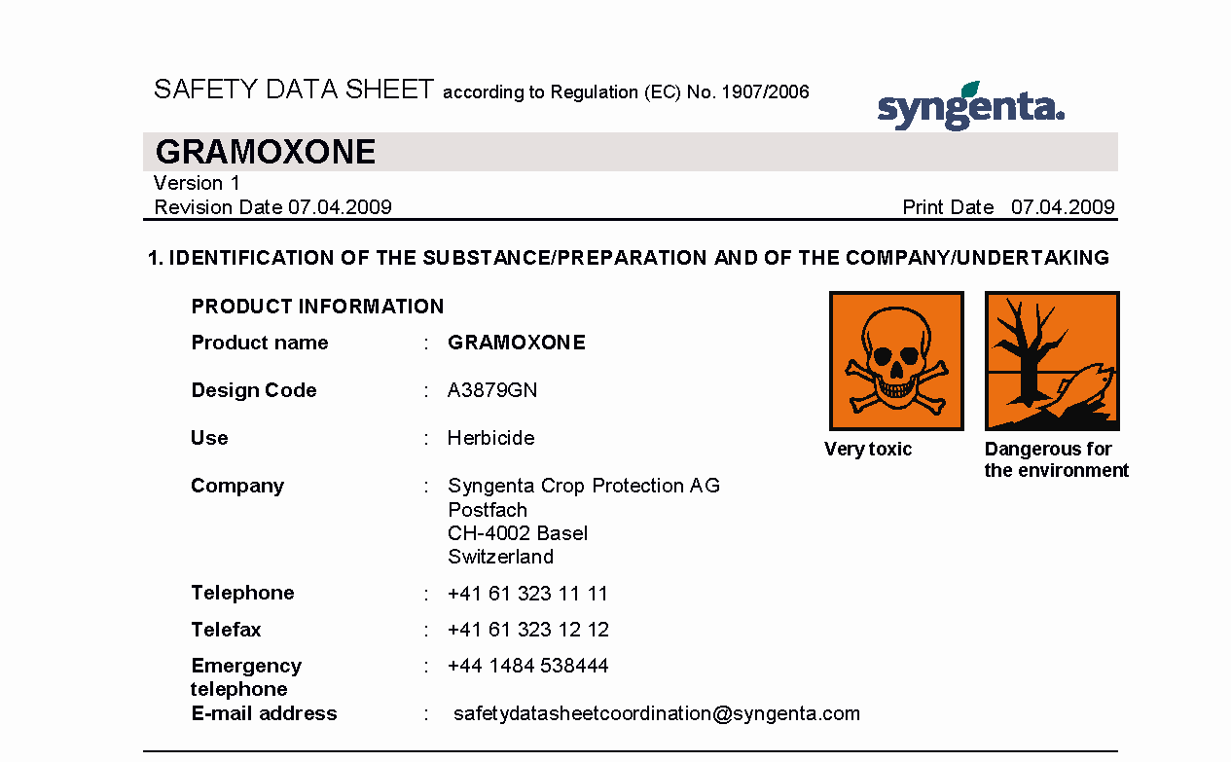
New SDS Pictograms and Hazards

Slide 7
Label signal word and SDS warnings may not match

Slide 8
Employee Information and Training
HazCom 1994
HazCom 2012
Requires employee information and training before a worker is exposed to the hazardous chemicals in the workplace, and whenever the hazard changes.
Clarifies that the labels on shipped containers and workplace labels must be explained, as well as SDS format.
Workers will have to be trained on the new label and SDS formats before all the provisions of the rule are effective.
HazCom 2012 says:
  Employers shall train employees regarding the new label elements and safety data sheet format by December 1, 2013.

Slide 9
Good Reading – The Pesticide Label
The BPC Inspectors are noticing growers making some mistakes
  Fungicide labels may not be specific, but restrictions on the number of applications apply even when you use two different product formulations
No endorsement intended or implied

Slide 10
Must read the label carefully
Bravo labels – Weatherstik and Ultrex
No endorsement intended or implied

Slide 11
Must read the label carefully
Pay attention to labels for restrictions on total active ingredient per acre per year
No endorsement intended or implied

Slide 12
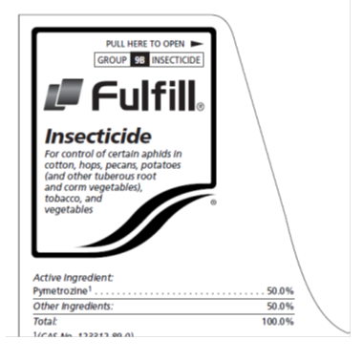
Must read the label carefully
Tank mixes may be prohibited
No endorsement intended or implied

Slide 13
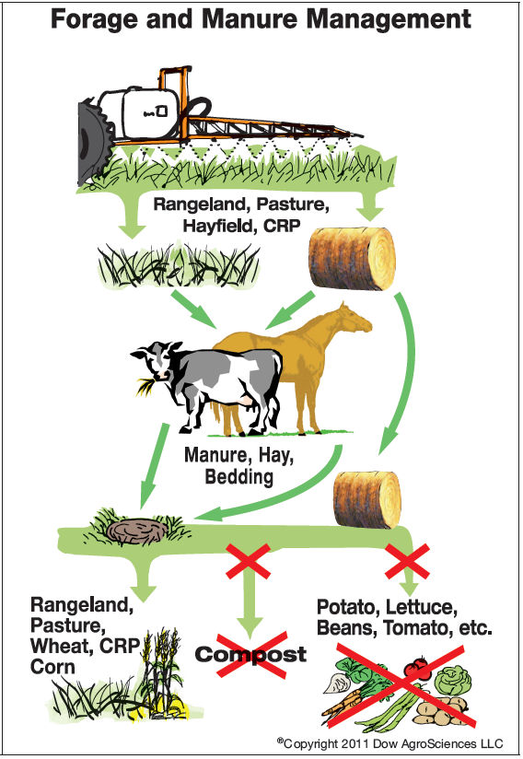
Persistent pyralid herbicides and compost
Aminopyralid and clopyralid herbicides have unfortunately ended up in compost mixtures that greenhouse growers use as a planting media
Product labels must be followed carefully by all people involved with the
  application,
  harvest, and
  subsequent disposal of the crop

Slide 14
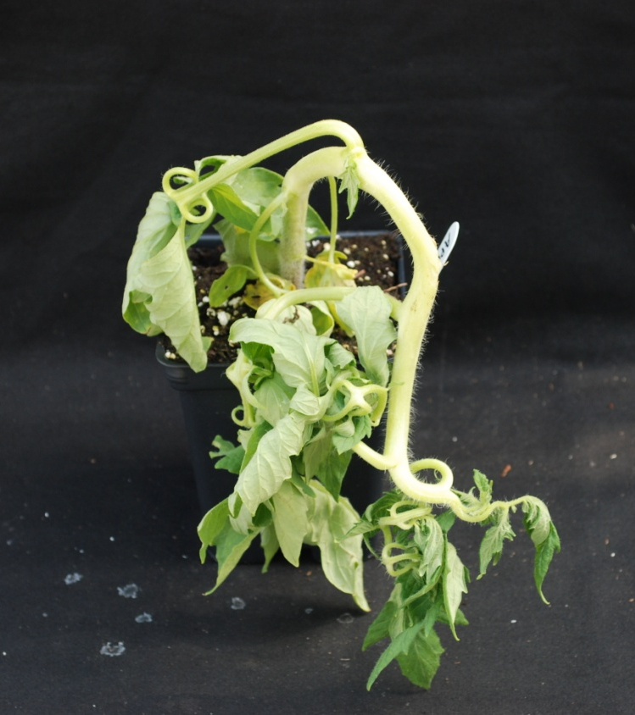
Label instructions must be passed on
Applicators or growers should make sure the label instructions are passed on and understood by anyone involved with treated crops and residues
Susceptible crops grown in media made with manure or crop residues can be affected
http://herbicidestewardship.utk.edu/tomato.htm

Slide 15
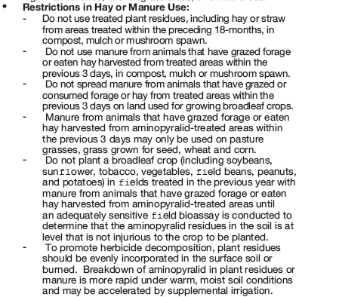
Forefront label restrictions

Slide 16
Forefront label restrictions

Slide 17

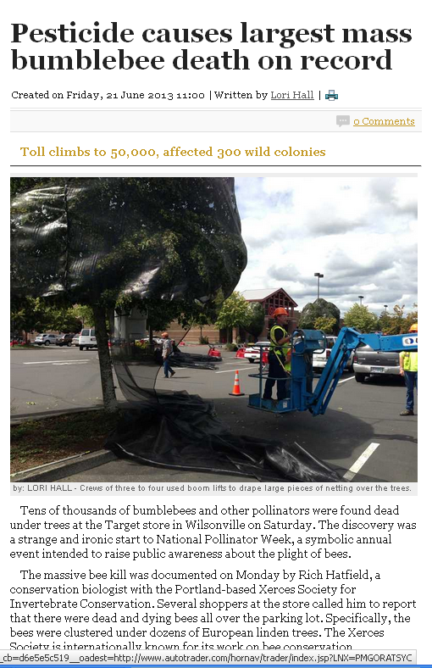
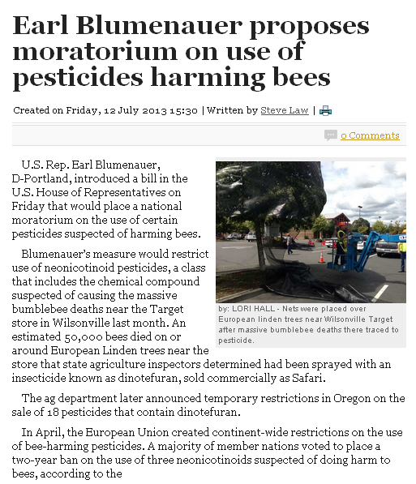
Pollinator Protection
Bee kills are in the news! Legislators are asking for bans or moratoriums all over the country
Growers must be extremely careful
This case involved “Safari” which is dinotefuran

Slide 18
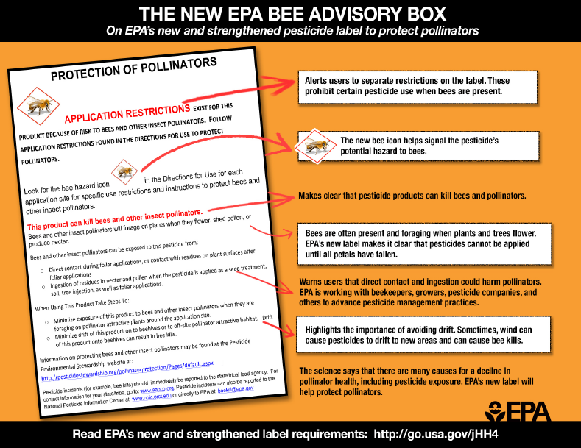
Pollinator Protection

Slide 19
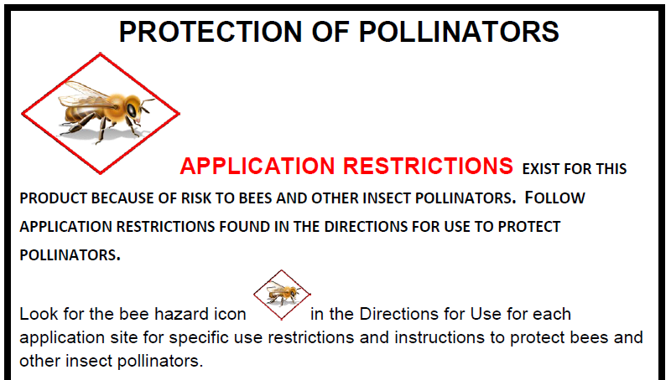

Slide 20
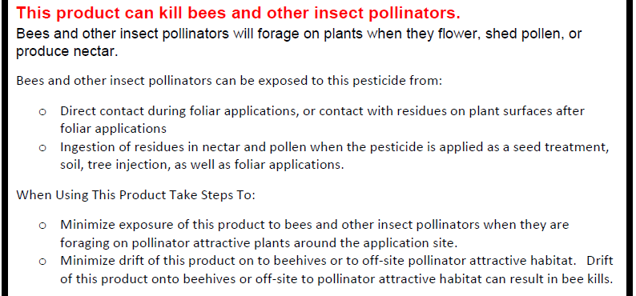
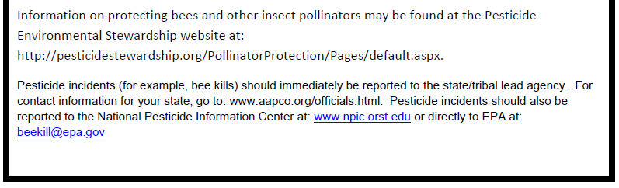

Slide 21
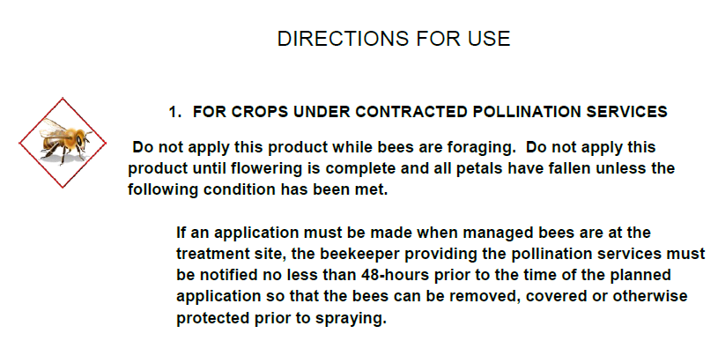
New use directions – Ag products

Slide 22
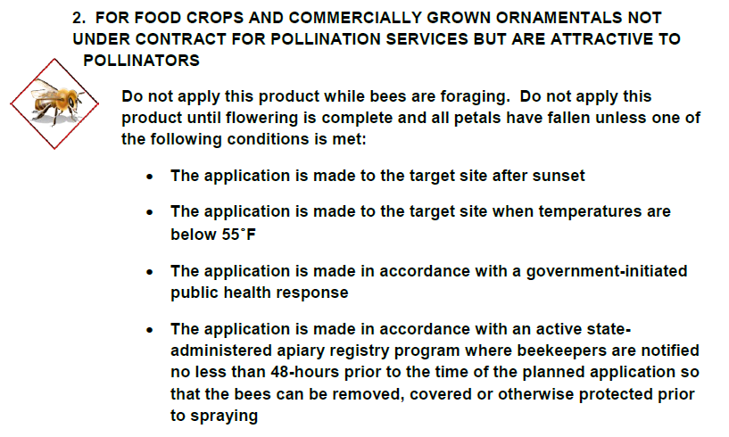
New use directions – Ag products

Slide 23
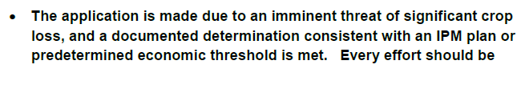
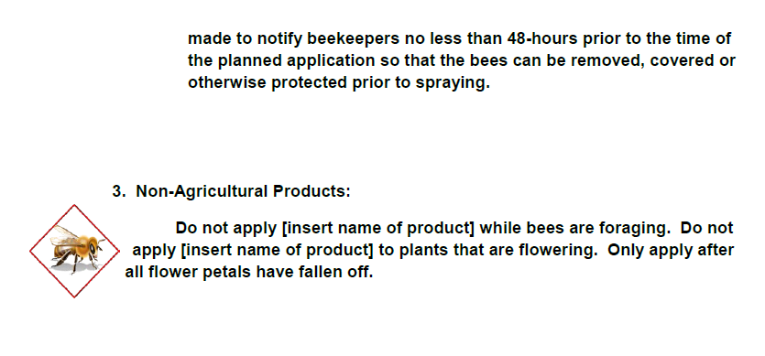
New use directions – Ag products & Non-Ag products
2. Cont.

Slide 24
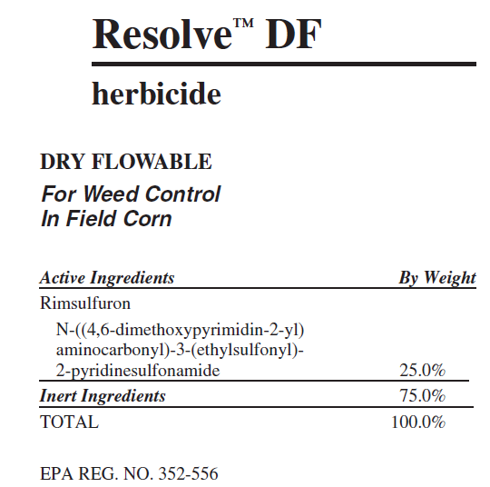
Measuring low rate pesticides
Inspectors have seen growers that are not measuring dry pesticide products properly
Our English system of measurements can be very confusing since we have both dry and liquid ounces
Products like Resolve DF prescribe applications rates in ounces per acre
How do you make sure to get the right rate?
No endorsement intended or implied

Slide 25
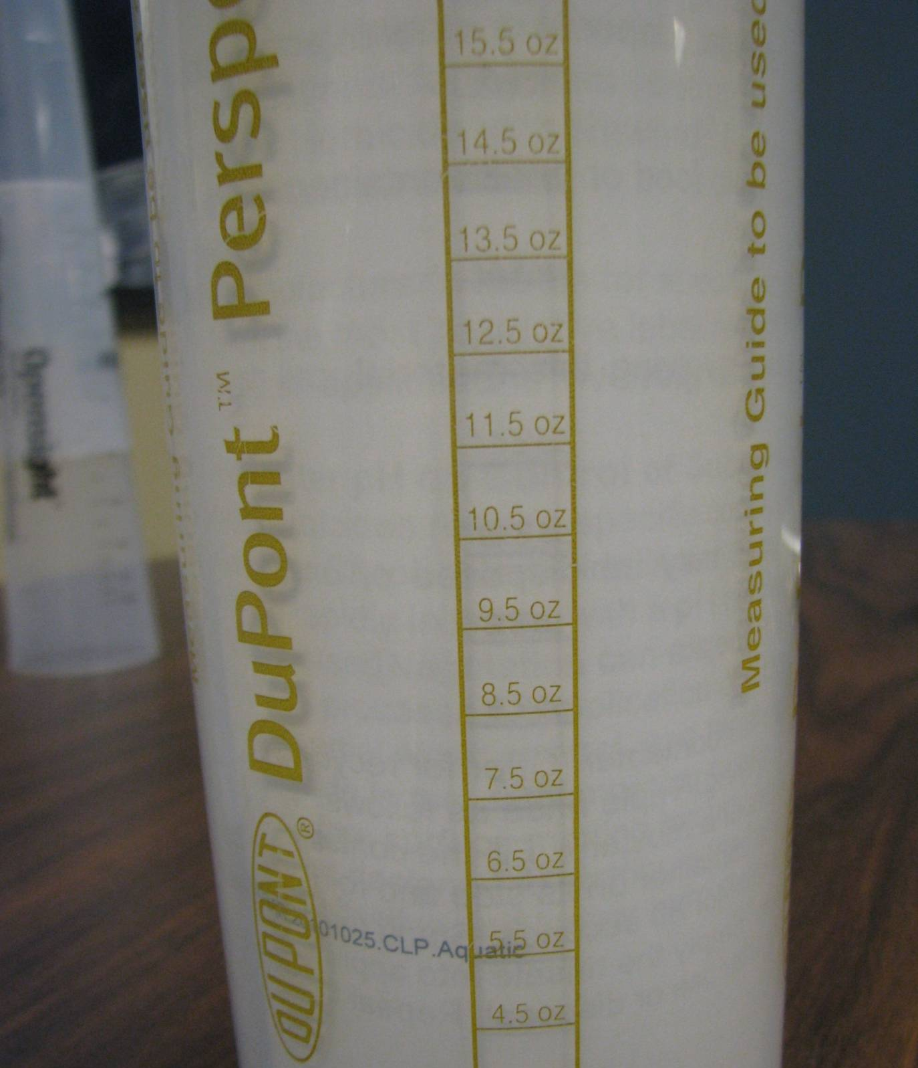
First
Conclusion
More precision required when measuring products by the ounce
No endorsement intended or implied

Slide 26
800 Gallon Tank
10 gallons per acre, now many acres
will tank do?
20 gallons per acre, how many acres
will tank do?
15 gallons per acre, how many acres
will tank do?

Slide 27
800 Gallon Tank
10 gallons per acre, now many acres
will tank do? 80
20 gallons per acre, how many acres
will tank do? 40
15 gallons per acre, how many acres
will tank do? 53

Slide 28
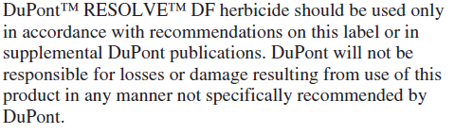
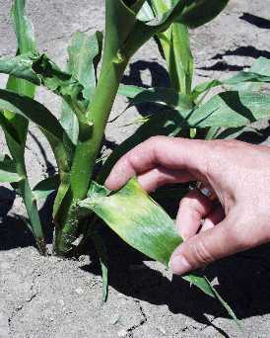
Many new pesticides are very low rate products
With low rate products measuring properly is even more important
Even slight miscalculations can result in crop damage
Ontario Ministry of Ag
"flash" of yellow on the leaf and crinkling

Slide 29
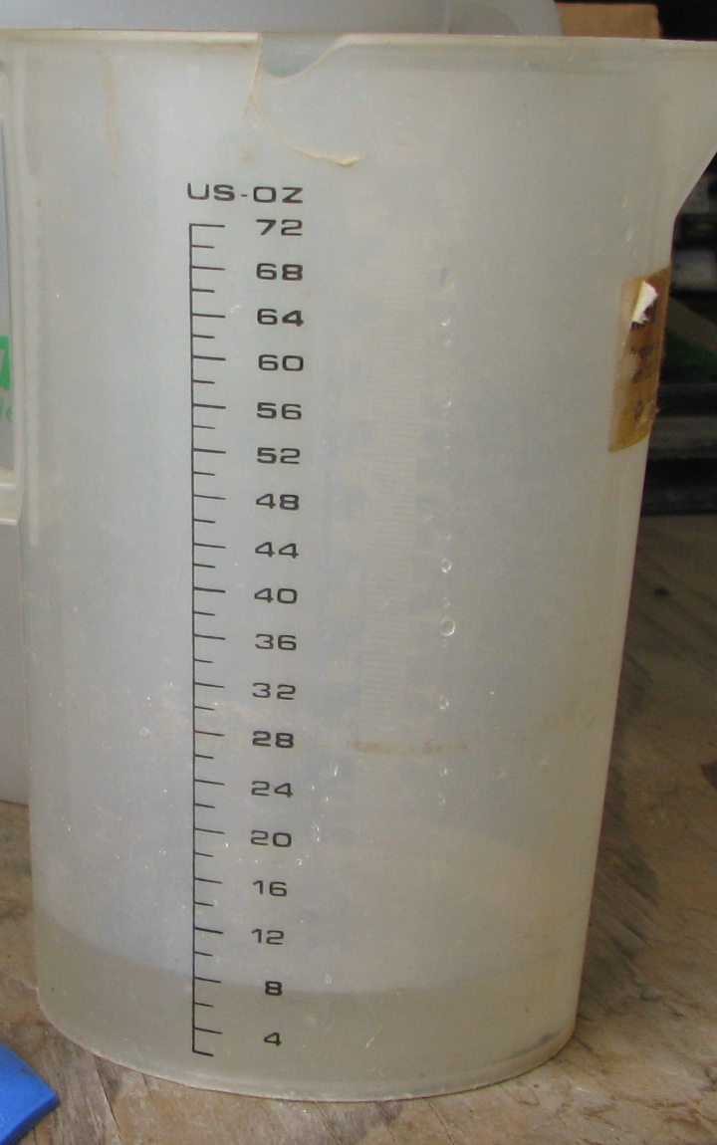
Second Conclusion
• Make sure device is accurate

Slide 30

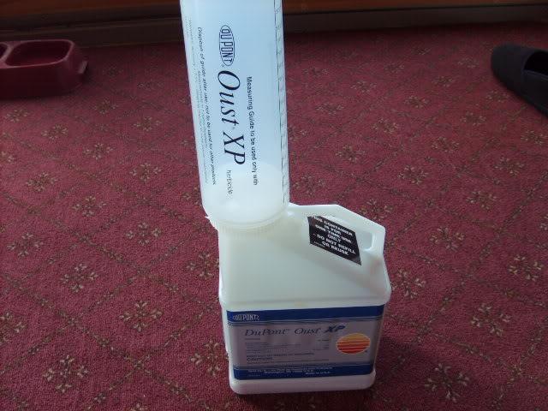
Must have a good scale or a product specific “calibrated” measuring cup
Dry ounces can only be accurately measured using a good quality scale (postal scales work well)
Calibrated measuring devices are fine but must be specifically designed for the product used
No endorsement intended or implied

Slide 31
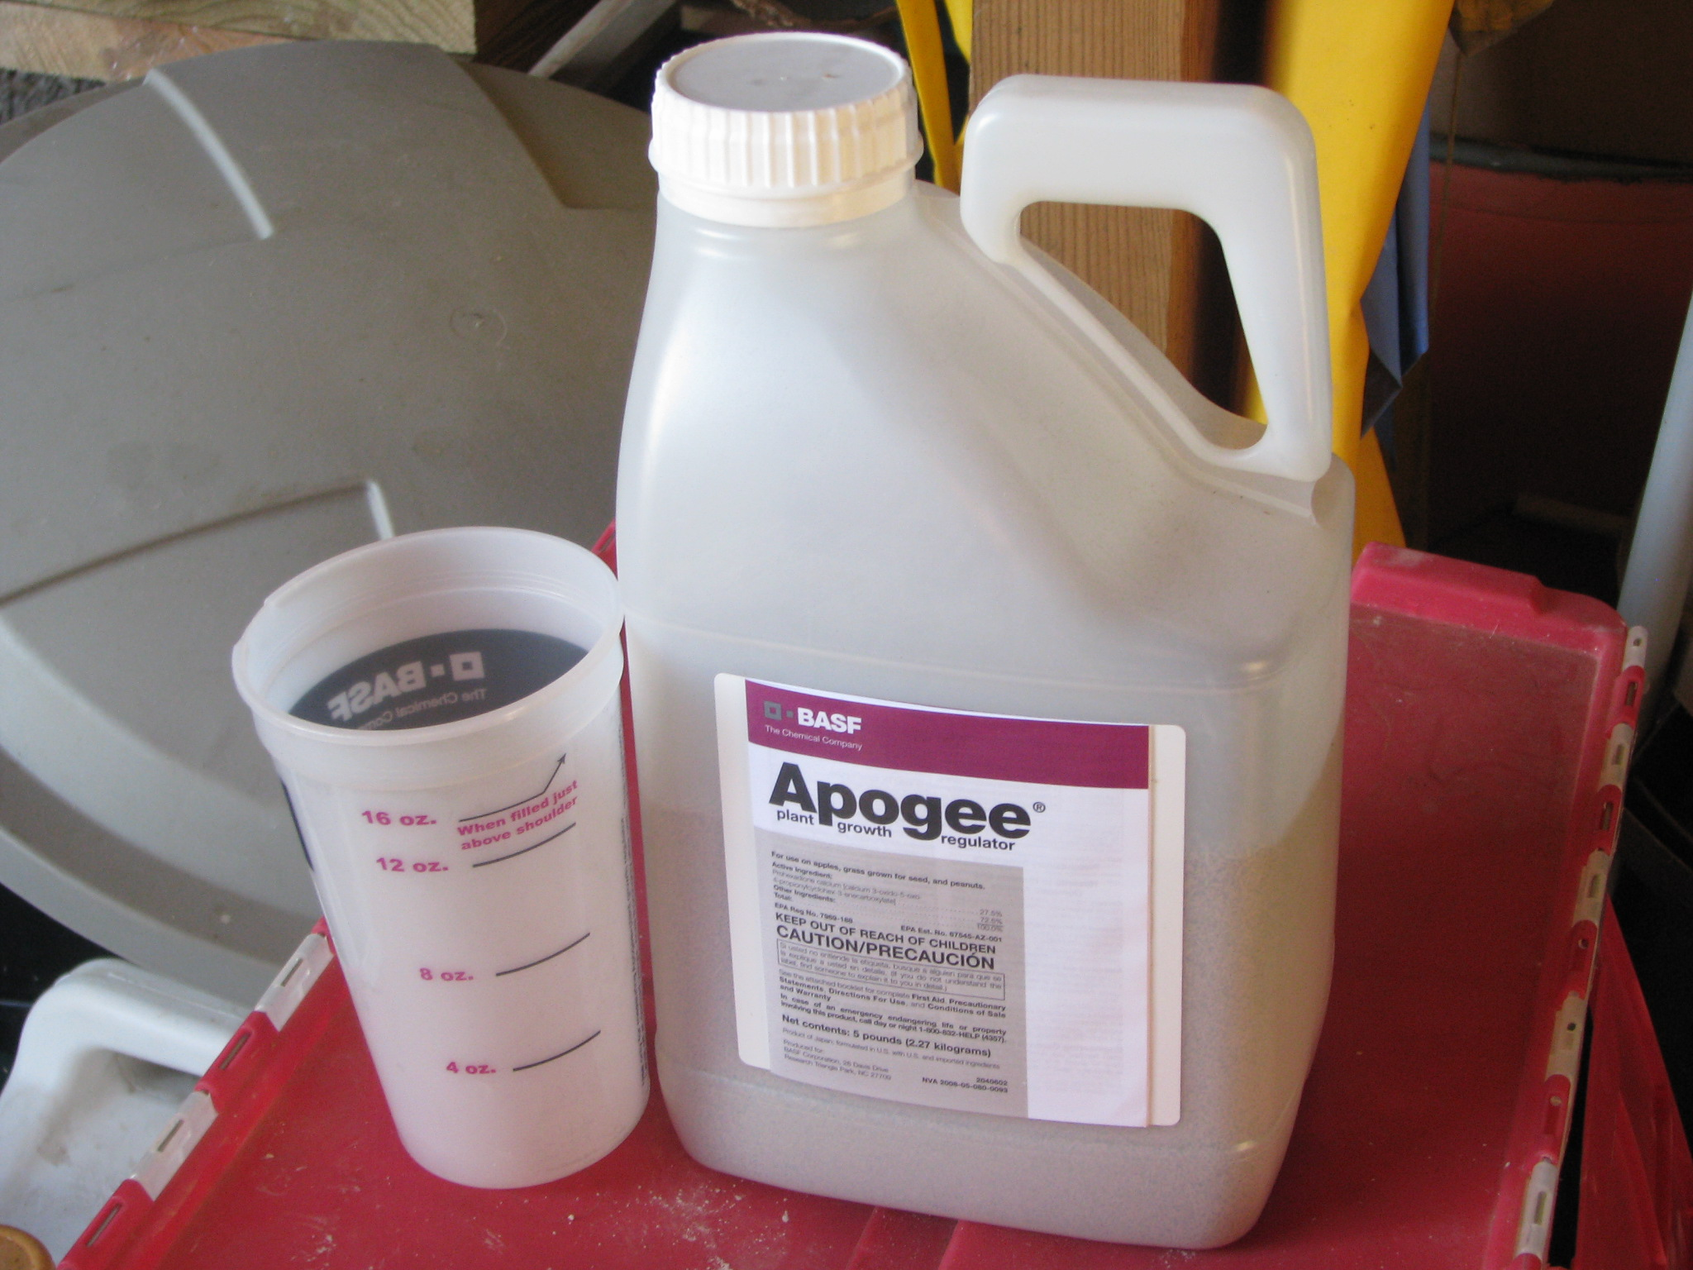
Fourth Conclusion
Use the measuring device that comes with dry materials
No endorsement intended or implied

Slide 32
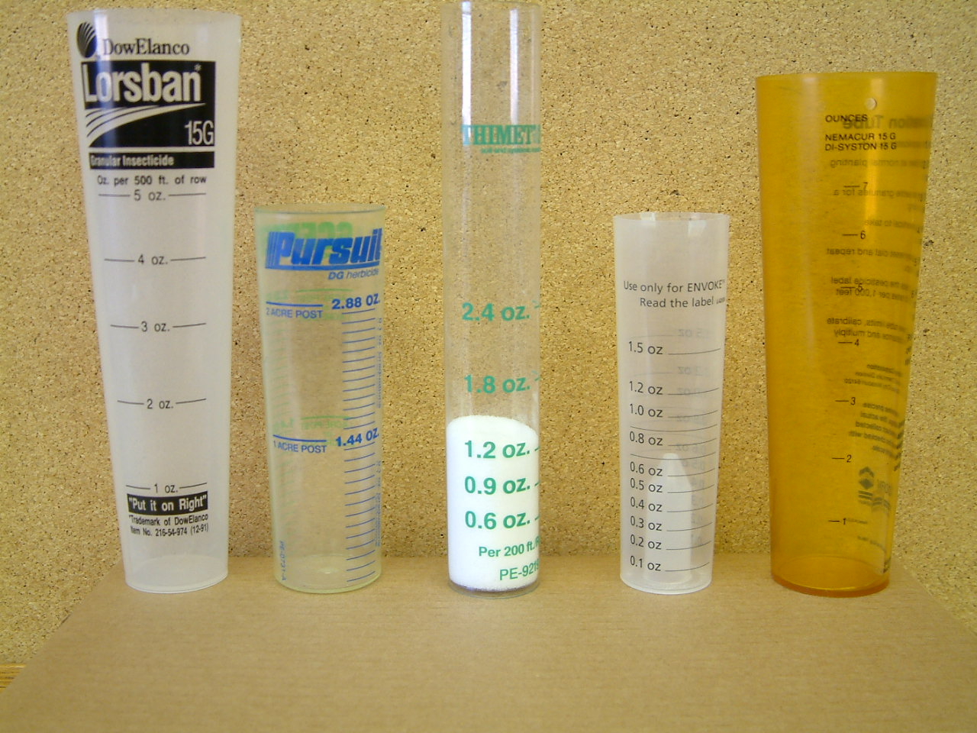
Dry Ounce
No endorsement intended or implied
Notes:
The ounce marks/lines vary because these five products are different in density (mass per unit volume).
An ounce (by weight) of a denser product takes up less space than an ounce of a product that is less dense. Think of a pound of lead vs. a pound of feathers. Both” batches” weigh a pound…but the pound of feathers will take up much more space than the pound of lead!
Like the dry formulation pellets and granules, the product density depends on the chemical nature of both the active ingredient AND the dry carrier(s) and other inert ingredients.

Slide 33
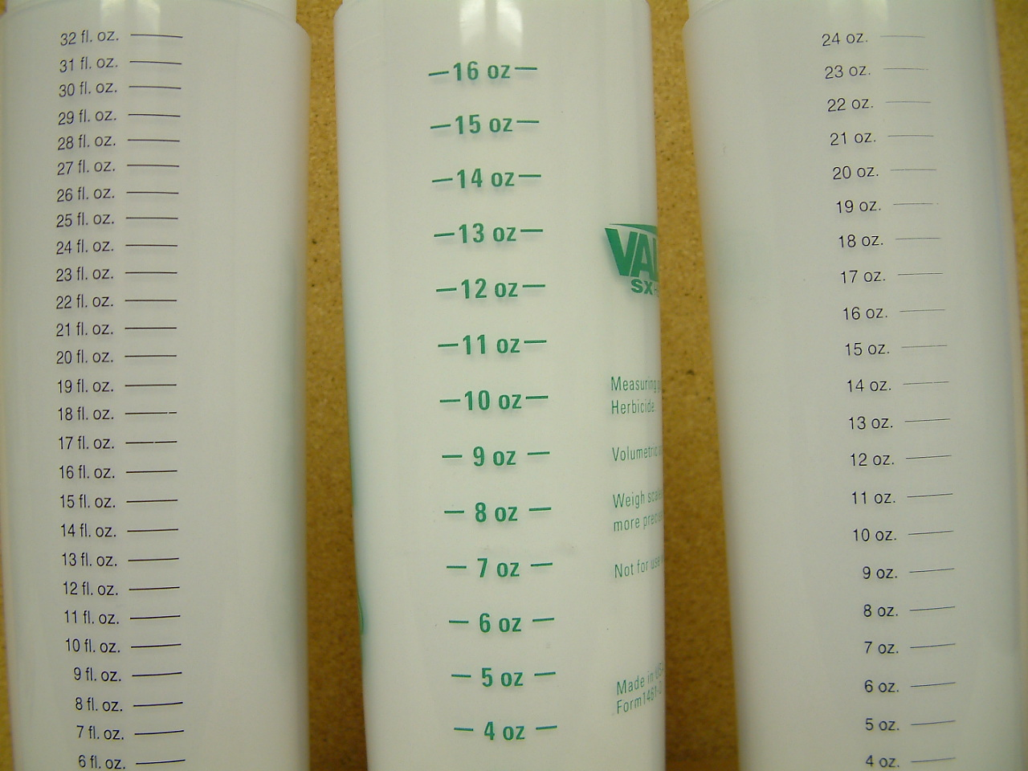
What are the consequences of using the wrong measuring tube?

Slide 34
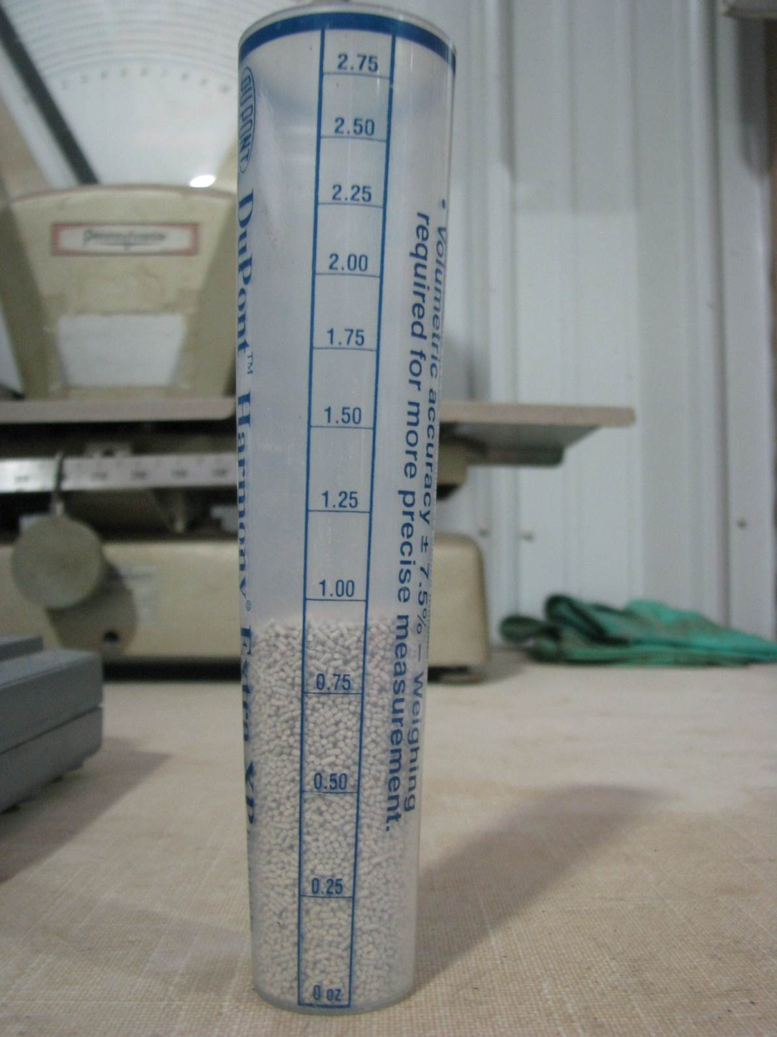
Fifth
Conclusion
Devices not very accurate. Weighing out material will get you the most accurate measurement.
No endorsement intended or implied

Slide 35
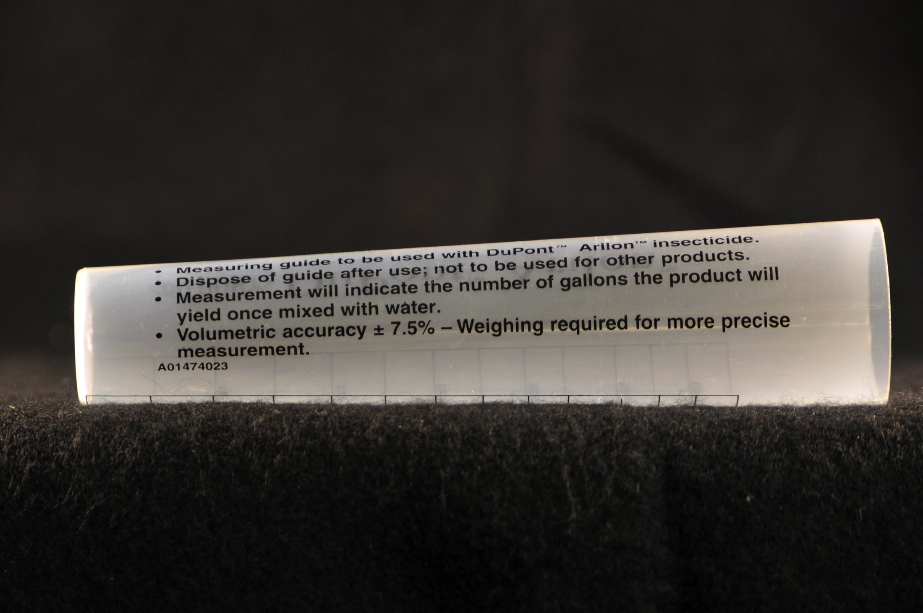
No endorsement intended or implied

Slide 36

No endorsement intended or implied

Slide 37
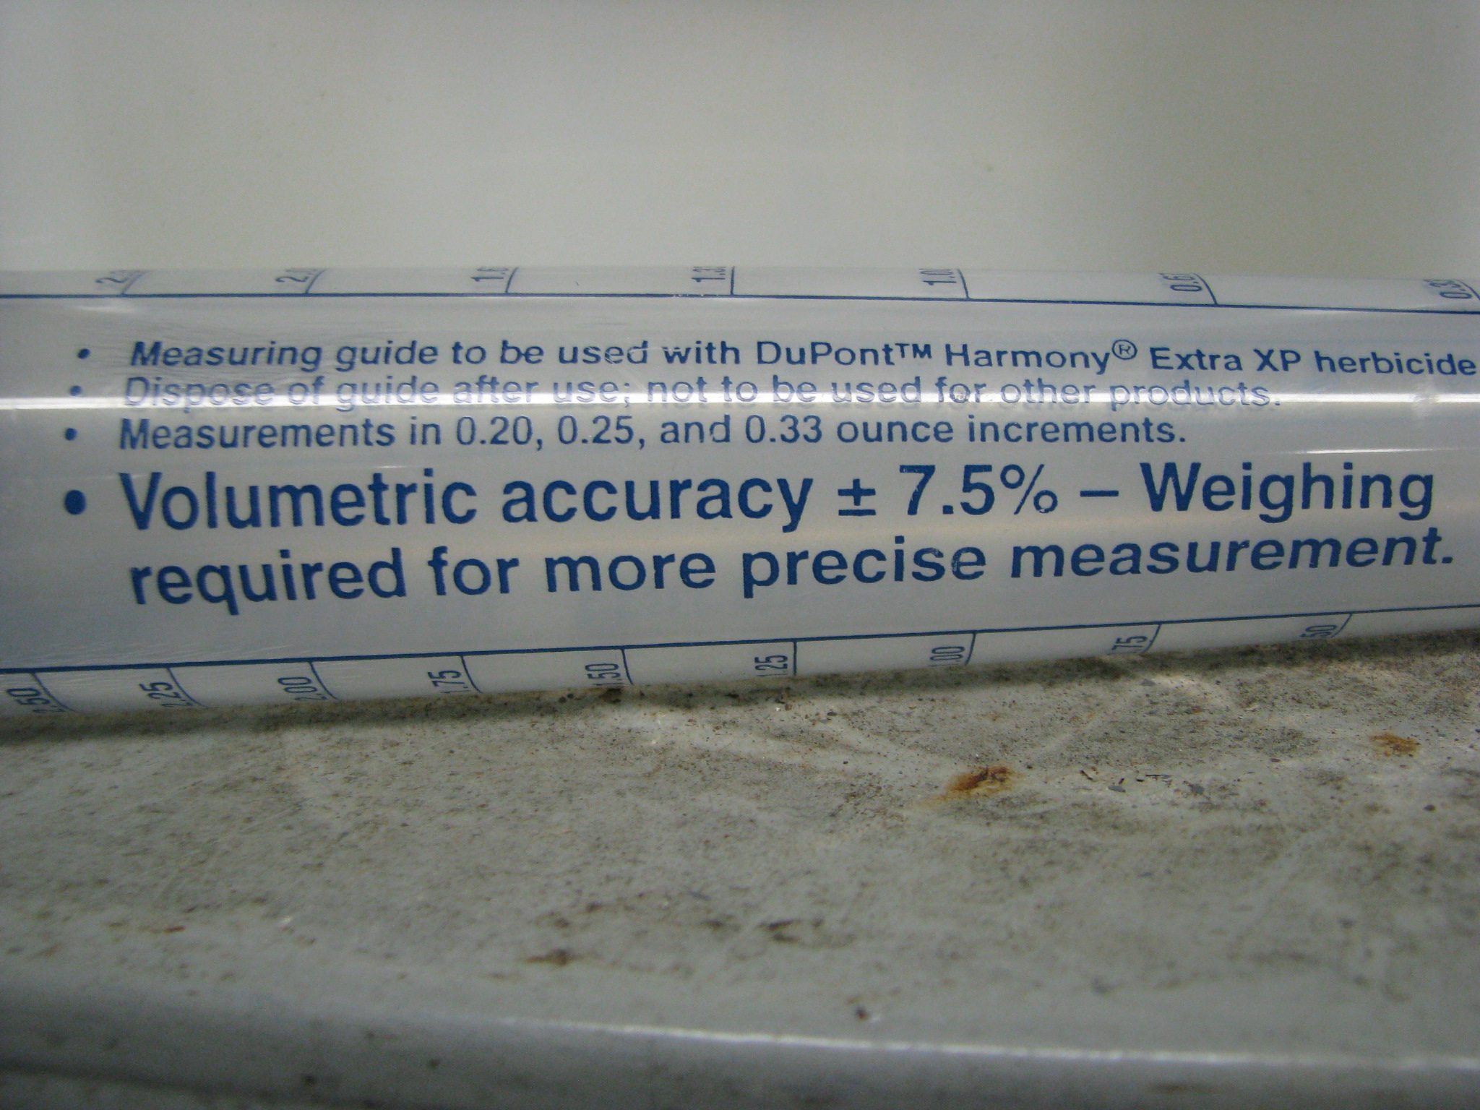
No endorsement intended or implied

Slide 38
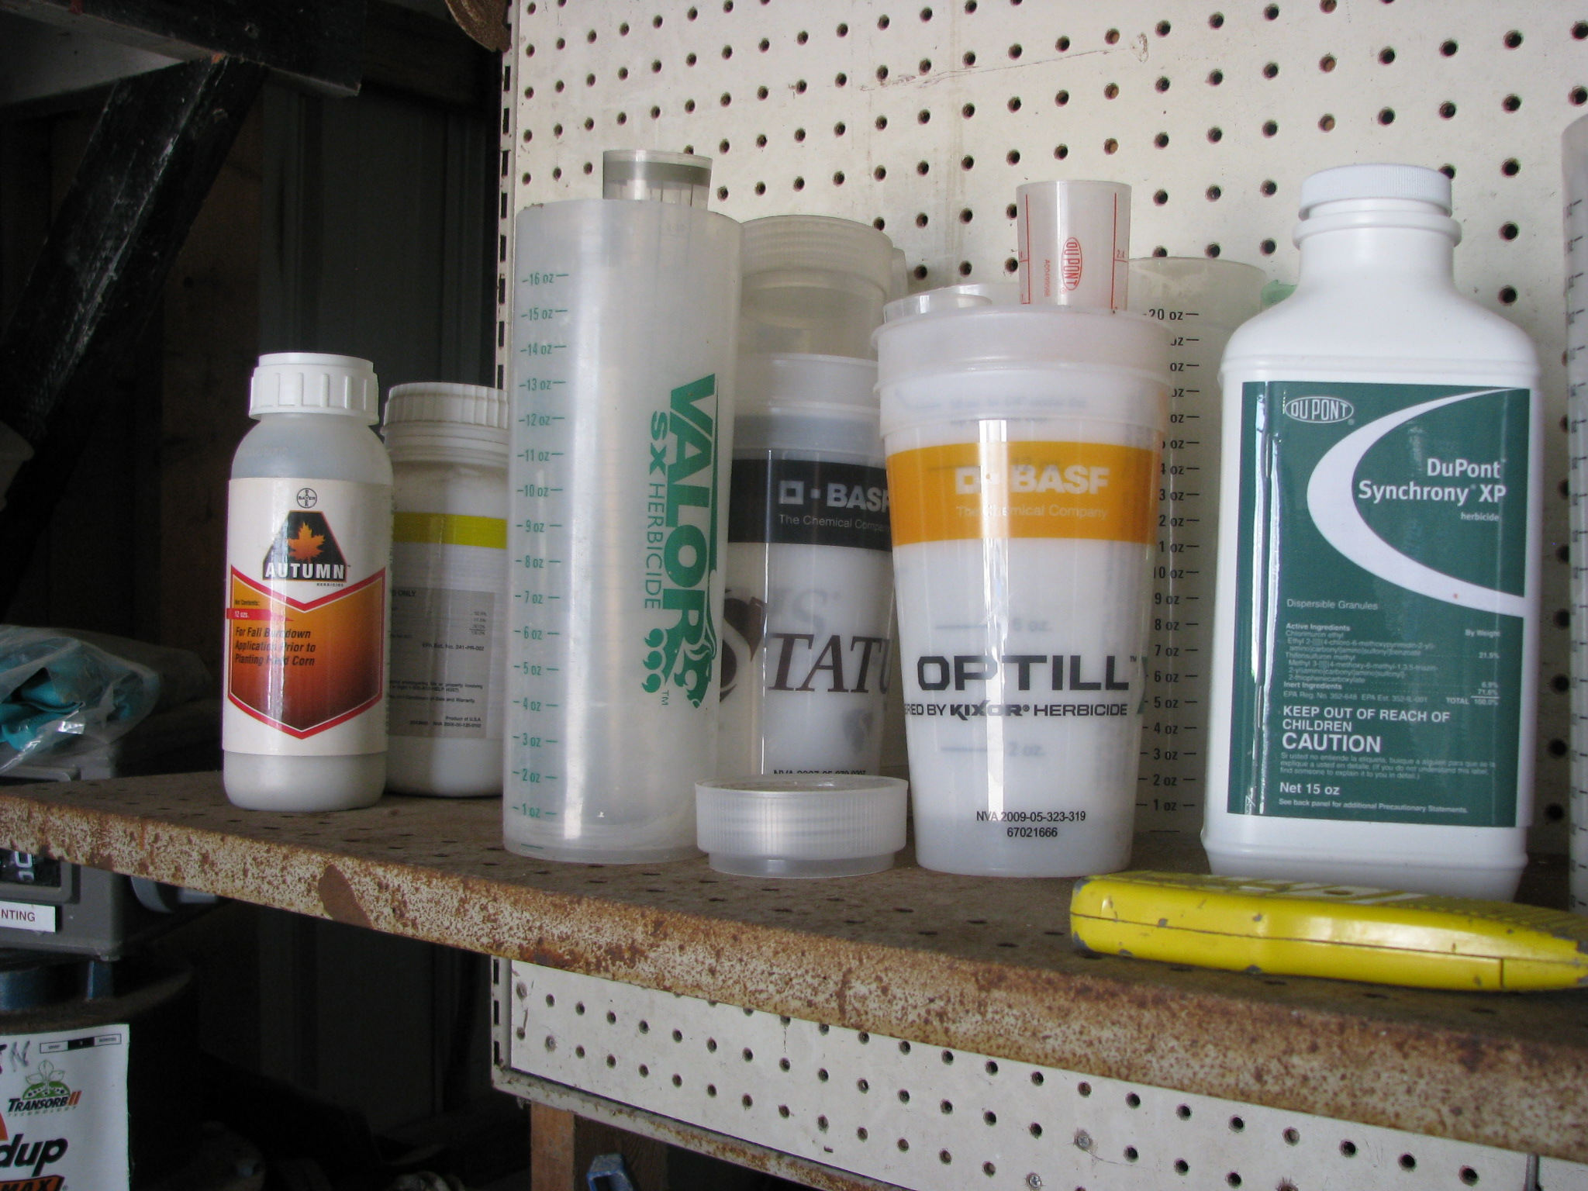
Sixth Conclusion
Throw away the measuring device after your supply has run out.
No endorsement intended or implied

Slide 39
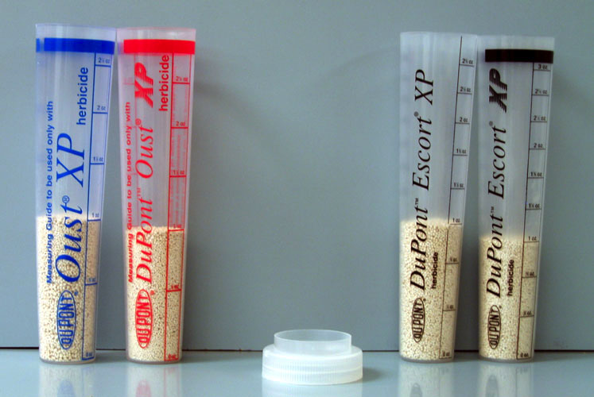
No endorsement intended or implied
Notes:
This picture illustrates that the measuring devices for different “batches” of the SAME PRODUCT are different. Each “batch” varies slightly in density (due to the carrier used). As a result, mixer-loaders MUST use the measuring device that came with the product…not an older one they saved from previous years/purchases.

Slide 40
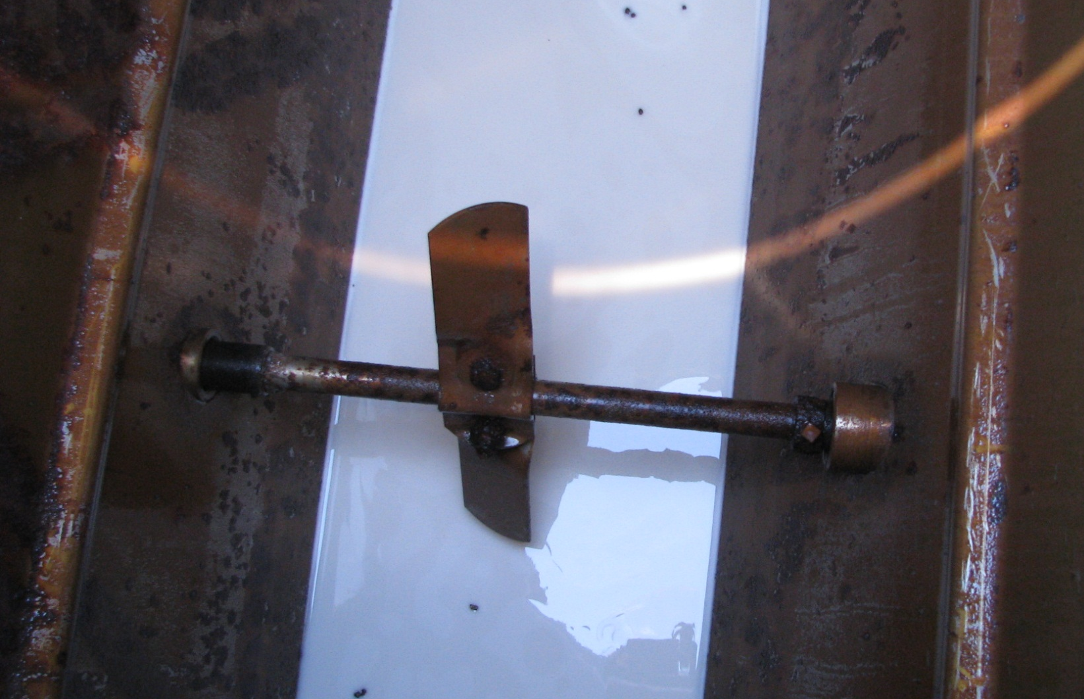
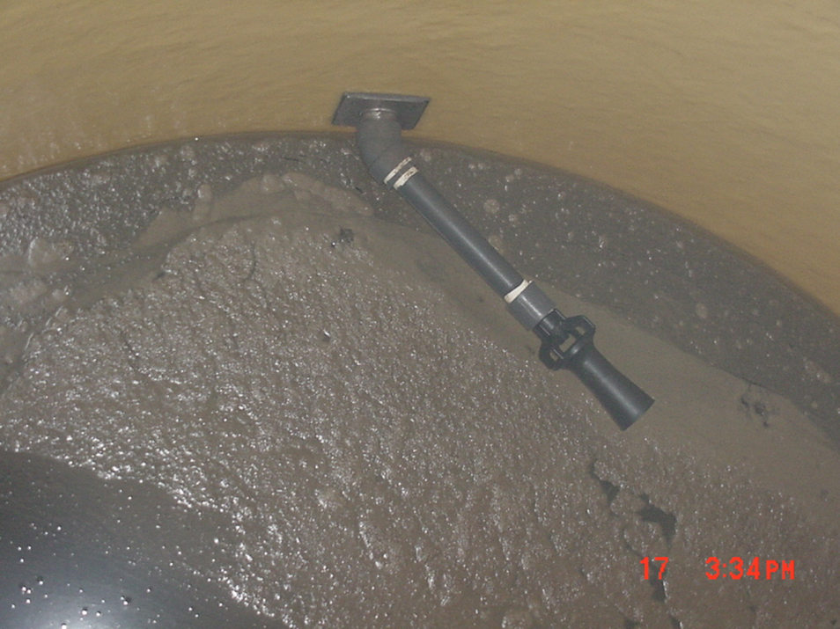

Tank Agitation
Seventh
Conclusion
Keep the dry product agitated in the spray tank
You might have to premix if water is really cold

Slide 41
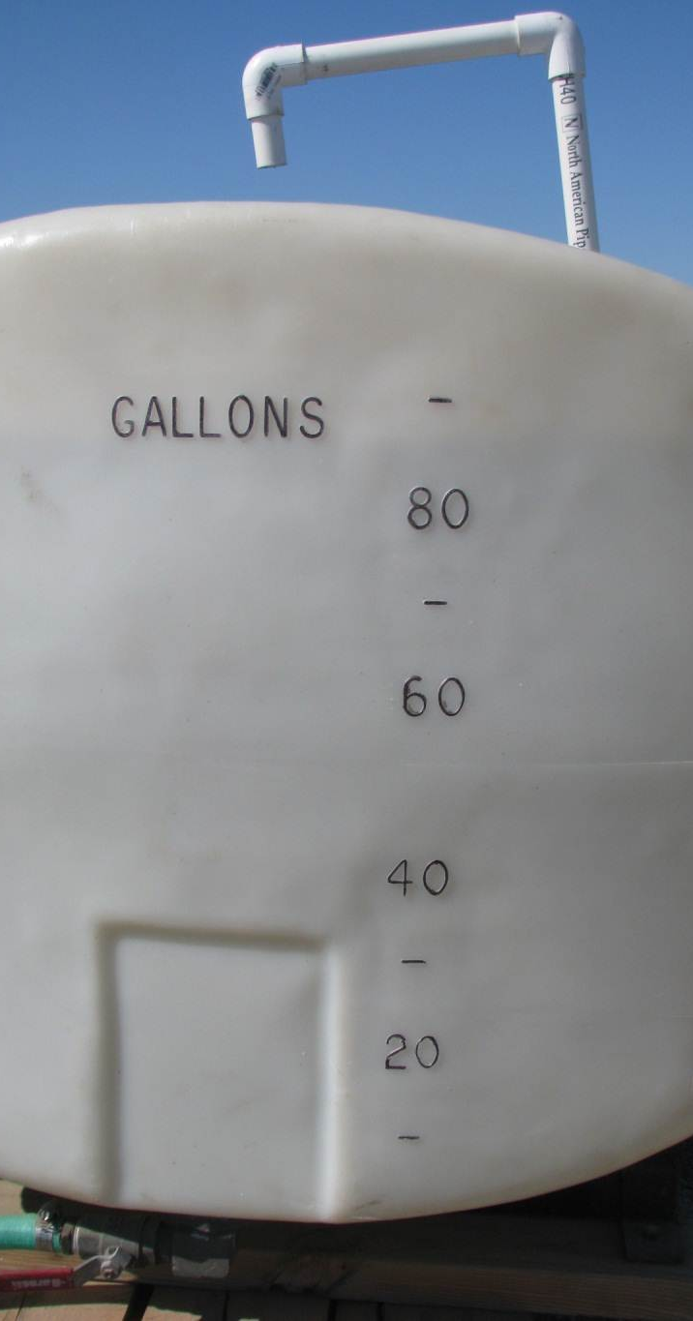
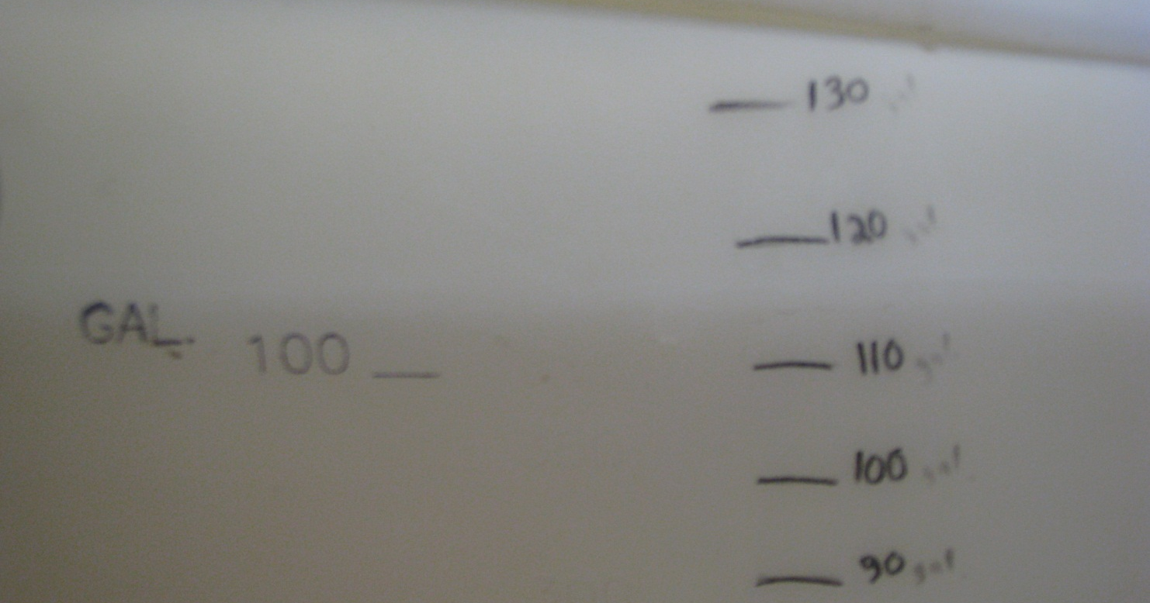
Verify Tank Measurements
Must verify tank measurements with a flow meter!

Slide 42
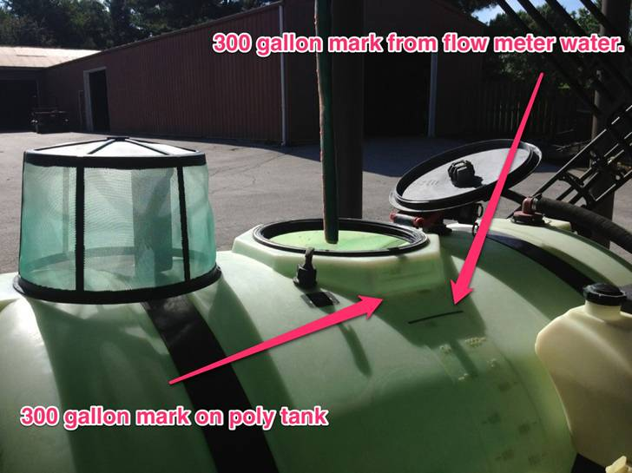

Slide 43

More precision needed for ounce measurements
Dry and liquid ounces are different
Use specific tubes made for dry products
Weigh dry products for accuracy
Summary
Accurate Measurement Starts the Chain of Events to Success or Failure

Slide 44
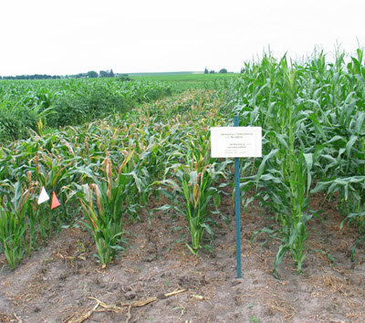
Throw away dry measuring tubes
Ask retailer for dry tube that came with product
Keep dry products well agitated
Make sure spray tank is accurately marked
Summary
A Little Inaccuracy, Perhaps a Ton of Explanation
Nicosulfuron damage on corn

Slide 45

Acknowledgements
Thanks to Fred Whitford – Purdue University and Pat Hipkins – Virginia Cooperative Extension for the slides on measuring small amounts of pesticides

Slide 46
2014 Pesticide Bills in Maine Legislature
Three pesticide bills have made it through the Legislative Council
  A 2-year moratorium on neonicotinoids
  Prohibition on methoprene and resmethrin if they will enter the Gulf of Maine
  Approval of more pesticides for Medical Marijuana producers

Slide 47
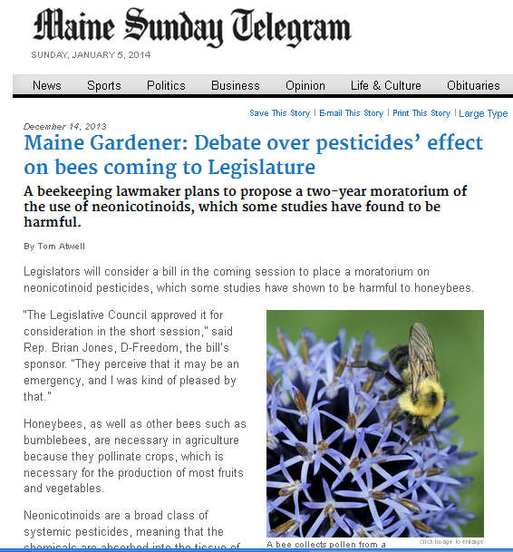
LD 1587 An Act to Temporarily Ban the Use of Neonicotinoid Pesticides
From July 15, 2014 to July 15, 2016
May not use, sell or distribute a neonicotinoid pesticide.
    Neonicitonoid pesticide means a pesticide containing the following active ingredients: (imidacloprid, clothianidin, thiamethoxam, acetamiprid, dinotefuran and thiacloprid)
    Product names include: (Actara, Admire, Aloft, Arena, Belay, Brigadier, Calypso, Couraze, Cruiser, Endigo, Meridian, Platinum, Provado, Venom, VoliamFlexi, etc.)

Slide 48
LD 1678 An Act to Protect Maine’s Lobster Fishery
The use of methoprene or resmethrin is prohibited in any body of water that drains into the Gulf of Maine or on land from which runoff could enter into any such waterway.

Slide 49
LD 1674 An Act to Further Ensure the Provision of Safe Medical Marijuana to Maine Patients
Allows additional pesticides to be used in medical marijuana cultivation, including:
  Spinosad;
  Pyrethrins;
  Neem oil;
  Potassium and sodium bicarbonate;
  DE;
  Soap;
  Dihydrogen dioxide;
  Sulfur;
  Bt, Bs and Bp;
  Streptyomyces; and
  Sesame Oil

Slide 50

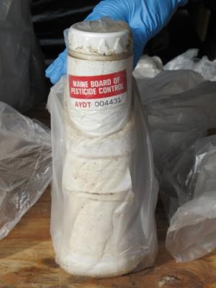
LD 1758 – Repeal of the container deposit law and rules
The Legislature and Board repealed the requirements for deposits on limited and restricted use pesticide containers
The Legislature added a new clause that requires dealers to continue refunding outstanding deposits paid when growers return containers with Board issued stickers until 12/31/2017

Slide 51
Top Violations Cited by BPC in Consent Agreements or Warning Letters 2012
Violation | # Of Occurrences
Applicator Records | 20
Unlicensed commercial applicator | 11
Personal Protective Equipment (PPE) | 10
Drift | 5
Treating wrong property | 4
Worker Protection Standard (WPS) | 4
Notification violation | 3
Posting | 3
Use Inconsistent with pesticide label | 3
Application rate | 2
Fraud | 2
School IPM | 2
Storage | 2
Top 71 of 82 total violations

Slide 52
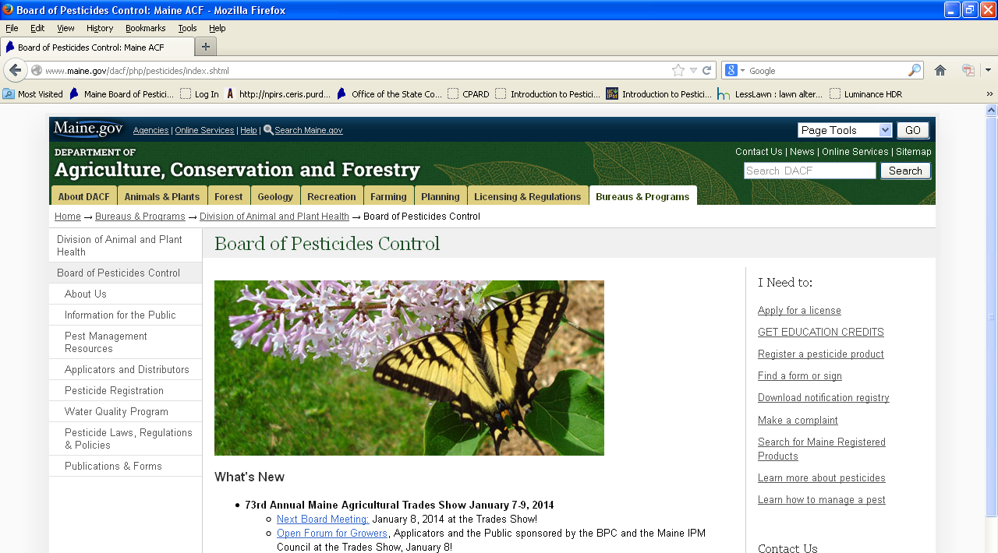
Must only use products registered in Maine
It is quick and easy to check online to see if a product is registered

Slide 53
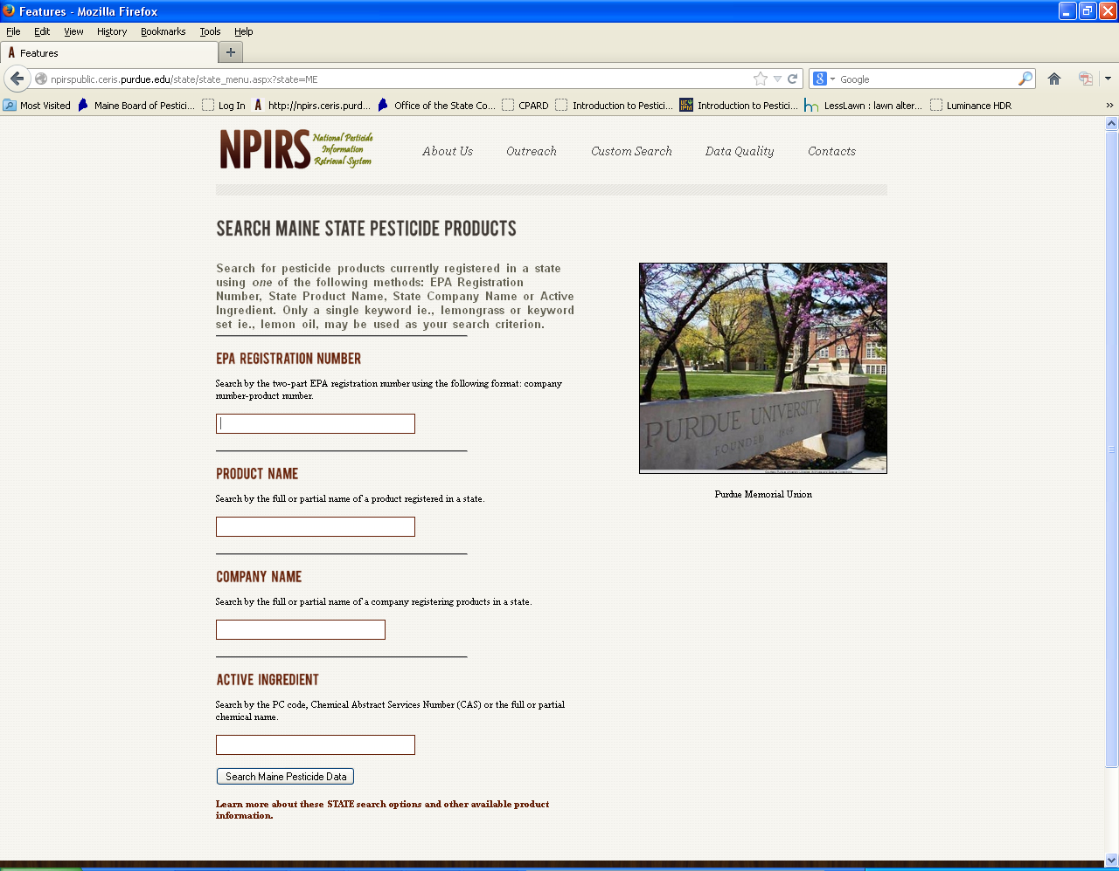

Slide 54


Slide 55
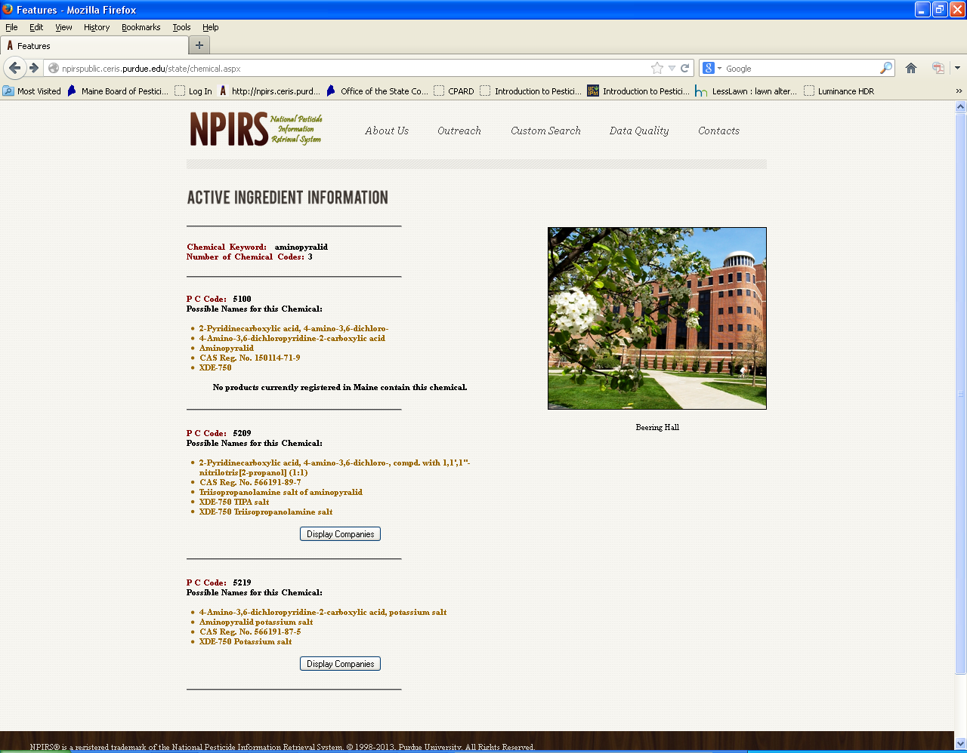

Slide 56
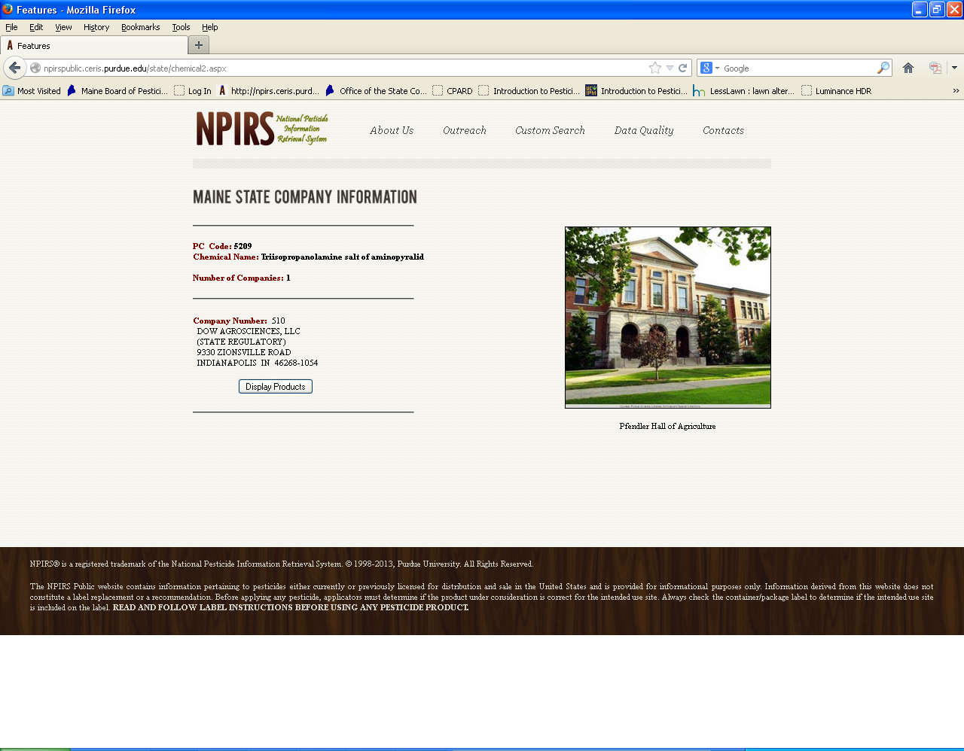

Slide 57
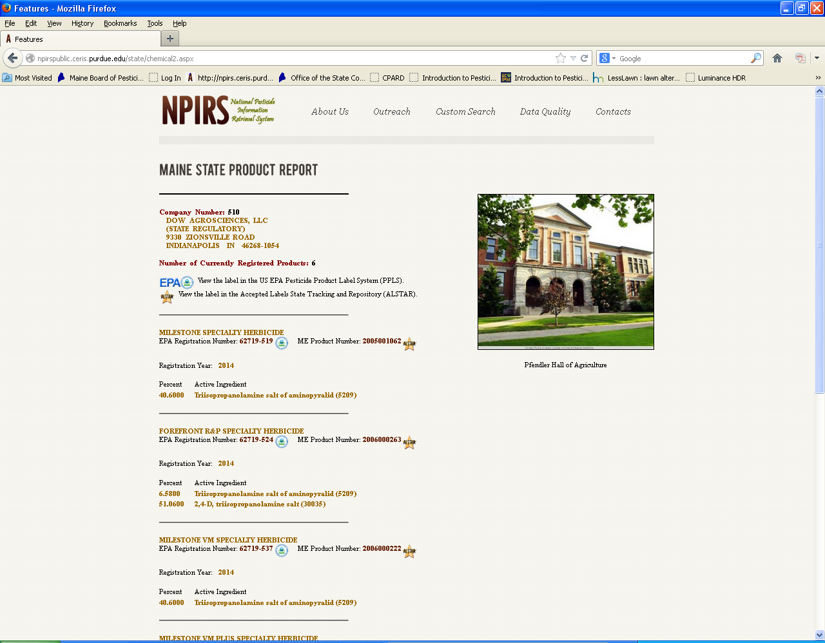

Slide 58
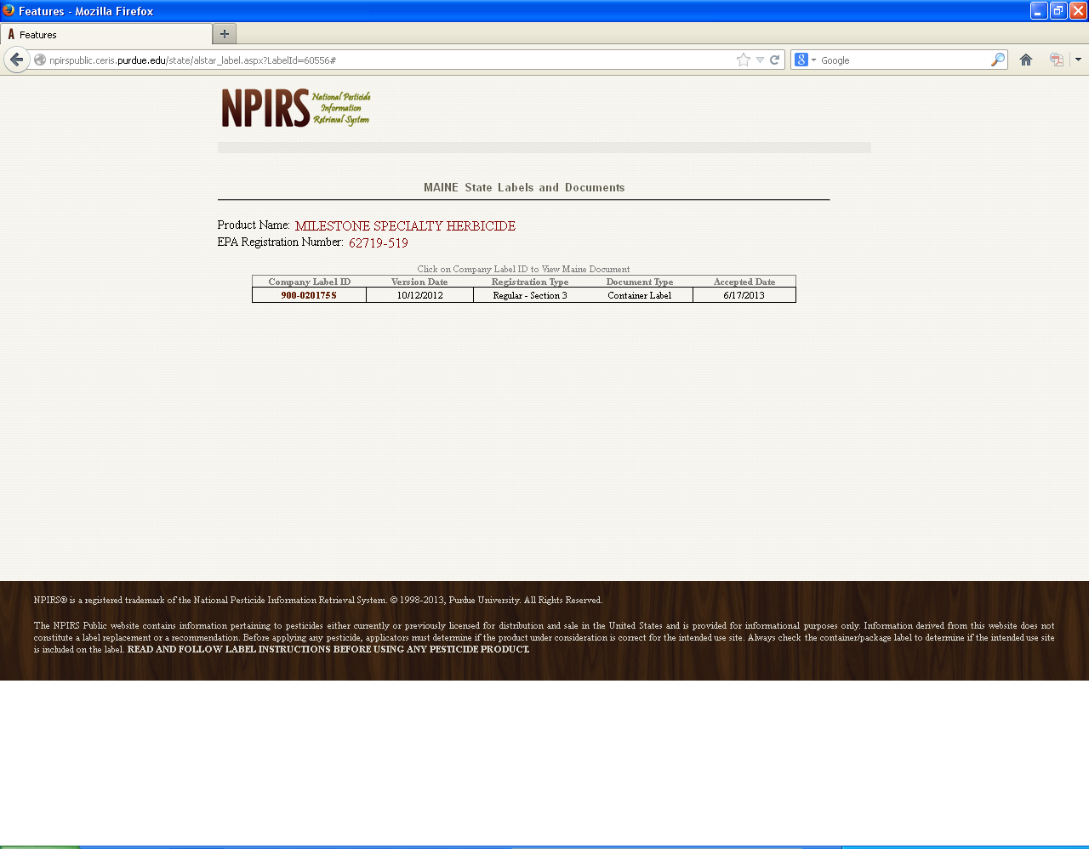

Slide 59
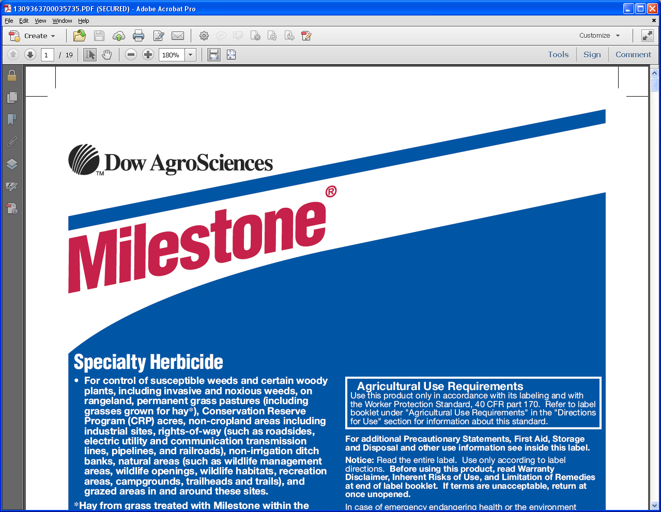

Slide 60
Online recertification opportunities
There are over 80 online programs approved
You can access them from the BPC website
http://www.maine.gov/dacf/php/pesticides/index.shtml

Slide 61
BPC phasing out snail mail delivery
Help us cut costs and
Help us get training information to you faster
Please provide us with your current email and update our records whenever your email address changes

Slide 62
That’s All Folks
Questions

