Slide 1
Pesticide Choice for Schools
Gary Fish
Maine Board of Pesticides Control
287-7545
gary.fish@maine.gov

Slide 2

Where do you start?
Read the labels
  The label must list the “site” to be treated
  Should also list the pest to be controlled, e.g., weed, insect, fungus, rodent, germ, etc.
Once you determine the above, then you can look at other product characteristics.

Slide 3
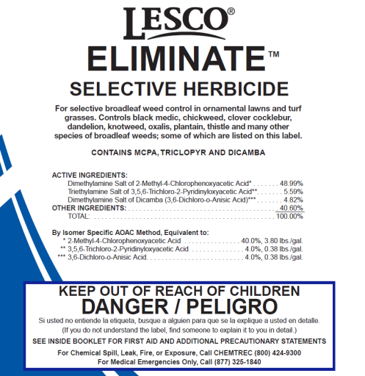
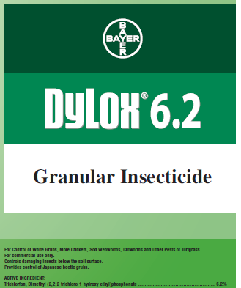
What chemical characteristics are important?
Toxicity – To humans (children especially), pets, bees and other pollinators, wildlife, plants
  Acute and chronic
Formulation – granular, spray or bait
  Drift potential
  Volatility
  Odors
  Equipment used to apply
    Injected in crack
    Sprayed
    Incorporated into soil
    Watered into the soil
No endorsement intended or implied

Slide 4
Reduce exposure by using targeted materials
Enclosed baits & gels
Spot treatments
Broadcast treatments
Best
Worst

Slide 5
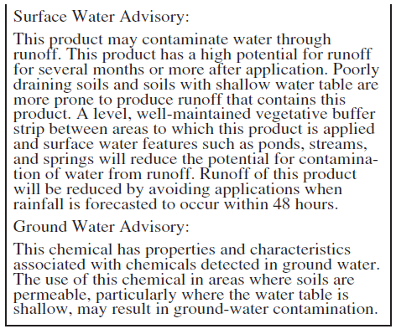
Environmental Fate
Will it runoff?
Is it leachable?
Is it volatile?
Will it leave a residue on the surface?
No endorsement intended or implied

Slide 6
Which characteristics do you think are most important?
Toxicity
Persistence
Formulation
Cost
Efficacy
Risk/Hazard
Residues
Environmental Fate

Slide 7
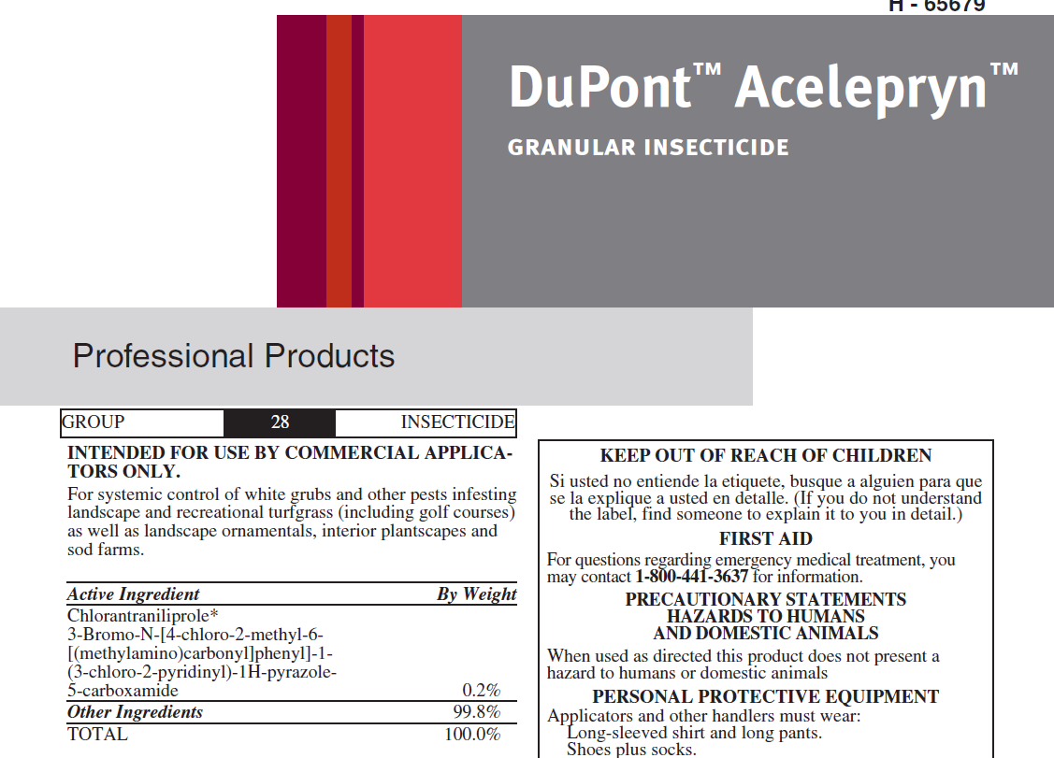
Where can you find this information?
Pesticide label
  Signal word (Caution, Warning or Danger)
  Precautionary statements
  PPE requirements
  Re-entry statements
  Environmental hazards
  Application restrictions
  Mode of action
No endorsement intended or implied

Slide 8
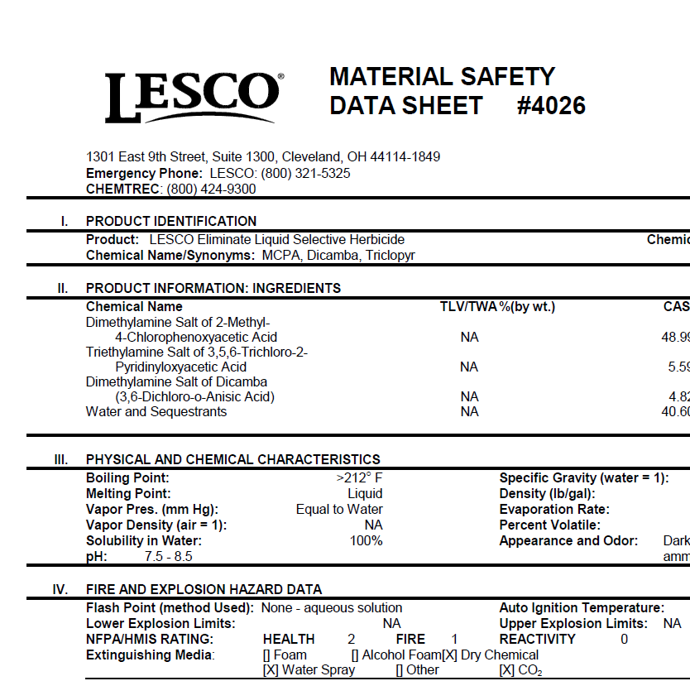
Where can you find this information?
MSDS or SDS
  Flammability
  Reactivity
  PPE
  Long term health effects
    Carcinogen
    Teratogen
    Mutagen
    Reproductive effects
  Vapor pressure
No endorsement intended or implied

Slide 9
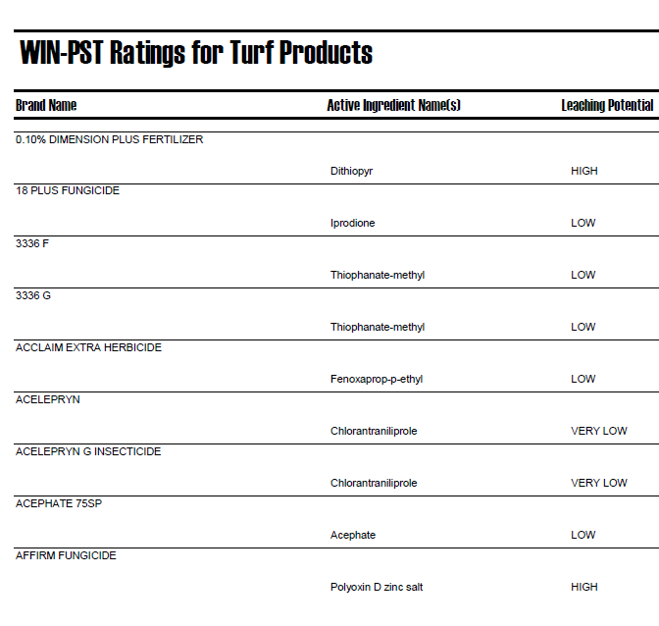
Where can you find this information?
Windows Pesticide Screening Tool WIN-PST
  Relative leaching potential
  Relative surface loss potential
  Potential loss attached to eroded soil
  Relative risk to humans in drinking water
  Relative risk to aquatic organisms in water or sediments
No endorsement intended or implied

Slide 10
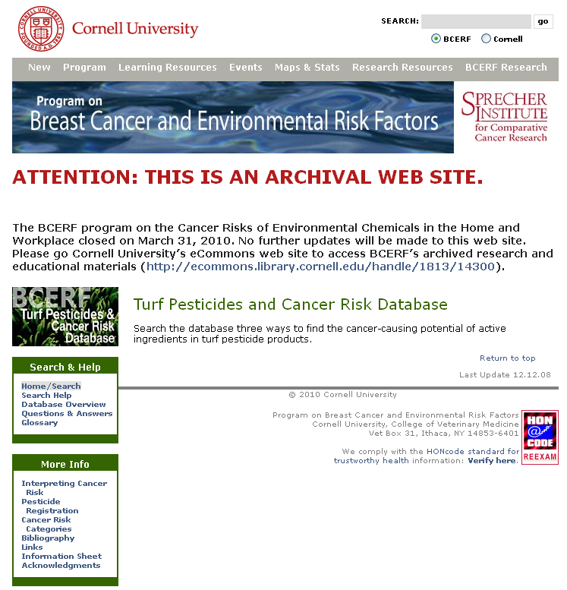
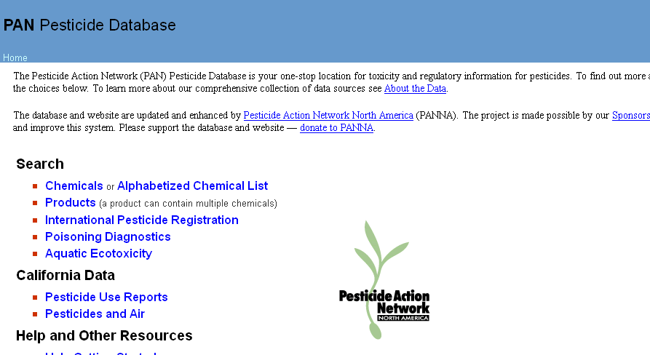
Where can you find this information?
Turf Pesticide & Cancer Risk Database - Cornell University
Pesticide Action Network Database - PANNA
No endorsement intended or implied

Slide 11
Which product is least hazardous to humans?
Acelepryn
Dylox
Eliminate
No endorsement intended or implied

Slide 12
Which product is more likely to leave a residue that poses some risk to students?
Acelepryn
Dylox
Eliminate
No endorsement intended or implied

Slide 13
Which product has the lowest drinking water risk?
Acelepryn
Dylox
Eliminate
No endorsement intended or implied

Slide 14
Which product has the greatest risk to aquatic life if it gets into a stream?
Acelepryn
Dylox
Eliminate
No endorsement intended or implied

Slide 15
Which product is more likely to give off vapors?
Acelepryn
Dylox
Eliminate
No endorsement intended or implied

Slide 16
Which product would you choose if you identified European chafer grubs in an athletic field at 10/sq. ft. in late July?
Acelepryn
Dylox
Eliminate
No endorsement intended or implied

Slide 17
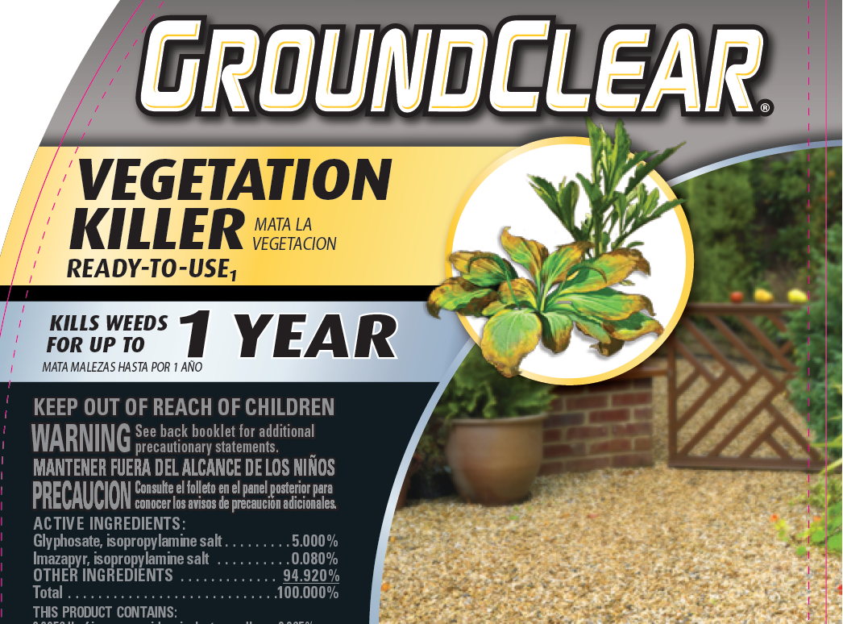
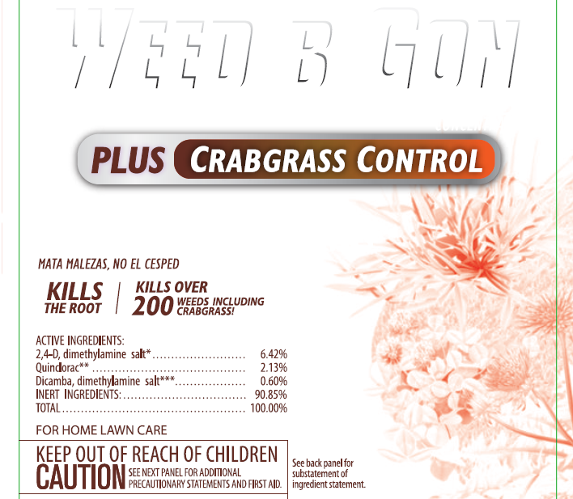
What about persistence?

Slide 18
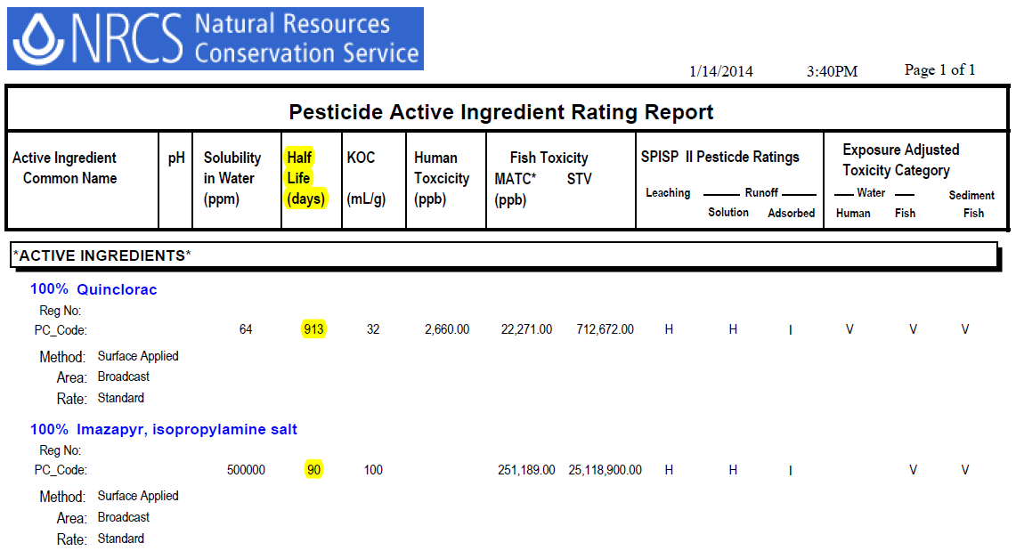
WIN-PST shows half-life in days

Slide 19
Where can you go for product efficacy and pest management information?
School IPM website
Got Pests website
University of Maine Pest Management
YardScaping website
U-Mass Turf Program
U-Mass Landscape & Nursery Program
The label
Research articles in journals
Pesticide dealer
Pesticide manufacturer

Slide 20
Which product is least likely to leach into groundwater?
Acelepryn
Dylox
Eliminate
No endorsement intended or implied

