Slide 1

Electronic Filing
and
Forms Overview
For Use With Forms Filing Mini Manual
Office of Monitoring, Audit and Enforcement
Aug 2023

Slide 2

Abbreviations
AWW - Average Weekly Wage
EDI - Electronic Data Interchange
FROI - First Report of Injury (WCB-1)
SROI – Subsequent Report of Injury
MOP - Memorandum of Payment (WCB-3)
NOC - Notice of Controversy (WCB-9)
RTW - Return to Work
SOC – Statement of Compensation Paid (WCB-11)
WCR – Weekly Compensation Rate
Office of Monitoring, Audit and Enforcement

Slide 3
Form Filing
Fillable forms are available on the MWCB website – www.maine.gov/wcb/
All MWCB forms have a four-part distribution as follows:
  COPY 1) Maine Workers Compensation Board
  COPY 2) Employee
  COPY 3) Insurer
  COPY 4) Employer
If COPY 1 is now submitted electronically to the MWCB, all other copies must still be sent to the respective recipients and must be materially the same as the form sent via EDI. (PDF filed to print and mail are being sent with the AKC)
All forms and correspondence, including, but not limited to petitions, shall be filled in the Central Office of the MWCB
Office of Monitoring, Audit and Enforcement

Slide 4
4-Part Distribution
Q: Must changes and corrections to forms be distributed to all parties?
A: Yes (for any significant change). If the amended form is going to become the operative document, all interested parties should have the same copy.
Office of Monitoring, Audit and Enforcement

Slide 5
Form Filing (Paper Forms)
Mail: Maine WC Board
      Claims Management Unit
      27 State House Station
      Augusta, ME 04333-0027
Fax: (207)287-5895
Email: forms.wcb@maine.gov
Office of Monitoring, Audit and Enforcement

Slide 6
Electronic Form Filing
Electronic filing requirements are available at the MWCB website – www.maine.gov/wcb/departments/technology/
Claim Administrators must use the IAIABC “Release 3” format. (See “EDI News” regarding Release 3.1)
It is critical that employers/insurers and their respective EDI vendors understand the MWCB’s EDI requirements
To avoid violations/penalties, employers/insurers must maintain routine communication with their respective EDI vendors to ensure that any FROIs or NOCs rejected by the MWCB are addressed in a timely manner
Office of Monitoring, Audit and Enforcement

Slide 7
Electronic Form Filing
A sender will receive one of the following codes after submitting an EDI transaction:
  TA = (Transaction Accepted). Transaction accepted and the First Report of Injury or Subsequent Report of Injury is filed.
  TE = (Transaction accepted with Errors). Errors will be identified in the acknowledgement transmission sent by the MWCB. All identified errors must be corrected within 14 days after the acknowledgement transmission was sent, or prior to any subsequent transmission for the same claim, which ever is sooner.
  TR = (Transaction Rejected) The entire transaction has been rejected and the First Report of Injury or Subsequent Report of Injury is not filed.
Office of Monitoring, Audit and Enforcement

Slide 8
Electronic Form Filing
EDI transactions are processed 3 times a day:
  6:00 am
  10:00 am
  2:00 pm
An acknowledgement report (AKC) is returned within about a half hour after the transmission is processed
If the transmission is accepted (TA or TE), the “Received at Board” date is the date the transaction was transmitted
If the transaction is rejected (TR), it must be re-submitted – it is not “Received at Board” until the transmission date of an accepted transaction
Office of Monitoring, Audit and Enforcement

Slide 9
WCB-1
Mini Manual Pages 4-5
Office of Monitoring, Audit and Enforcement

Slide 10
FROI
Injury or Disease (WCB-1)
Types of FROI transmissions:
  00 = (Original) Used to file an original FROI
  01 = (Cancel) Used to cancel an original FROI that was sent in error
  CO = (Correction) Used to correct a data element or elements when a filing is accepted with errors (“TE”)
  02 = (Update/Change) Used to update/change one or more data elements
  04 = Original FROI and Full Denial
  UR = (Upon request) Submitted in response to a request from the MWCB
  AQ = (Acquired Claim) Used to report that a new claim administrator has acquired the claim
Office of Monitoring, Audit and Enforcement

Slide 11
Wage Statement (WCB-2)
Mini Manual Pages 6-7
Office of Monitoring, Audit and Enforcement

Slide 12
Wage Statements
“The wage statement must report the earnings or wages of the employee on a weekly basis, except that if the employee is paid on other than a weekly basis, the employer may report the earnings or wages on that basis.” (§303)
Need actual weekly earnings for week of injury, and week of hire (if within the 52 weeks)
Need to indicate any weeks with NO earnings
Rules in process for monthly, semi-monthly
Office of Monitoring, Audit and Enforcement

Slide 13
Fringe Benefits Worksheet (WCB-2B)
Mini Manual Pages 10-11
Office of Monitoring, Audit and Enforcement

Slide 14
WCB-2, -2A and -2B Recap
Wage Statements (WCB-2) and Fringe Benefit Worksheets (WCB-2B) must be filed for all claims where lost time exceeds seven days (waiting period).
These same forms must be filed for all controverted lost time claims.
The Schedule of Dependents and Filing Status Statement (WCB-2A) is not required for dates of injury on or after January 1, 2013.
Office of Monitoring, Audit and Enforcement

Slide 15
Establishing the Weekly Compensation Rate (WCR)
Once the Average Weekly Wage (AWW) is determined, the next step is to determine the Weekly Compensation rate (WCR).
For injuries on or after 1/1/2013, it is calculated as two-thirds of the employee’s gross AWW.
For injuries prior to 1/1/2013, it was 80% of the employee’s after-tax amount.
Office of Monitoring, Audit and Enforcement

Slide 16
Weekly Benefit Calculation for Injuries on or After January 1, 2013
The Weekly Compensation Rate (WCR) shall be equal to 2/3 of the employee’s gross Average Weekly Wage (AWW), but not more than the maximum benefit level.
Calculate the WCR by dividing the AWW by three and multiplying by two. Using a decimal (AWW x .667 for example) may result in errors.
Office of Monitoring, Audit and Enforcement

Slide 17
Maximum Benefit Levels
For dates of injury on or after 1/1/2013 - 100% of the state average weekly wage as adjusted annually on July 1 (90% for injuries prior to 1/1/2013).
Adjustment must be made on July 1 and a WCB-4 Modification filed. Failure to adjust may result in penalties.
If new adjusted maximum rate exceeds employee’s own rate, use employee’s own rate.
Office of Monitoring, Audit and Enforcement

Slide 18
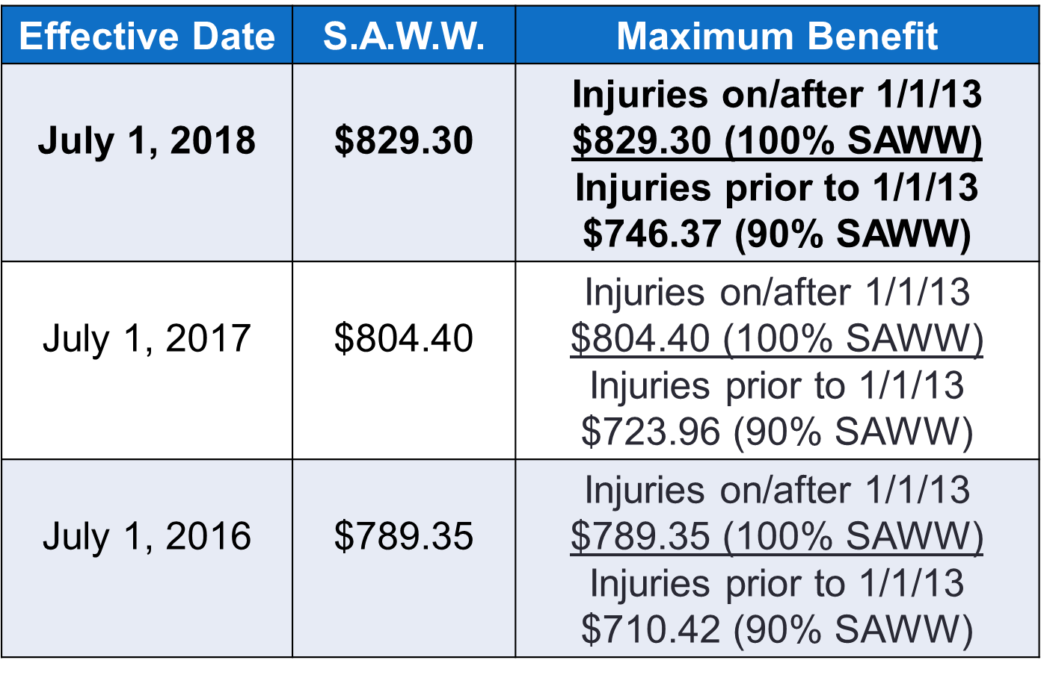
Maximum Benefit Levels
Office of Monitoring, Audit and Enforcement

Slide 19
Memorandum of Payment (WCB-3)
Mini Manual Pages 12-13
Office of Monitoring, Audit and Enforcement

Slide 20
Discontinuance or Modification of Compensation (WCB-4)
Mini Manual Pages 14-15
Office of Monitoring, Audit and Enforcement

Slide 21
Consent Between Employer & Employee (WCB-4A)
Mini Manual Pages 16-17
Office of Monitoring, Audit and Enforcement

Slide 22
21-Day Certificate of Discontinuance or Reduction (WCB-8)
Mini Manual Pages 18-19
Office of Monitoring, Audit and Enforcement

Slide 23
WCB-8 – Certified Mailing Reminder
Claim administrators should have this sender’s receipt postmarked to prove when they sent the WCB-8.
Electronic verification of certified mailing from the USPS is also acceptable.
Office of Monitoring, Audit and Enforcement

Slide 24
Notice of Controversy (WCB-9)
Mini Manual Pages 20-21
Office of Monitoring, Audit and Enforcement

Slide 25
Notice of Controversy (Denial)(WCB-9)
A NOC must be filed:
  To dispute indemnity.
      Due Within 14 days of notice or knowledge of a claim for incapacity or death benefits (Rules Ch 1 section 1).
  To dispute medical bill(s) and/or treatment (including requests from the employee).
      NOC must be filed within 30 days of “notice or knowledge of the claim for medical benefits.” (Rules Chapter 5 section 107.5).
  To dispute jurisdiction.
  To dispute coverage.
  To dispute for any other reason as described in the Full or Partial Denial Codes.
Office of Monitoring, Audit and Enforcement

Slide 26
Statement of Compensation Paid (WCB-11)
Mini Manual Pages 22-23
Office of Monitoring, Audit and Enforcement

Slide 27

Questions?
Office of Monitoring, Audit and Enforcement

