Slide 1
High Quality Assessments in Performance Evaluation and Professional Growth (PEPG) Systems

Slide 2
Outcomes
Prepare to identify appropriate and available assessments for use in the Student Learning Objective (SLO) process
Understand the broad context for using student learning and growth as a measure of effectiveness
Understand where assessments fit in the context of the SLO
Understand the meaning of student 'growth' in a PEPG system
Understand the basic elements of a growth measure in a PEPG system
Review the guidelines for appropriate content standards
Review the requirements and guidelines for selection of assessments

Slide 3
General Requirements and Concepts

Slide 4
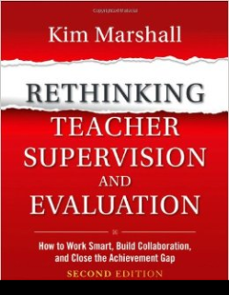
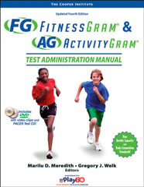
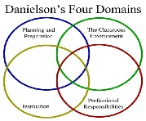
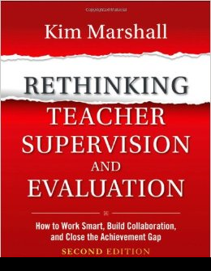
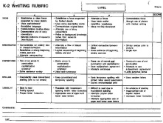
Required Measures of Educator Effectiveness
Professional Practice
Student Learning and Growth
A district may choose to include other measures of effectiveness , such as professional growth or surveys.
Multiple Measures

Slide 5
The Context of the SLO

Slide 6
The SLO Process
The SLO is a locally designed document framework that always includes
Demographic information on students and teacher(s) of record
Identification of content standards (knowledge and skills) that will be addressed
Identification of students' needs or readiness to meet the standards, based on available data
Selection of an appropriate pre- and post-assessments
Baseline performance on the pre-assessment
Post-assessment results (amount of growth achieved)

Slide 7
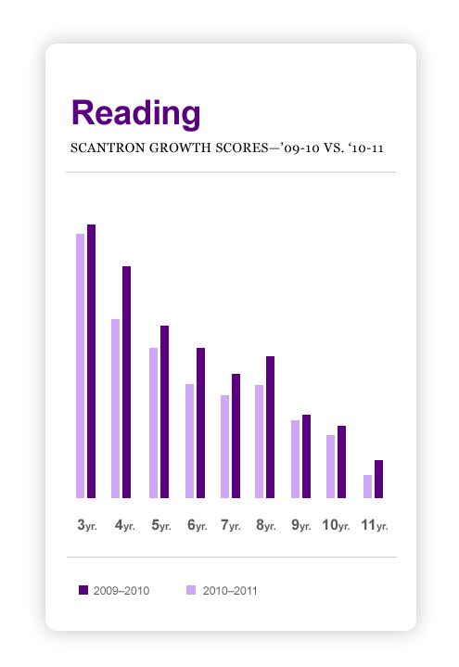
Defining 'Student Learning and Growth'
As a factor in the summative effectiveness rating of a teacher or principal, 'Student Learning and Growth' is based on data that measures a change in an *instructional cohort's content knowledge and skills between two points of time during which the educator has influence.
*The student or group of students whose
academic growth will be attributed to a
teacher or principal.

Slide 8
Growth Measure: The Basics
Growth Measure
Based on Content Standards
Requires Pre and post assessment
* Attributed to individual or multiple teachers of record
Based on an assessment that meets criteria for "permissible measures" in Rule Chapter 180
*May be applied outside TOR under certain conditions
HOME

Slide 9
Selecting Assessments

Slide 10
Table 1— Guidance on Content Standards
Definitions | Criteria or Procedural Guidelines
Learning standards— Essential area(s) of learning within learning experiences and content area(s) that align with national and/or state standards. | The content standards set forth in an SLO must Be substantive; Include standards that align to state, national, or local content standards; Include standards that are focused enough to allow for growth to be measured using an appropriate assessment.
Description | Considerations
Content standards set forth in an SLO may be drawn from the state learning results, or from national standards if state standards have not been developed. | Teachers should understand the difference between standards that strictly call on knowledge and standards that call on procedure and application.

Slide 11
Table 2.1— Guidance on Assessments
Definitions | Criteria and Procedural Guidelines
The pre-assessment is the instrument or set of criteria used to assess the baseline performance of students in a cohort. The summative or post-assessment is the instrument or set of criteria used to assess student growth at the end of the instructional period. | According to the criteria set forth in Rule Chapter 180, the instrument or criteria used to measure student learning and growth must: Be able to measure growth in identified and intended learning outcomes; Provide all students in the instructional cohort the opportunity to demonstrate growth [must provide for a range of performance levels] Be able to inform instruction and inform others about the effectiveness of a teacher; and Be administered consistently across similar grade spans, courses or instructional cohorts.

Slide 12
Table 2.2— Guidance on Assessments: Acceptable Measures
Acceptable Measures of Student Growth Examples of assessments that could meet the criteria for measuring growth | Unacceptable Measures of Student Growth Examples of measures that may be used as a factor in the evaluation of an educator but must be a factor separate from student learning and growth in a summative rating calculation
School-based assessment Course-based assessment District-designed assessment State assessment (SBAC) Commercial test Teacher-developed assessment Performance criteria based on school-wide or district-wide rubric | Assessment data that is strictly normed Course pass/fail rates Assessment data that is not released within the necessary timeframe (former NECAP Assessment) Attendance "Habits of Mind"

Slide 13
Table 2.3— Guidance on Assessments: Confidence and Commonality
Description | Considerations
High quality assessments accurately measure growth toward an identified learning goal, and they are carefully vetted. | Confidence and Commonality: Many teachers will need to identify an existing or develop a new assessment or set of criteria that can be used to measure growth. When a new assessment or performance criteria (rubric) is called for, it should be developed collaboratively by teachers who have expertise in the learning standards that the assessment will measure, and, ideally, who will use the assessment in similar contexts.

Slide 14
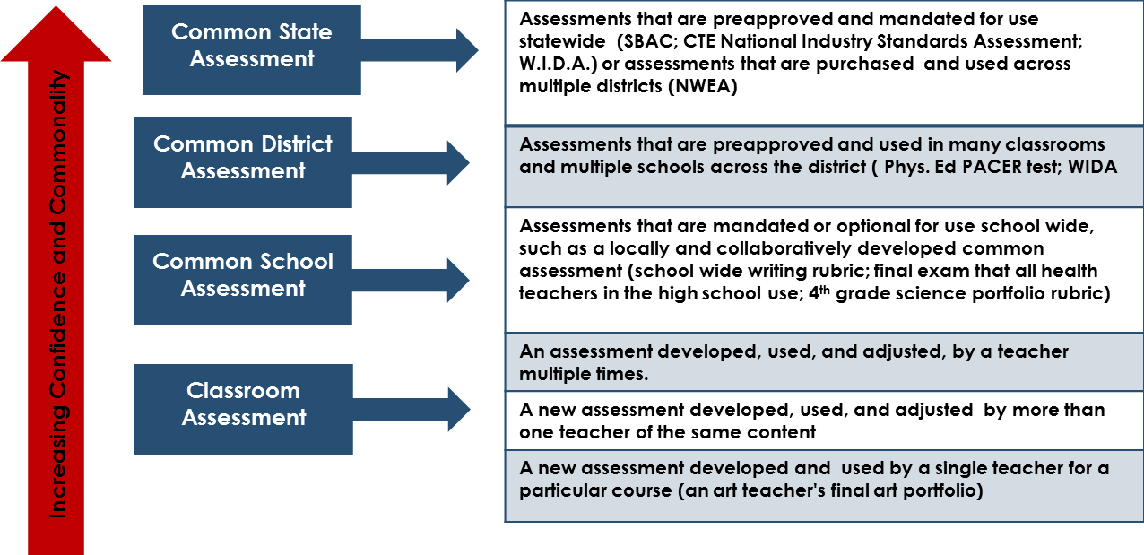
Confidence and Commonality
This scale should not be interpreted as making the claim that large-scale, commercial assessments are better than or more appropriate than school- or district-developed assessments. Rather confidence that the assessment meets the criteria in Table 2 is the first consideration, with common usage the second.

Slide 15
Today's Next Steps:
In groups of like teachers and contexts (or as directed by your administrators),
Identify all assessments currently in use or available
Determine if the assessment is able to measure growth according to the guidelines
Does the assessment lend itself readily to a pre-assessment?
Could a pre-assessment be developed based on the available assessment?
Identify the range of content standards the assessments measure

Slide 16
Further Guidance
Use the Confidence and Commonality Framework to work from the top down as you identify assessments.
Consider multi-faceted assessments to measure substantive content: An essay rubric + constructed response rubric + multiple choice
Consider standards-specific rubrics as opposed to task-specific rubrics that can be used with different tasks
Consider classroom, teacher-developed assessments that could be collaboratively revised and adopted
Find that Local Assessment System folder!
Use the Assessment Checklist on the following slide

Slide 17
Preliminary Assessment Checklist
 | The Assessment
Confidence | Aligns with a comprehensive set of content and process standards Can be given pre and post Can be adapted to provide a pre-assessment Provides a range of opportunity to demonstrate growth Can be administered and scored within a school year Is free of bias, avoiding unnecessarily complex language, and can be administered fairly and consistently to all students. Can accommodate IEPs, 504 plans, or ELL status
Commonality | Can be administered similarly across similar contexts within a school or district
 | Can be graded consistently between administrations and classrooms

Slide 18
Resources
Your own file cabinets
Empower curriculum and resources
Maine Learning Results: http://www.maine.gov/doe/proficiency/standards/maine-learning-results.html
Extensive List of assessments with profiles compiled by Massachusetts (Many can measure growth)
http://www.doe.mass.edu/edeval/ddm/example/ddmlist.aspx
Locally Developed CTE Assessments (Oregon) http://www.ode.state.or.us/search/page/?=3237

