Slide 1
Performance Evaluation and Professional Growth (PEPG) System An Overview of the Requirements

Slide 2
"Systemic changes to standards, curricula, instructional practices and assessment will achieve little if efforts are not made to ensure that every learner has access to highly effective teachers and school leaders."
-Maine Department of Education' s Education Evolving,
Core Priority Area Two: Great Teachers and Leaders

Slide 3
Outcomes for Viewers
Awareness of the legal context and policy that informs system requirements
Awareness of the Performance Evaluation and Professional Growth (PEPG) system components and rule requirements
Working understanding of the two required measures of educator effectiveness, Professional Practice and Student Learning and Growth
Familiarity with the features and functions of the Student Learning Objective (SLO) framework
Familiarity with various approaches to combining multiple measures to arrive at a summative rating
Access to additional guidance resources

Slide 4
Background
LD 1858, “An Act To Ensure Effective Teaching and School Leadership”—April 2012
Becomes Maine Statute: Title 20-A: EDUCATION, Chapter 508: EDUCATOR EFFECTIVENESS
First law of its type enacted in Maine:
Requires SAUs to implement Performance Evaluation and Professional Growth (PEPG) systems that combine evaluation and support
Establishes basic requirements for systems
Establishes a process by which the basic requirements will be detailed in the rule

Slide 5
Activity Since Enactment of LD 1858
Maine Educator Effectiveness Council makes recommendations
Chapter 180 is written and processed; fails in 125th session
Commissioner advises SAUs to proceed despite of lack of approved rule and appropriated funds
Rule-making begins anew
Educator Effectiveness Coordinator is hired by the Department
Provisional Rule is filed, followed by public hearing, work session, and amendments by the Education and Cultural Affairs Committee of the legislature; both houses pass resolve; Governor vetoes; houses override veto: Rule Chapter 180 is adopted
Wide variation in development status exists among SAUs

Slide 6
Key Components of PEPG Systems
Standards of professional practice
Multiple measures of educator effectiveness, including professional practice and student growth measures
A rating scale consisting of 4 levels of effectiveness …with professional growth opportunities and employment consequences tied to each level
A process for using information from the evaluation to inform professional development and other personnel decisions

Slide 7
Quality Assurances/Implementation Requirements
Involvement of teachers and other stakeholders in initial development of system
Local steering committee for ongoing review of system
Trained evaluators; mechanism for ongoing training
Training of educators in components and procedures of system
Process for determining teacher of record
Observation and feedback on a regular basis
Peer review components
Opportunities for professional improvement

Slide 8
Implementation Timeline
Activity | Specifications
2013-14—Development of system | Initial group of stakeholders (development committee) must be composed of a majority of teachers, 1/3 of whom are endorsed by a majority of district teachers, 1/3 endorsed by the school board, and 1/3 endorsed by both the teachers and the board. Decisions must be made by consensus. Failure to reach consensus by June 1, 2015 on the percentage that student learning and growth will weigh in a summative rating results in a default to 20%. Failure to reach consensus on any other element results in default to a state model (to be released in July 2014). An SAU may request additional l time to reach consensus if appropriate.
2014-15—Pilot; adjustments | As many aspects as possible of the proposed PEPG system should be included. SAUs are encouraged to include student learning and growth measures in the pilot year. The pilot does not have to include all teachers and principals in the SAU, but should include a large and diverse enough sample to evaluate efficacy and quality of the PEPG system elements under study. Ratings assessed during the pilot year may not be used for employment or compensation purposes. This does not mean that evaluations and consequences, such as action plans, based on an existing systems cannot be carried out in an official manner, but the new PEPG system cannot be the basis of such decisions until it is approved by the DOE. A Steering Committee, composed of teachers—some of whom are appointed by the association—must be in place at the start of the pilot. During or after the pilot, any needed adjustments should be made , and the process used to evaluate and adjust the systems recorded for submittal purposes.
Submittal to MDOE for approval 90 days prior to 2015-16 school year | The Maine DOE will advise SAUs as to the process for submittal. Submittal requirements can be found on pages 3-4 of Chapter 180 (link in first paragraph of article).
2015-16—Full implementation | All required components and elements of the PEPG system must be in operation; all teachers and principals in the system must be placed into the evaluation framework.

Slide 9
Two Required Measures of Educator Effectiveness
The next several slides provide information about the two required measures of educator effectiveness:
1. Professional Practice
2. Student Learning and Growth
A district may opt to include other measures of effectiveness, such as surveys and professional growth.

Slide 10
Professional Practice as a Measure of Effectiveness

Slide 11
Benchmarks for Practice Standards
In order to achieve the goal of ensuring that all Maine educators are effective, we need a clear and common understanding of what effective teachers and school leaders look like in practice.
To that end, in 2012, the Maine Educator Effectiveness Council (MEEC) identified the InTASC Model Core Teaching standards and the ISLLC 2008 Standards as the benchmarks for teacher and principal effectiveness, respectively.

Slide 12
The Three Parts of a Professional Practice Model
In order to ensure that the professional practice element of a PEPG system provides a comprehensive analysis and accurate measures of effective teacher or principal practice, the Maine DOE requires that a system model include three parts:
Performance standards aligned with the benchmark standards
Supporting descriptors for each standard as published or endorsed by the creator/sponsor of the standards
Rubrics for each standard

Slide 13
Using the InTASC or ISLLC Standards
At this time, the creators of the InTASC Model Core Standards and the ISLLC Standards have not created rubrics; that is, they are missing one of the three required parts. Therefore, to use benchmark standards a school administrative unit would have to locate or create rubrics for the benchmark standards.
Alternatively, a district may use any of the models approved by the Maine DOE.

Slide 14
Maine DOE Menu of Approved Professional Practice Models
This menu will be updated as additional models are approved. A School administrative unit wishing to use a model that does not appear on the menu should contact the Educator Effectiveness Coordinator for information and assistance.
Professional Practice Models for Teachers | Professional Practice Models for Principals
The National Board for Professional Teaching Standards (NBPTS) Five Core Propositions and Indicators, along with the TPEG rubrics created by the Maine Schools for Excellence The Framework for Teaching, by Charlotte Danielson The Marzano Art and Science of Teaching Framework Kim Marshall Teacher Evaluation Rubrics | National Board Core Propositions for Accomplished Educational Leaders, adopted by the National Board for Professional Teaching Standards in 2009, along with the LEPG rubrics created by the Maine Schools for Excellence The principal professional practice evaluation model created by the Supervision and Evaluation Committee of the Maine Principal’s Association, dated September 2013 and posted on the association’s Website at www.mpa.cc. The Marzano School Leader Evaluation Model

Slide 15
Student Learning and Growth as a Measure of Educator Effectiveness
In addition to the guidance on the following slides, the Maine DOE Student Learning Objective Handbook provides detailed information on each aspect of setting student learning and growth targets and selecting appropriate assessments.

Slide 16
Defining 'Student Learning and Growth'
As a factor in the summative effectiveness rating of a teacher or principal, 'Student Learning and Growth' is based on data that measures a change in an *instructional cohort's academic knowledge or skills between two points of time.
In determining student learning and growth factors for the purposes of assessing educator performance, administrators and educators should consider how much data is necessary to making an accurate assessment.
*The student or group of students whose academic growth will be attributed to a teacher or principal.

Slide 17
Student Learning and Growth: Key Procedural Requirements and Guidelines
Multiple Measures: In a PEPG system, multiple measures of Student Learning and Growth must be used in the evaluation of a teacher or principal. For each teacher or principal, at least two measures of student growth are required. For the purposes of gathering data on educator effectiveness, the measures do not have to be, and should not be, of growth in the same learning outcomes for the same instructional cohort. For example, an elementary teacher might have a measure of growth in writing for a certain group of students and a measure of growth in social studies standards for the same group of students, but not two measures for the same writing or social studies standards.
Continued

Slide 18
Student Learning and Growth: Key Procedural Requirements and Guidelines
Variety of Types: Rule Chapter 180 states:
"Large-scale, norm-referenced standardized tests may not be the sole type of student learning and growth measure used"; and
"A student learning and growth measure must measure student growth in achievement, not solely the level of achievement."
The intent of this rule language is to require the use of growth measures to ensure that students are progressing toward mastery under the instruction of a teacher, no matter where the students begin. Many large scale tests provide both normative data on a student (i.e., the student's rank relative to others in the same group) as well as growth data (i.e., how much progress the student has made relative to his or her previous score). For the purposes of evaluating a teacher's or principal's impact on student learning and growth, growth data must be used.
Continued

Slide 19
Student Learning and Growth: Key Procedural Requirements and Guidelines
Pre and Post Assessments: Rule Chapter 180 states that "In order to determine academic growth, comparable pre and post assessments must be given to the instructional cohort under the instruction of the teacher or the leadership of the principal whose evaluation is impacted by the cohort."
In order to measure growth toward mastery of a set of learning outcomes at the end of a learning experience, a student's beginning achievement level must be determined.
Continued

Slide 20
Criteria for Permissible Measures of Student Learning and Growth
According the Rule Chapter 180, The instrument or criteria used to measure student learning and growth must:
Be able to measure growth in identified and intended learning outcomes
Provide all students in the instructional cohort the opportunity to demonstrate growth in knowledge or skill, i.e., must provide for a range of performance levels to accommodate learners at different stages of proficiency
Be able to inform instruction and inform others about the effectiveness of a teacher; and
Be administered consistently across similar grade spans, courses or instructional cohorts. The following two slides provide examples and types of assessments that could be brought into alignment with the key procedural requirements and criteria for assessments.

Slide 21
Student Learning and Growth: Examples of Acceptable Measures
Acceptable Measures of Student Learning and Growth Examples of assessments that could meet the Key Procedural Requirements and Guidelines for determining growth | Unacceptable Measures of Student Learning and Growth Examples of measures that may be used as a factor in the evaluation of an educator but must be a factor separate from student learning and growth in a summative effectiveness rating calculation
State assessment (Interim and Summative) Commercial test District-designed assessment School-based assessment Course-based assessment Teacher-developed assessment Performance measured using a rubric/scale | Student-participation/attendance on state or other assessments Course pass/fail rates Progress on school Improvement plans Quality of teacher-developed SLOs Graduation rate Assessment data that is strictly normed (SAT) Assessment data is not released within the necessary timeframe (former NECAP Assessment)

Slide 22
Ensuring High Quality Assessments
An assessment for a set of learning objectives should meet the highest level of *confidence and commonality. First, the educator should have a high level of confidence that the assessment meets the criteria set forth in the rule and other criteria for best practices in assessment. Second, when possible, the assessment should have been in use and vetted by educators. When a new assessment or performance criteria (rubric) is called for, it should be developed collaboratively by educators who have expertise in the learning standards the assessment will measure, and, preferably, who will use the assessment in similar contexts.
Use the illustration on the following slide as a reference for ranking types of assessments for highest level of confidence and commonality.
*Developed by the Minnesota Department of Education
*a framework developed by the Minnesota Department of Education.

Slide 23
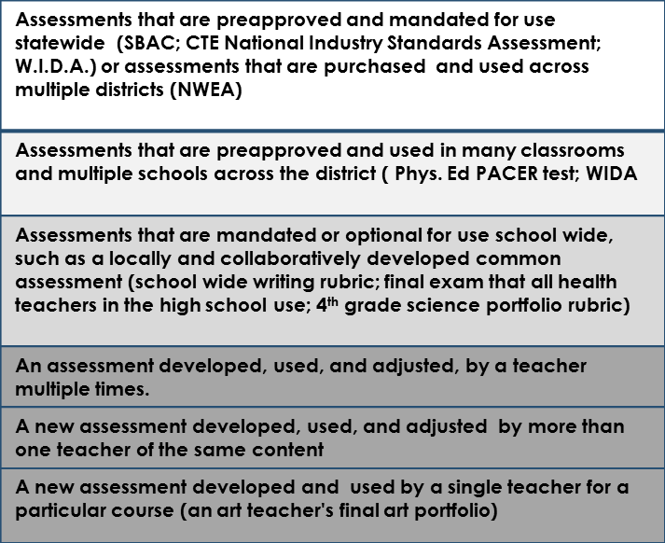
Confidence and Commonality
State or National Assessment
District wide Assessment
School wide assessment
Class/course Assessment
* Based in a framework developed by the Minnesota Department of Education

Slide 24
The Student Learning Objective (SLO)
Chapter 180 states that "Student Learning Objectives (SLOs) and Individual Education Plan (IEP) goals are important tools for individualizing instruction and learning. They may be used to establish an appropriate basis for measuring student growth, as long as progress toward the objective or goal can be, and is, assessed according to the criteria [for permissible measures]."
The SLO is an omnibus framework in a PEPG system in that it can take care of many technical requirements as well as help ensure high quality learning goals and assessments. The next few slides provide detailed information on the features and uses of the SLO.

Slide 25
What is an SLO?
The term SLO is, technically speaking, an acronym for Student Learning Objective, but the term SLO commonly refers to a comprehensive process-framework for developing, articulating, and recording measurable academic growth goals for students, along with all related information, such as student demographics, teacher(s) of record, analysis of student needs, learning standards, the duration of the learning experience, and assessments.
An SLO targets the specific learning needs of students, based on a thorough review of available data, and conveys appropriate state, national, or local standards that will inform instruction, learning, and assessment. Within an SLO, the teacher specifies one or more growth targets—a quantifiable amount of student learning expected by the end of the academic term (course or other defined learning experience)—and identifies the assessments or criteria that will be used to measure growth.
For detailed explanations of each part of the SLO Framework, see the Maine DOE Student Learning Objective (SLO) Handbook.

Slide 26
Why use SLOs in a PEPG System?
Professional Evaluation | Professional Growth
Holds a record of an instructional cohort of students | Reported by teachers to be the "most valuable part of the PEPG system" for improving practice
Identifies the teacher(s) of record | Relies on and promotes important collegial conversations about learning and teaching
Records changes to the instructional cohort | Fosters improvement of practice with each SLO
Teacher-directed and monitored; reduced risk of inaccurate data | Universal process allows for access to supportive resources
Allows for flexibility in a student-centered system | Based on researched methods of improving student progress

Slide 27
The SLO and the Individual Education Plan (IEP)
A major difference between the SLO and the IEP is that the SLO usually sets an academic goal for a group of students, while an IEP sets an academic goal for an individual student. A regular educator's SLO may include a student with an IEP, and a growth target set in an SLO for a cohort to which the student belongs may align with the goal on the student's IEP.

Slide 28
Weighting of Student Learning and Growth: "Significant Factor"
The percentage of an overall summative rating that student learning and growth will comprise is a local decision subject to Maine DOE approval.
The Educator Effectiveness law requires that in an educator's summative effectiveness rating Student Learning and Growth must be a "significant factor." "To be considered “significant,” student learning and growth measures must have a discernible impact on an educator’s summative effectiveness rating" (Rule Chapter 180).
If by June 1, 2015 the local development committee cannot by consensus reach agreement on the percentage that Student learning and Growth will comprise, the default percentage will be 20% in a numeric scale.
Note: a percentage on a numeric scale is not the only approach to making student growth a "significant factor. See slides 34-49 for possible approaches.

Slide 29
Teacher of Record: Definitions
“Teacher” means a person who provides classroom instruction to students in a general education, special education or career and technical education program. It does not include adult education instructors or persons defined as “educational specialists” in State Board of Education Rule Chapter 115, section 2.20 [athletic director, school counselor, library-media specialist, literacy specialist, school psychologist, school nurse, special education consultant, speech-language clinician, or career and technical education evaluator.] The Teacher of Record is the teacher to whom the academic growth of a student in a course or other learning experience is attributed, in whole or in part.
An educator who is certified and hired as a teacher but who does not provide direct instruction to students (e.g., a special education teacher who provides only consultation and support to the regular ed. teacher), is not included in this evaluation system as the performance ratings are based on classroom practice. Any such employee who is assigned classroom instruction and assessment as a teacher part time (e.g., elementary guidance counselor or literacy coach who teaches some classes) is to be evaluated in accordance with the Educator Effectiveness law and Chapter 180.

Slide 30
Teacher of Record: Criteria
A teacher is a “teacher of record” for a student only if:
(1) The student is enrolled in the course or other learning experience taught by that teacher;
(2) The student was present and was subject to instruction by that teacher at least 80% of the scheduled instructional time for that course or learning experience [associated with the learning and growth targets] with that teacher; and
(3) The student took both the pre-test and the post-test designed to measure achievement in that course or learning experience.

Slide 31
Attribution of Student Growth Measures to More Than One Teacher
A student’s academic performance may be attributed to more than one teacher if
The criteria for teacher of record are met for each teacher OR
The criteria for collective measures are met

Slide 32
Collective Measures
A PEPG system may include academic growth of students outside the teacher’s instructional cohort. For example, a school may wish to apply measures of student growth in reading on a state assessment to all teachers in the school or to teachers comprising a team. Any such use of a collective measure must:
A. Be agreed to by teachers to whom it will be applied; an SAU must submit to the Maine DOE in its approval application the process by which agreement is obtained.
B. Comprise not more than one-fourth of the total student growth measure for an individual teacher.

Slide 33
Combining Multiple Measures to Arrive at a Summative Rating
A summative rating can be approached in a number of ways, any of which follows a process of determining ratings on the multiple individual measures and combining the individual ratings to arrive at a single effectiveness rating of Highly Effective, Effective, Partially Effective, or Ineffective, or labels to that effect.
The following slides provide illustrations of the most common approaches to the summative rating.

Slide 34
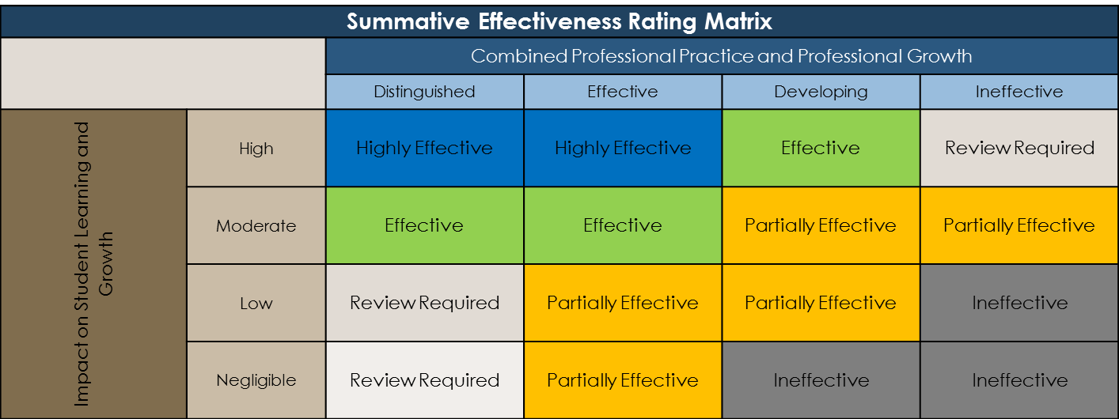
Approach 1: Using a Decision Matrix Like The One Pictured Below
Rating is based on three factors: 1) professional practice, 2) professional growth, and 3) Impact on student growth
In a matrix, student growth must appear on a single axis by itself.
See next 7 slides for the process of arriving at the summative effectiveness rating matrix.

Slide 35
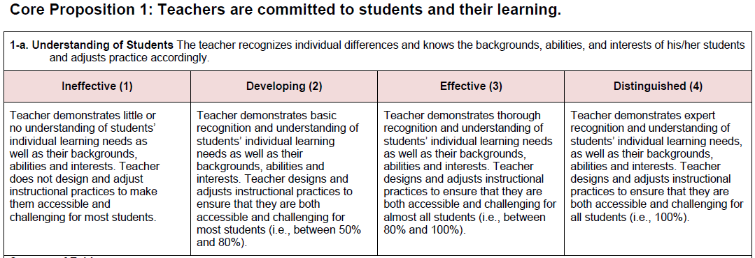
Using a Decision Matrix: Step 1
Rate teacher on standards of professional practice
There are 13 rubrics of the type pictured, one for each Indicator of the *National Board Core Propositions used to evaluate professional practice (CPs 1, 2, 3, and 5). At the end of the evaluation cycle the evaluator makes a final determination on each of the Indicators and assigns a rating for each indicator.
*In a system that uses a professional practice model other than National Board Core Propositions the professional practice ratings would be based on the rubrics that accompany the practice standards, e.g., Marzano's Scales.

Slide 36
Using a Decision Matrix: Step 2
Determine overall rating on professional practice
The evaluator uses the Professional Practice Rating Rubric to determine the overall professional practice rating.
Professional Practice Rating Rubric *CP= Core Proposition; ICP= Instructional Core Propositions (CPs 1, 2, and 3)
Ineffective | Developing | Effective | Distinguished
Performance ratings of Effective on fewer than 7 of the 11 ICP Indicators | Performance ratings of Effective or Distinguished on at least 7 of the 11 ICP Indicators with ratings on the six remaining indicators (CPs 1, 2, 3, 5) to include no more than two Ineffective | Performance ratings of Effective or Distinguished on at least 7 of 11 *ICP Indicators with performance ratings on the six remaining Indicators (CPs 1, 2, 3, 5) to include no more than two Developing with no rating of Ineffective | Performance ratings of Distinguished on at least 7 of 11 ICP Indicators with no rating below Effective on any Standard
Threshold: Effective on 7 ICP Indicators | Threshold: Effective on 7/11 ICPs; Developing on 4 remaining CP Indicators | Threshold: Effective on 11/13 Indicators; no Ineffective | Threshold: Distinguished on 7/11 ICP Indicators; nothing lower than Effective
The professional practice rating scale is a local decision.
In this sample, core propositions related to instruction have been given more weight as the first indicator of effectiveness.
MENU

Slide 37
Using a Decision Matrix: Step 3
Rate each of the two Indicators of Professional Growth
There are two rubrics of the type pictured, one for each of the two Indicators of Core Proposition 4 used to evaluate Professional Growth. At the end of the evaluation cycle the evaluator makes a final determination on each of the indicators and assigns ratings.
In this sample, professional growth is one of three measures of effectiveness. Including measures in addition to professional practice and student learning and growth is optional; however, multiple measures generate a broader basis for the summative effectiveness rating.

Slide 38
Using a Decision Matrix: Step 4
Determine the combined rating for professional practice and professional growth
In a system that uses only professional practice and impact on student learning and growth as measures of effectiveness, this step would be skipped.
Maine DOE TEPG Combined Professional Practice and Professional Growth Rating Matrix
 |  | Professional Practice
 |  | Ineffective | Developing | Effective | Distinguished
Professional Growth | Distinguished | Developing | Developing | Effective | Distinguished
 | Effective | Developing | Developing | Effective | Distinguished
 | Developing | Ineffective | Developing | Effective | Effective
 | Ineffective | Ineffective | Ineffective | Developing | Developing

Slide 39
Using a Decision Matrix: Step 5
Determine the educator's impact on student learning and growth
Impact on Student Learning and Growth
This sample shows a scale that would be determined by the local district. Rather than weighting the Student Learning and Growth factor in a summative effectiveness rating, a determination of the educator's impact is made. At the end of the instructional period for each growth target, determine the percentage of students who have met the target. At the time of the summative effectiveness rating, add all the percentages together and average to arrive at the impact rating.
Percentage Ranges of Students Who Met Their Growth Targets
85–100% | High
71–84% | Moderate
41–70% | Low
0–40% | Negligible
Sum of the percentage of students who met their growth targets for all growth targets during the cycle ÷ number of growth targets | Impact on Student Learning and Growth

Slide 40
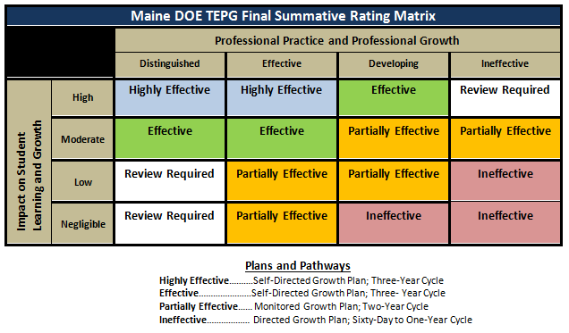
Using a Decision Matrix: Step 6
Arriving at the summative rating
A major disparity between ratings on different measures should prompt a review of the rating factors.
In this sample, teachers are placed on growth plans based on summative ratings.

Slide 41
Approach 2: Using a Numeric Matrix Like The One Pictured Below
Rating is based on two factors: 1) professional practice, and 2) student growth.
*
Draft Design by Auburn School Department

Slide 42
Using a Numeric Matrix: Determine a numeric score for each measure
In a numeric matrix approach all scores on all measures must be converted to a 1-5 or lower point scale as shown here and then plotted on the matrix.
 | Professional Practice | Student Learning and Growth
Measures | Performance on each of the 60 Elements of the Marzano Teacher Evaluation Model | SLO Assessment 75% SLG | School-wide assessment data 25% SLG
Rating scale | Marzano Element Scale Not Using When Called For= 0 Beginning= 1 Developing = 2 Applying= 3 Innovating=4 Maximum Points = 240 (4X60 elements) | Growth scale determined by teacher and evaluator or at district level Did not meet = 1 Partially met = 2 Met = 3 Exceeded/high = 4 Maximum Points = 12 | Did not meet = 1 Partially met = 2 Met = 3 Exceeded/high = 4 Maximum Points =4
Sources of evidence | Observations, conferences, and teacher-led collection of evidence | Assessment data on two Teacher-Developed SLOs | Student growth data from state assessments in reading
Calculation | Average all ratings to determine overall professional practice rating. | Multiply score by 3 to get rating for SLO assessment | Multiply score by 1 to get rating for collective measure
Overall rating | 200-240 = 4 100-149 =2 150-199 =3 0-99 = 1 | 15-16= 4 9-11 = 2 12-14 = 3 5-8 =1

Slide 43
Using a Numeric Matrix: Arriving at the summative rating
Final values are not necessarily averages; they are based on decisions made when developing the matrix.
Rating is based on two factors: 1) professional practice, and 2) student growth.
*
Draft Design by Auburn School Department

Slide 44
Incongruent Professional Practice and Student Learning and Growth Ratings
A major incongruity between the professional practice rating and the student learning and growth results (using any approach) should prompt a review by the original evaluator, a second, trained evaluator, and the teacher. The review should include:
The accuracy of the scoring process
The accuracy of the evaluator's judgments
The appropriateness of the assessments used to measure student growth
The students included in the calculation of the student growth measure
The appropriateness of the student growth goal

Slide 45
Approach 3—Using weighted percentages (TEACHER-Sample 1)
This sample represents multiple measures including professional practice standards and multiple measures of Student Learning and Growth weighted at 20%. No other measures are included beyond the two required measures.
 | Professional Practice | Student Learning and Growth
Measures | Performance on each of the 60 Elements of the Marzano Teacher Evaluation Model | SLO Assessment | School-wide assessment data
Rating scale | Element Scales Not Using When Called For= 0 Beginning= 1 Developing = 2 Applying= 3 Innovating=4 | Did not meet/low = 1 Partially met/low average= 2 Met/high average = 3 Exceeded/high = 4 | Did not meet/low = 1 Partially met/low average= 2 Met/high average = 3 Exceeded/high = 4
Sources of evidence | Observations, conferences, and teacher-led collection of evidence | Assessment data on two Teacher-Developed SLOs | Student growth data from school wide NWEA Reading Assessments
Calculation | Average all ratings to determine overall professional practice rating. | Average two ratings to determine 15 % of overall growth measure | Determine aggregate score and calculate as 5% of overall growth measure
Weight | 80% | 15% | 5%

Slide 46
Approach 3—Using weighted percentages(TEACHER-Sample 2)
This sample represents a system that includes measures in addition to the two required measures—professional practice standards and student growth—and weighs student growth at 40%.
 | Professional Practice | Professional Growth | Learner Perception | Student Learning and Growth
Measures | Performance on each of the 16 Standard Indicators of the MSFE TEPG Rubric | Professional growth goal progress and attainment | 7Cs Tripod Student Perception Survey | State assessment; SLO Assessment
Rating scale | Ineffective = 1 Developing = 2 Effective = 3 Distinguished = 4 | Did not meet = 1 Partially met = 2 Met = 3 Exceeded = 4 | Low = 1 Low average = 2 High average = 3 High = 4 | Did not meet/low = 1 Partially met/low average= 2 Met/high average = 3 Exceeded/high = 4
Sources of evidence | Observations, conferences, and teacher-led collection of evidence | Conversations and documents related to professional goal progress | Student survey results | SLO assessment: Student growth data from NWEA Informational Text SLO assessment: Student growth data from district/team designed assessment
Calculation | Average all ratings to determine overall rubric rating. Factor X 4 | Determine overall goal rating. | Translate survey results into a 1–4 scale. | Rate performance for each measure and average.
Weight | 40% | 10% | 10% | 40%

Slide 47
Approach 3—Using weighted percentages(PRINCIPAL-Sample 1)
This principal-sample represents multiple measures, including professional practice standards and multiple measures of Student Learning and Growth weighted at 20%.
 | Professional Practice | Student Learning and Growth
Measures | Performance on each of the 6 Domains of the MPA Principal Evaluation Model on the model rubric | Student growth and improvement | Student growth and improvement
Rating scale | Does not Meet =1 Basic= 2 Proficient= 3 Exemplary= 4 | Did not meet/low = 1 Partially met/low average= 2 Met/high average = 3 Exceeded/high = 4 | Did not meet/low = 1 Partially met/low average= 2 Met/high average = 3 Exceeded/high = 4
Sources of evidence | Observations, conferences, and principal-led collection of evidence | Average of student growth on one SLO per content | Student growth data from School wide NWEA Reading
Calculation | Average all ratings to determine overall professional practice rating. | Determine aggregate score and calculate as 10% of overall growth measure | Determine aggregate score and calculate as 10% of overall growth measure
Weight | 80% | 10% | 10%

Slide 48
Approach 3—Using weighted percentages(PRINCIPAL-Sample 1)
This principal-sample represents a system that includes measures in addition to professional practice standards and student growth, and weighs student growth at 35%.
 | Professional Practice | Student Learning and Growth
Measures | Performance on each of the 6 Domains of the MPA Principal Evaluation Model on the model rubric | Student growth and improvement | Student growth and improvement
Rating scale | Does not Meet =1 Basic= 2 Proficient= 3 Exemplary= 4 | Did not meet/low = 1 Partially met/low average= 2 Met/high average = 3 Exceeded/high = 4 | Did not meet/low = 1 Partially met/low average= 2 Met/high average = 3 Exceeded/high = 4
Sources of evidence | Observations, conferences, and principal-led collection of evidence | Average of student growth on one SLO per content | Student growth data from School wide NWEA Reading
Calculation | Average all ratings to determine overall professional practice rating. | Determine aggregate score and calculate as 10% of overall growth measure | Determine aggregate score and calculate as 10% of overall growth measure
Weight | 80% | 10% | 10%

Slide 49
Arriving at Summative Rating Using weighted percentages and numeric scale
Summative Evaluation Score Table
Component | Sub score |  | Weight |  | Weighted Sub score
Professional Practice | 3.5 | X | .40 | = | 1.4
 |  |  |  |  | +
Professional Growth | 3 | X | .10 | = | .3
 |  |  |  |  | +
School Growth | 2.5 | X | .15 |  | .375
 |  |  |  |  | +
Student Learning and Growth | 3 | X | .35 |  | 1.05
 |  |  |  |  | =
 | Final Summative Score |  |  |  | 3.125
Final Score | Summative Evaluation Rating
3.4 or higher | Distinguished
2.5-3.4 | Effective
1.5-2.4 | Developing
Less than 1.5 | Ineffective

Slide 50
Training Requirements
A PEPG system must include a comprehensive training program for both evaluators and the educators who will participate in the system. Rule Chapter 180 provides the areas that a training program must include. Districts must ensure that their training program is of high quality in addressing all of the areas. The following slides list the areas of training necessary for evaluators and educators.

Slide 51
Requirements for Evaluator Training
A person is a qualified evaluator in a Chapter 508 system only if that person has completed training appropriate to the role he or she will play in the system. Evaluators must be trained in The specific professional practice model selected by the school administrative unit in which the evaluator will perform duties; Conducting pre-observation and post-observation conferences; Observing and evaluating the professional practice of teachers and/or principals; and Developing and guiding professional growth plans. Continued

Slide 52
Requirements for Evaluator Training, Continued
The training in observing and evaluating professional practice of teachers and/or principals must include the following: Training in evaluating performance based on evidence, and without bias; Adequate time for evaluators to practice and become familiar with the model during their trainings; Opportunity for evaluators to work collaboratively; Training in assessing evidence of performance not directly observed in classroom observations or direct observations of principals and in incorporating that evidence into a summative evaluation; and Training designed to ensure a high level of inter-rater reliability and agreement. To continue to serve as a trained evaluator, an evaluator must maintain an identified minimum level of inter-rater reliability and agreement by participating in training or recalibration at intervals specified in the PE/PG system plan.

Slide 53
Requirements for Educator Training
Prior to implementing a PE/PG system, a school administrative unit must provide training to each educator who will be evaluated under the PE/PG system to provide the opportunity for each educator to understand:
The structure of the system, including the multiple measures of educator effectiveness and the evaluation cycle;
The names and roles of administrators and others whose decisions impact the educator’s rating;
How to participate in professional development opportunities to assist the educator in meeting professional practice standards used in the system;
The results and consequences of receiving each type of summative effectiveness rating; and
Other aspects of the system necessary to enable the educator to participate fully in the evaluation and professional growth aspects of the system.

Slide 54
Evaluation Frequency
Rule Chapter 180 states:
A school administrative unit shall determine and set forth in its system plan, the frequency with which it will conduct full evaluations leading to summative effectiveness ratings. A school administrative unit is not required to conduct a full evaluation leading to a summative effectiveness rating of each educator in each year. The frequency of full evaluations may vary depending on the effectiveness rating of an educator. However, full evaluations must be conducted at least every three years, even for highly effective educators.

Slide 55
Observation, Review, and Feedback
Rule Chapter 180 states:
Regardless of whether an educator is evaluated formally in a particular year, observations of professional practice and formative feedback must occur each year and throughout the school year for all educators.
The observation and formative feedback may take a variety of forms and can involve both evaluators and peers.
Peer Review and Collaboration Requirements are described on the next slide.

Slide 56
Peer Review and Collaboration
Each PE/PG system must include a peer review component and opportunities for educators to share, learn and continually improve their practice. Peer review is for formative evaluation purposes only, and must not be included in determining the summative effectiveness rating unless the peer reviewer is trained in the evaluation process as required under Section 11 of this rule, and the educator being evaluated chooses to include the peer review as part of the summative effectiveness rating.
Peer review includes, but is not limited to, observation of peers, review of portfolios and other evidence offered to demonstrate an educator’s performance, and review of professional improvement plans. Opportunities for sharing, learning and continually improving practice include, but are not limited to, providing opportunities for mentoring and coaching, involvement in professional learning communities, and targeted professional development.
The Maine DOE (state) Teacher PEPG Model provides a menu from which teachers, peers, and evaluators select such opportunities to provide a minimum number and type of "Points of Contact." See pages 16-20 of the model document for details.

Slide 57
Resources
Maine DOE Educator Effectiveness Website
Includes links to state teacher and principal PEPG models
Publications Related to the Development and Implementation of Performance Evaluation and Professional Growth Systems; Published by the Maine DOE Office of Educator Effectiveness:
Legislation Final Rule Chapter 180 Adopted: This article explains the changes that were made to Chapter 180 in the spring of 2014 and links to the finally adopted rule.
Timelines FAQ on Piloting a PEPG System: Answers many questions about the pilot year.
Professional Practice Models Professional Practice model survey results: Who’s using what professional practice model where Choosing a professional practice model: In addition to announcing the Department’s approval of the Kim Marshall Teacher Evaluation Rubrics, this article contains general information about choosing a professional practice model.
Connections Across Local Systems Advisability of merging certification support systems and performance evaluation systems with Q and A: This article explains why it is advisable to keep some aspects of the local certification support team separate from aspects of an evaluation system.
Continued

Slide 58
Resources Continued
Publications Related to the Development and Implementation of Performance Evaluation and Professional Growth Systems; Published by the Maine DOE Office of Educator Effectiveness:
Local committees Initial PEPG development committee Q and A Guidance on requirements related to the initial stakeholder group that develops a local Performance Evaluation and Professional Growth system; sample consent form to be used to obtain endorsement of existing group. Local steering committee This article makes a distinction between the initial development committee and the steering committee. The information regarding the steering committee is accurate, but the legislative amendment to the rule in April, 2014 makes the guidance on the development committee obsolete. See the next previous
Networking Professional Practice model survey results: Who’s using what professional practice model where? Fall 2013 survey of SAU’s In October, 2013 the Maine DOE’s Educator Effectiveness Coordinator sent out a survey to assess the status of performance evaluation and professional growth (PE/PG) system implementation across the state. The article provides a summary of the responses as of November 18, 2013. Much has changed since the survey was completed, with many more districts further along in the process than reported in November.

Slide 59
Thank you for using this slide presentation to become familiar with the major components of a PEPG system. Please check back periodically as this resource will continue to grow.

Slide 60
MENU
Presentation Outcomes Background Legislative and Maine DOE Activity Implementation Timeline Key Components of PEPG System Quality Assurances Professional Practice Benchmarks Three Parts Using the Benchmarks Menu of Approved Models Student Learning and Growth Defined Key Procedural Requirements and Guidelines (18-20) Criteria for Permissible Measures Ensuring High Quality Assessments Confidence and Commonality Acceptable Measures Student Learning Objective (SLO) What is an SLO? Why use SLOs SLOs and IEPs | "Significant Factor" and weighting Teacher of Record Defined Criteria Attribution to multiple teachers Collective Attribution Combining Multiple Measures Approach 1—Decision Matrix (7 slides) Approach 2—Numeric Matrix (4 slides) Incongruent ratings Approach 3—Weighted Percentage Sample 1—Teacher Sample 2—Teacher Sample 1—Principal Sample 2—Principal Training Requirements Evaluation Frequency Observation, Review and Feedback Peer Review and Collaboration Resources Educator Effectiveness Website Commissioner's Update Articles on PEPG
Notes:
+

