Slide 1
Maine Education Financial System (MEFS) Sometimes referred to as NEO Financial
September 21, 2022
Denise Towers
School Finance Team

Slide 2
Maine Education Financial System
What you need to do in MEFS
Obtain NEO – MEFS permission. Instructions here. Must be requested by Superintendent. Be on the lookout for a time sensitive email to gain access once request is made.
Review the Getting Started Guide for MEFS & the Upload File Format Instructions. File format requirements are very specific; no spaces, no dollar signs, etc.
Submit an annual electronic transfer of specifically coded budget revenue and expenditure file records from the SAU accounting system to MEFS. Due 30 days after budget passes or by August 15.
Upload budget backup documentation to MEFS. Due 30 days after budget passes or by August 15.
Submit the EF-M 46 budget assessment report if your district consists of more than one town. Due 30 days after budget passes or by August 15.
Submit quarterly electronic transfer of specifically coded actual revenue, actual expenditure, and actual balance sheet file records from the SAU accounting system to MEFS. Due August 30.
Once the annual audit is complete, it may be necessary for you to upload a new Q4 if audit adjustments were made to accounts previously reported in the Q4.

Slide 3
What we do when we get your data…. We validate it and use that data for many purposes.
Budget files are validated using official Warrant Articles/Resolves/Orders that were voted on in that district.
The EF-M 46 is validated using the budget revenue raised in official Warrant Articles/Resolves/Orders that were voted on in that district.
Actual revenue and expenditure files with new records are validated using the Accounting Handbook & the MEFS business rules engine to determine if codes within the string are allowable with each other.

Slide 4
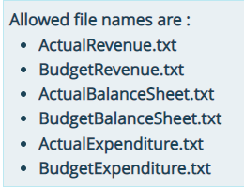
Uploading Files
You can drag & drop the file, or you can select the file from your computer using the Select File button.
Once you submit, the system will tell you if the file was submitted successfully.

Slide 5
Upload Budget Backup Documentation
Budget Backup should consist of Budget meeting minutes, copies of Warrant Articles/Resolves/Orders, and Official Vote Declaration
Click Financial Data Submissions tab.
Then, choose Document Upload.
* Indicates a required field. Complete required fields and choose file from your computer to upload.

Slide 6
The budget backup documents go to the supplementary document section below the submission section.
The file can be viewed by using the View File link.

Slide 7
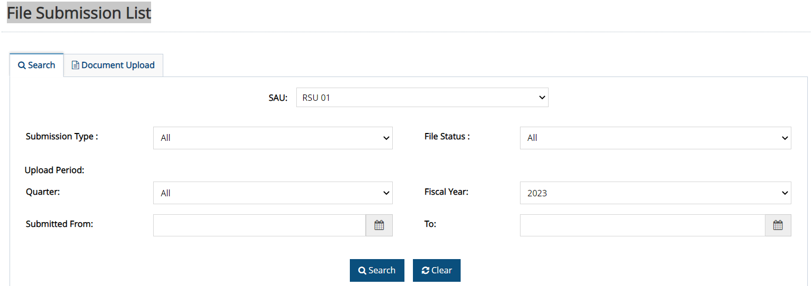
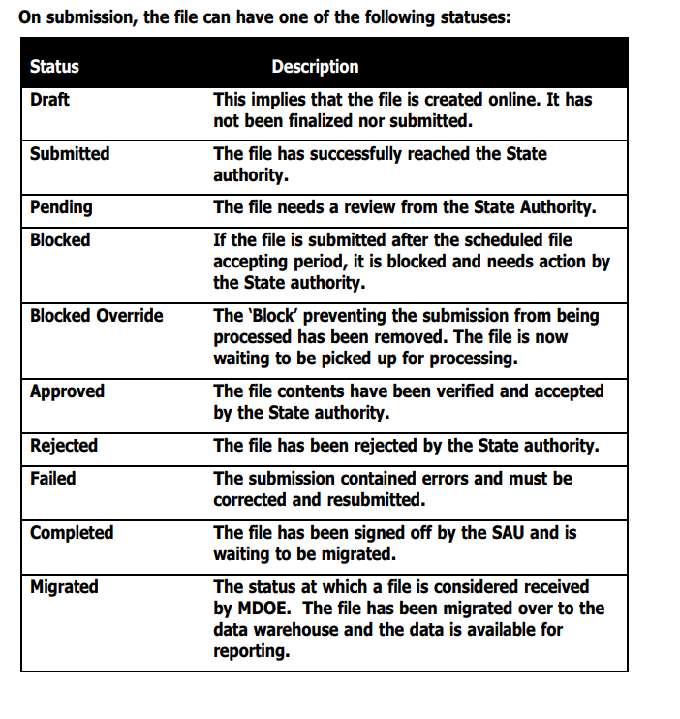
Check the status of your uploads
I typically filter by fiscal year. This will show me the files and the status of those files for that fiscal year.

Slide 8
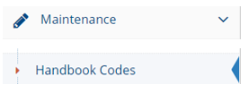
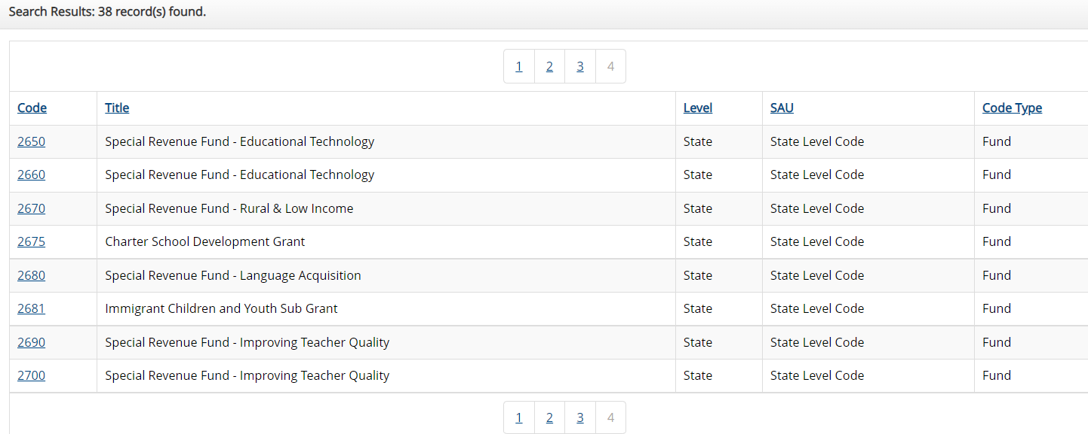
Handbook Codes
This feature allows you to see all codes established in the MEFS system since 2011.

Slide 9
Handbook Codes
Click on the fund code link on the left.
The result shows code title and that the code was valid from 2011 to 2021.

Slide 10
Code Combination Validation List
Here you can test code combinations.
The results indicate that there is an exception, (Y) when trying to use function 1000 with object code 5400.
Does this code work with that code?
If there is a (Y) in the exclusion rule column, it means it is excluded and you cannot use that combination.
If you see an (N), it means not excluded and you can use that combination together.
If no results appear, assume the combination will work as there is no exclusion set in the system.

Slide 11
One of the tools Maine School Administrative Units (SAUs) use to ensure they receive sufficient funding is the Financial Accounting for Local School Systems in Maine, Accounting Handbook . Using codes appropriately at the local level is important. State and Federal level reports are driven by the data provided to MEFS. Your hard work providing good data enables the DOE to use the best method possible in efficiently allocating support to districts.
I’d like to say this is easy work but, it is not!
Thanks for all you do….
Connect with me if you have any questions ☺
Denise.towers@maine.gov

