Slide 1
NEO Staff Module
Drew Mitchell

Slide 2
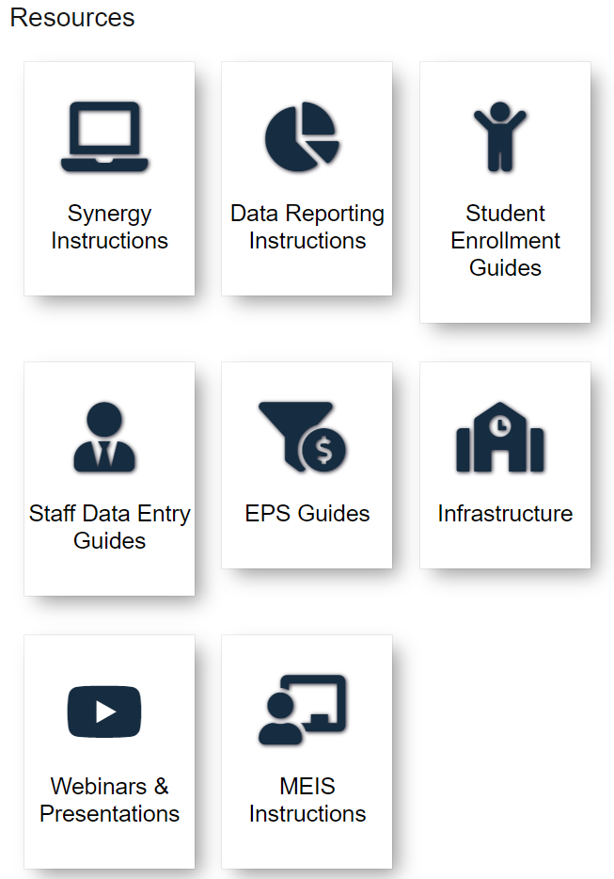
https://www.maine.gov/doe/data-reporting/collection/helpdesk
Notes:
Go over helpdesk resources

Slide 3
What is NEO Staff?
• The NEO Staff system is an application to record data on all staff members.
The NEO Staff System is NOT a personnel system.
There is no association with the NEO Staff data and the data Maine PERS retirement system may collect.
NEO Staff simply lists staff members who are actively employed at any moment in time during a school year.
• Data entered in NEO Staff is used for both EPS and Certification needs, and as needed reports for state and federal programs.

Slide 4
Who needs to be entered?
• All staff persons employed by the school administrative unit must be entered into NEO Staff. In addition, all contractors employed in a position required for EPS reporting and/or in a position with sustained direct unsupervised access to students must be entered into NEO Staff.
• Include contracted staff for work that is considered part of the regular operations; Examples may include bus drivers, school nurses, psychologists, and physical therapists.

Slide 5
Who needs to be entered?
• Include staff employed by another entity that is contracted to provide work that can be considered part of the district’s regular operations.
These staff work within the district but are employees of the entity with which the district contracts.
The district does not pay retirement or other benefits.
Examples may include staff of the school; school security personnel provided by a private firm; or outsourced Pre-K programs.

Slide 6
Who needs to NOT be entered?
• Do not include employees of contractors who provide a non-regular service; these are staff furnished by the contractor, on- or off-site, to provide the service.
Examples may include carpenters or electricians working for a firm hired to refurbish school building(s).

Slide 7
Staff Details Export
The staff details export was created to provide an all-encompassing staff download for districts.
This IS NOT to be used for verifying FTE data as is assigns staff a line in the report for each assignment

Slide 8
In this example we can see it would appear this teacher has an EPS FTE of 4 but the EPS FTE is only a 1

Slide 9
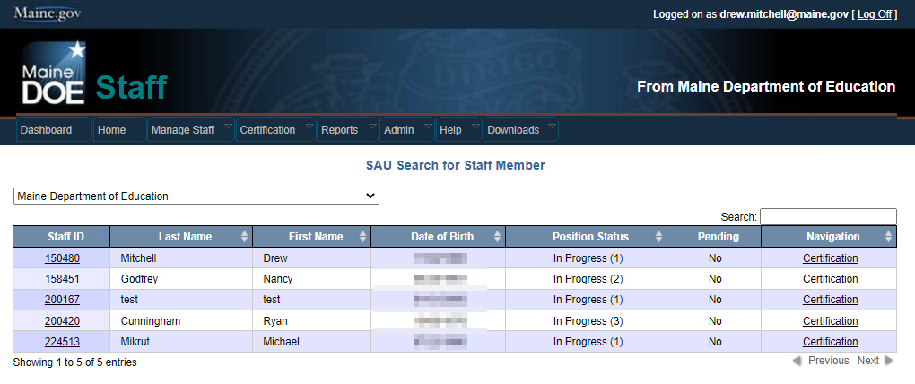
SAU Search Screen
The SAU Search screen is ideal to search all currently employed staff in your district.
This is also an easy way to access staff on one screen to see who is in “pending” status. Filtering the Pending field will bring Yes’s to the top.

Slide 10
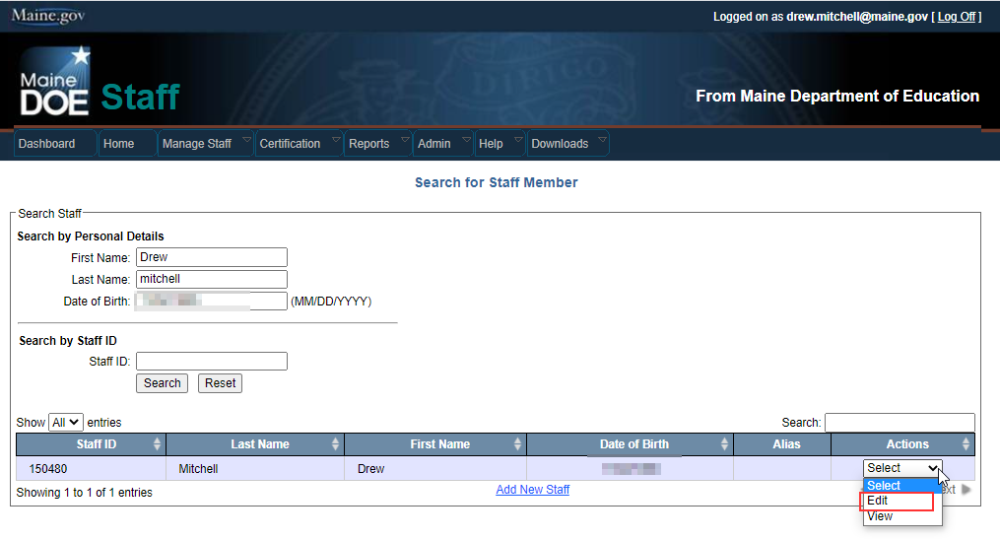
Staff Search Screen
The Staff Search screen is used to locate any staff person in Maine. One must know the SSN of the staff person in order to associate the person to the school district.
The person lookup looks for any person that may potentially be in NEO already through the current NEO modules instead of duplicating a person.
Notes:
Mention the add staff option if the person you’re trying to add is not listed

Slide 11
Edit Staff Record Screen
This screen is where you can make name changes to Highest Degree Earned or Name.
In order to make a change you need the SSN or the Educator ID (Acquired from MEIS) of the staff member.
SSN and DOB edits require you to call the helpdesk
Degree effects reports
Notes:
Go over how to get the educator ID for staff members for the event no SSN is provided.

Slide 12
Assignment Grid
Lists all assignments for a staff member including ones from other districts
Districts can only edit data for their own district but can view all data entered.
If there is a previous district’s assignment listed, that should be exited before entering your assignment to avoid errors related to EPS totals
Total EPS FTE cannot exceed 1.0 for any staff person in a given year
Total FTE can exceed 1.0

Slide 13
Add or Edit Assignments
Notes:
Is Federal Funding a payment source for this position?
Do the duties of your position include services to students age 3-20 who receive Special Education
Is the staff member Highly Qualified (for Special Education) or qualified (for ed techs and other special education roles)?

Slide 14
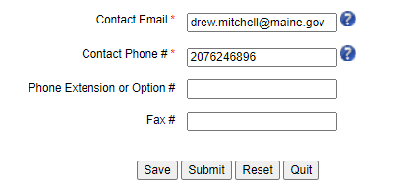
Contact Information
The email address and phone number provided here is very important as if it’s not correct we may send outreaches (or list serve emails) to the wrong people.

Slide 15
Year of Experience
Zero if brand new to the position (IE: Ed tech going to a teaching role, or teachers going to a Principal role).
Previous experience in the position, regardless if it’s within the district or out of state is entered into this field (having 6 years experience teaching would be entered if they’re entering a teaching role).
CTE has two experience fields – Year of Experience and Professional Experience. Professional experience would be experience in whatever field you’re licensed in (IE: Welding, Carpentry, Plumbing).

Slide 16
Staff – Special Education Question
• If personnel work part of their time with children without disabilities, and other times with children with disabilities (IDEA), report only the proportion of their FTE that the related services personnel works specifically with children with disabilities (IDEA) receiving special education and related services.
• This is a separate FTE calculation just for IDEA
It is used for EFS- 05 - Pt 2 reporting

Slide 17
Staff – Special Education Question & Calculation
The questions now located in Staff will help to replace the old MEDMS EFS-01 part 2
Position FTE requires estimation akin to… “about 1/3 of the students I work with have disabilities and I work half time, so I work (1/3)*.5 = 0.166666 = 17% FTE with students with disabilities”.
Calculations need to be entered as a %
Notes:
Mention that the question marks can be used to provide more detail on those questions

Slide 18
Staff Certification
Notes:
Expound on the number of pending positions either here or slide 24 on how to identify the positions via SAU search

Slide 19
Staff Certification
Prior to the superintendent’s certification all current staff must be given an active assignment(s) for the current school year
The staff certification will not be accepted if the certification report contains any pending records or if there is any missing data in the designated roles section of the certification report
SAUs without a librarian or nurse can select the superintendent as the district role without actually giving them a staff assignment for that role.

Slide 20
Staff Certification
There are nine columns on the staff certification report
Position – The staff position by job title
Number of Staff – the number of staff members with this position.
Number of In-Progress Positions – the number of positions with the in-progress status
Number of Active Positions – the number of active positions in this role
Number of Positions – the total of the previous three positions columns
Notes:
Go over the active positions vs active staff and what that means in relation to a teacher teaching 2 positions

Slide 21
Staff Certification
Total FTE – the total of FTE for this position. This includes both regular FTE and EPS FTE
Total EPS FTE - this is the total EPS FTE count for staff members in this position district wide. EPS FTE is only listed if there are staff assigned to EPS Positions
Number of Pending Positions – the number of staff members in this position that have pending assignments within the district. If there are any staff assignments pending, the superintendent will not be able to certify the staff data
Navigation – takes you to a listing of all staff in this position

Slide 22
Staff Certification
The district roles section is where you indicate which staff members perform critical roles within the district. These are also used for point of contacts via the NEO contact search.
Anyone with SAU admin access to the staff module within NEO can update the designated roles for their district throughout the school year. It is important that this is done because the designee you list is the one that is listed in all public reports. It is not necessary for the superintendent to recertify if changes are made after December 1st

Slide 23
Staff Certification
These roles should be filled by whomever is performing these functions and updated whenever this changes during the year.
These contacts are the ones that appear in contact search so its important to keep them updated

Slide 24
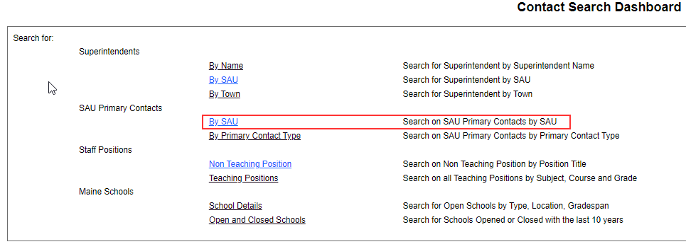
Contact Information

Slide 25
Contact Information

Slide 26
Contact Information

Slide 27
EFS-05 Part 2 – Special Education Staff
The Special Education Staff reporting will no longer be an editable report
In order to make changes in the report you will need to update staff assignments directly
Changes will then be updated in the report itself

Slide 28
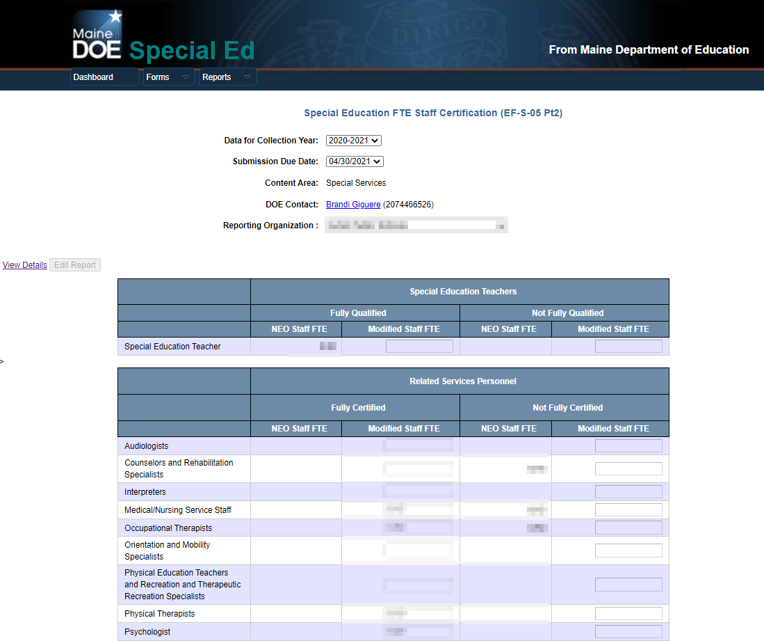
EFS-05 Part 2 – Special Education Staff
Notes:
The report WILL LOOK DIFFERENT this year so reiterate if the FTE is wrong here it needs to be adjusted in the staff records directly

Slide 29
EFS-05 Part 2 - Statuses
SPED Teachers
Fully Qualified: Fully Certified and hold at least a bachelors degree
Not Fully Qualified: Missing one of the above (Degree of other is most common issue) or are holding a waiver for a certification on an emergency, temporary, or provisional basis
Related Service Personnel and Special Ed Paraprofessionals
Fully Certified: Holds a Maine Certification or License
Not Fully Certified: One of the above is not met

Slide 30
https://www.maine.gov/doe/data-reporting/collection/helpdesk
Notes:
Go over helpdesk resources again

