Slide 1
Present Options for Launching OSW Hulls
By: Matt Burns, Maine Port Authority

Slide 2
Launching Methodology
OSW foundations are massive.
Foundation construction in the uplands.
Foundation must be transferred from the uplands into the water.
So far, this group has discussed launching foundations by barge.
Other options may be appropriate depending on size/characteristics.

Slide 3
Launching by Barge/Vessel
Specialized semi-submersible barge/vessel.
Barge can be moved and relocated elsewhere.
Requires deeper water to submerge.
Can be expensive to build specialized barges.
More sensitive to wind/wave and sea characteristics.

Slide 4
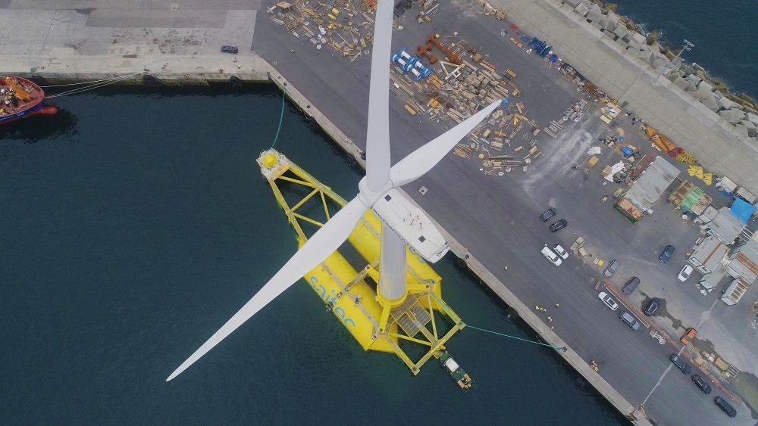
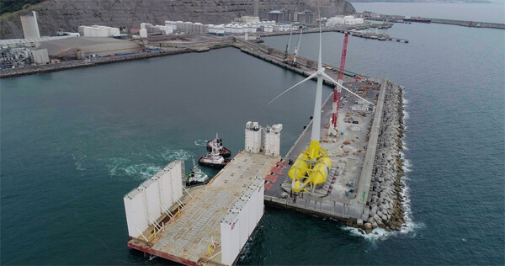
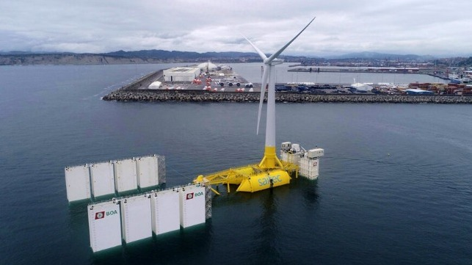
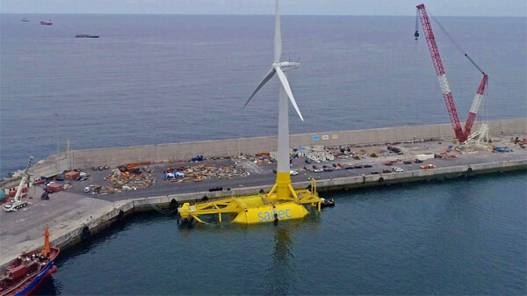

Slide 5
Launching by Ramp/Ways
Similar to how ships can be launched.
Fixed equipment that can not be relocated.
More complex mechanical components than a barge.
Can be expensive to build and maintain.
Several different ways to control the launch.

Slide 6
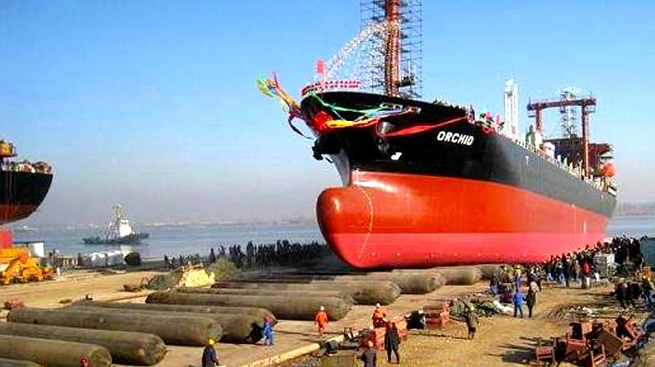
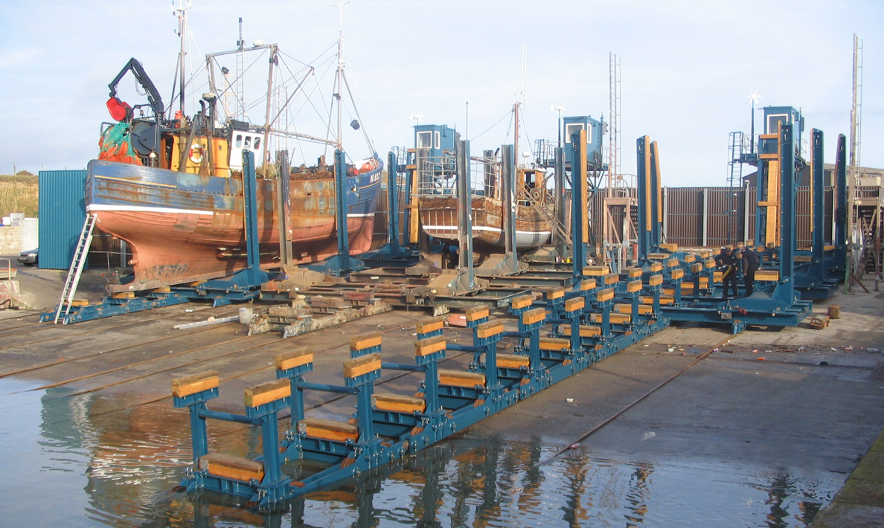
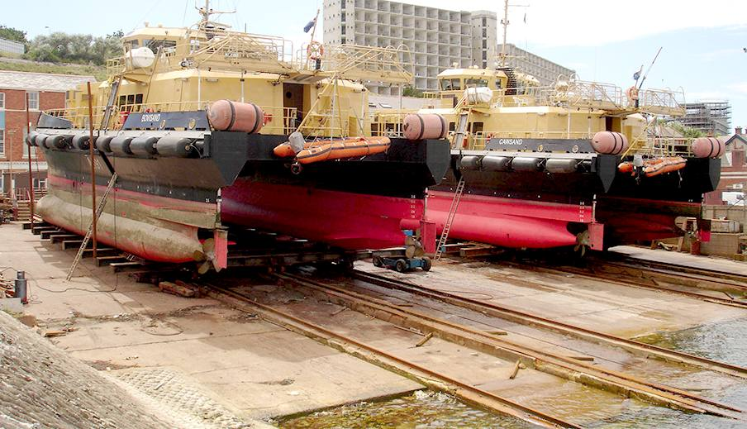

Slide 7
Where we are at…
State is continuing to refine alternative concepts.
Exploring inclined ramp and semi-sub barge options.
Optimal launching methodology depends on foundation type.
Launching OSW foundations with a ramp is a novel concept.
Heavier foundations may require multiple barges configured together.

Slide 8
Changes to Conceptual Alternatives
By: Matt Burns, Maine Port Authority

Slide 9
OSW Marshalling Terminal Alternatives
Mack Point with Launching Ramp – 100 acres
Sears Island with Launching Ramp – 100 acres
Mack Pt/Sears Island Hybrid/Ramp – 119 total acres
Eastport, Estes Head – 100 acres
No Build

Slide 10
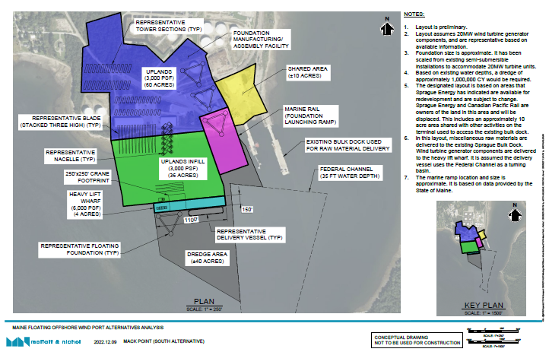

Slide 11
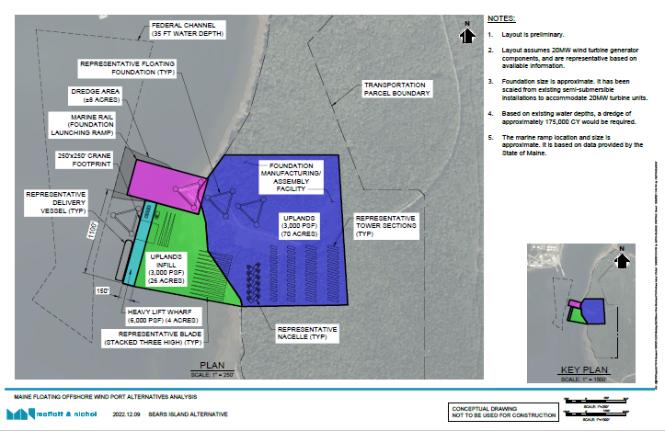

Slide 12
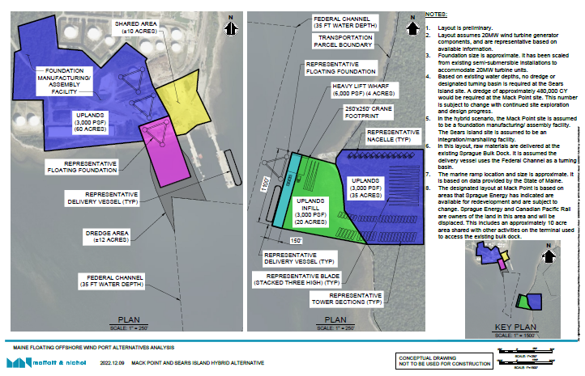

Slide 13
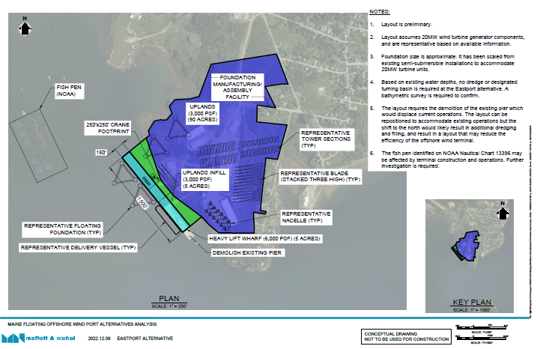

Slide 14
Port Infrastructure Development Program Awards for Offshore Wind Ports
Any news from the Committee?
California OSW Lease Sale – Current Events
Searsport Projects – Nate Moulton, Highland Pellets
Searsport Maintenance Dredging
Industry Updates

Slide 15
